Slide 1
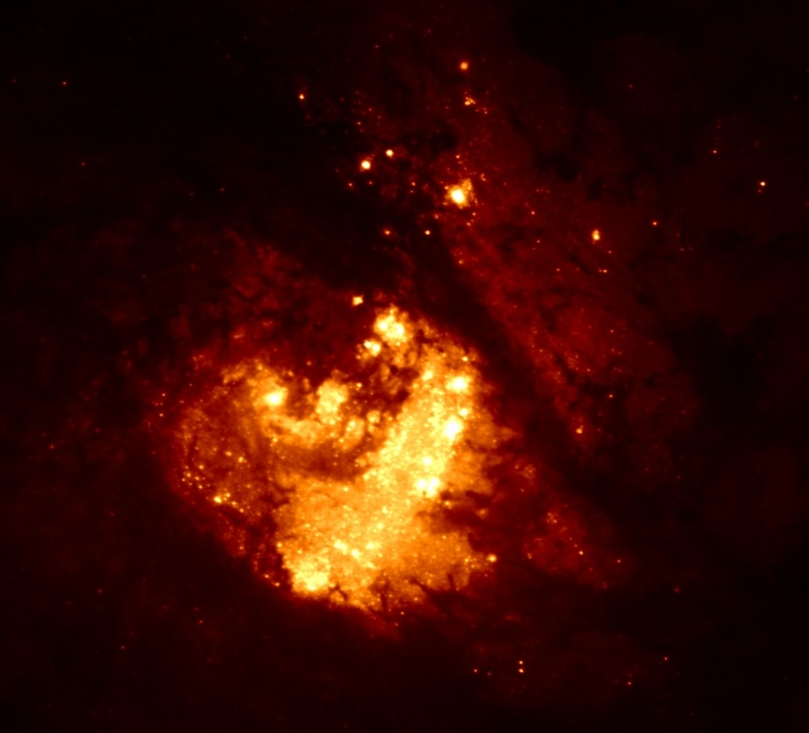


Uncovering the effects of Star Formation in the heart of M83
?
Svea Hernandez
ESA/AURA Astronomer
L. Jones, L. Smith, A. Togi, A. Aloisi, W. P. Blair, M. Melendez, V. Abril-Melgarejo, A. Adamo,
A. Alonso Herrero, T. Diaz-Santos, T. Fischer, S. Garcia-Burillo, A. Hirschauer, L.K. Hunt,
B.L. James, N. Kumari, V. Lebouteiller, K. Long, M. Mingozzi, L. Ramambason, C. Ramos Almeida

Slide 2
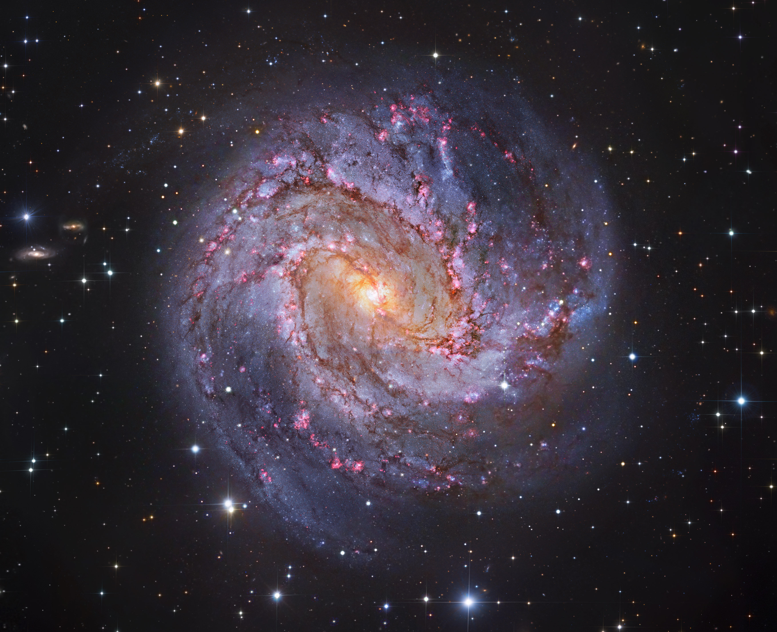
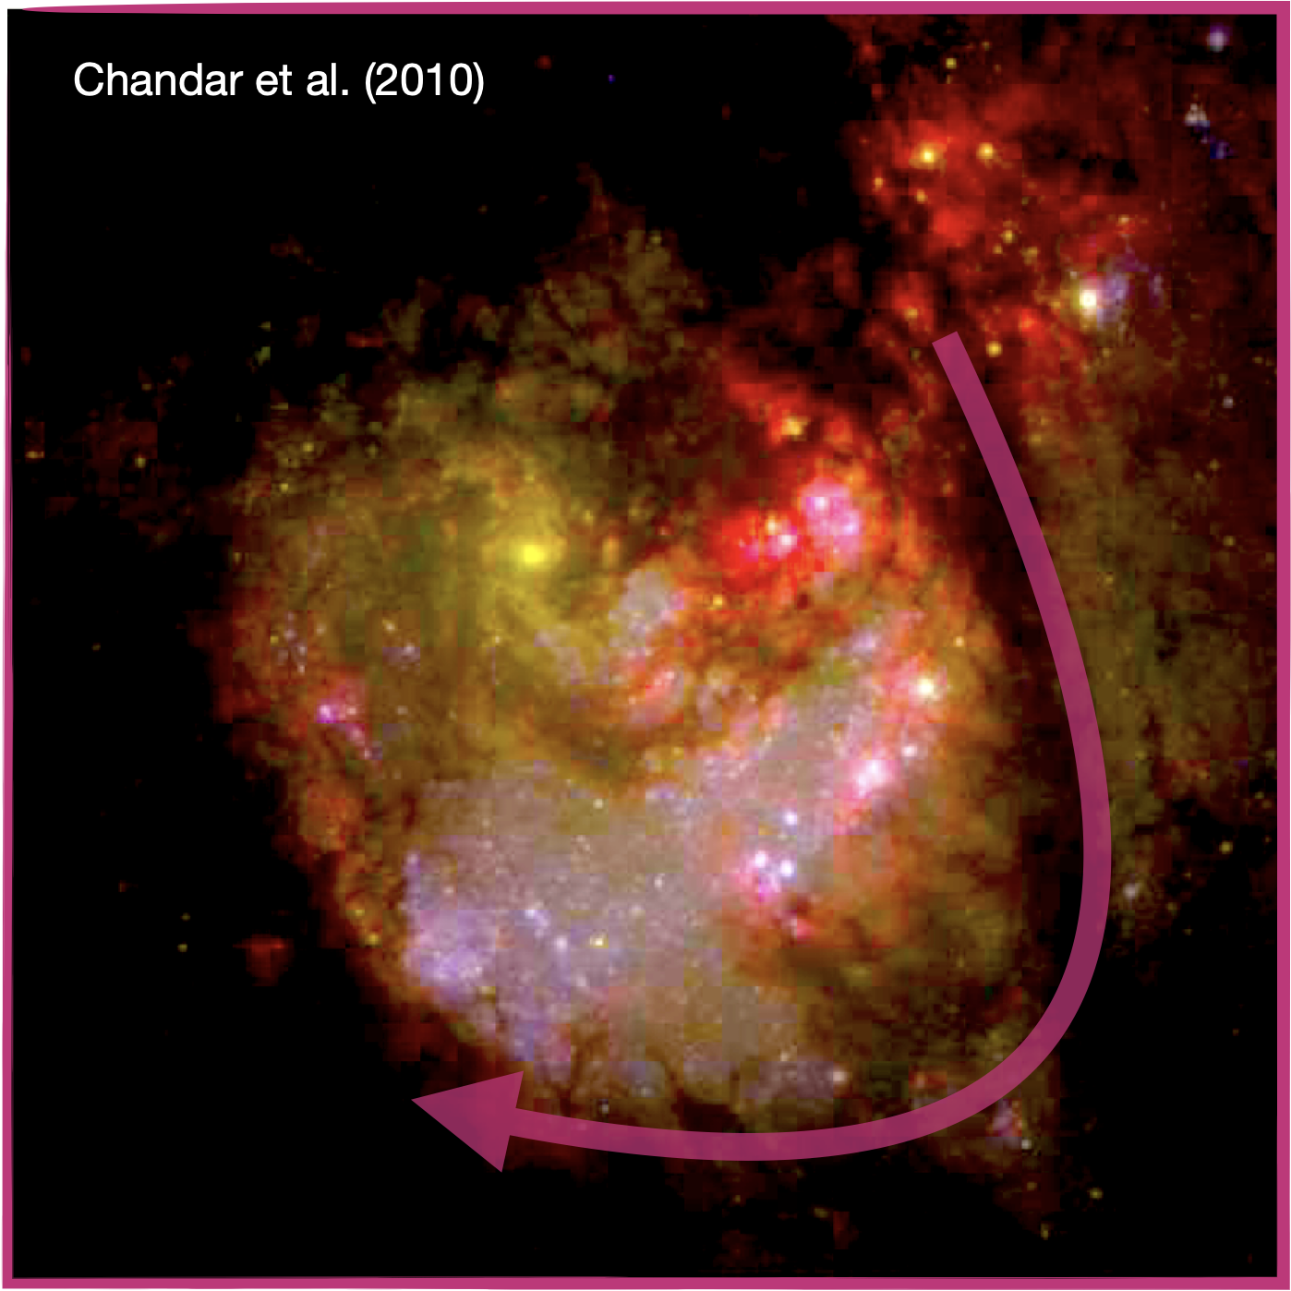




Nuclear Region in
M83: Ideal Laboratory
?
N
Photometric Ages
Harris+01
E

Slide 3
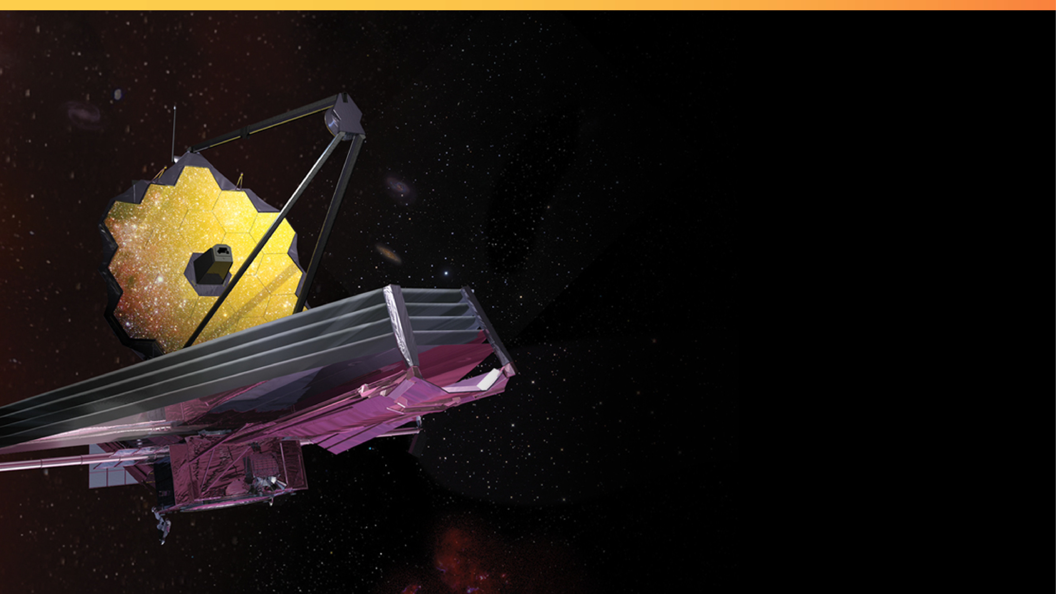
JWST Cycle 1
15 hours with JWST/MIRI
(PID: 2219, PI: Hernandez)

Slide 4
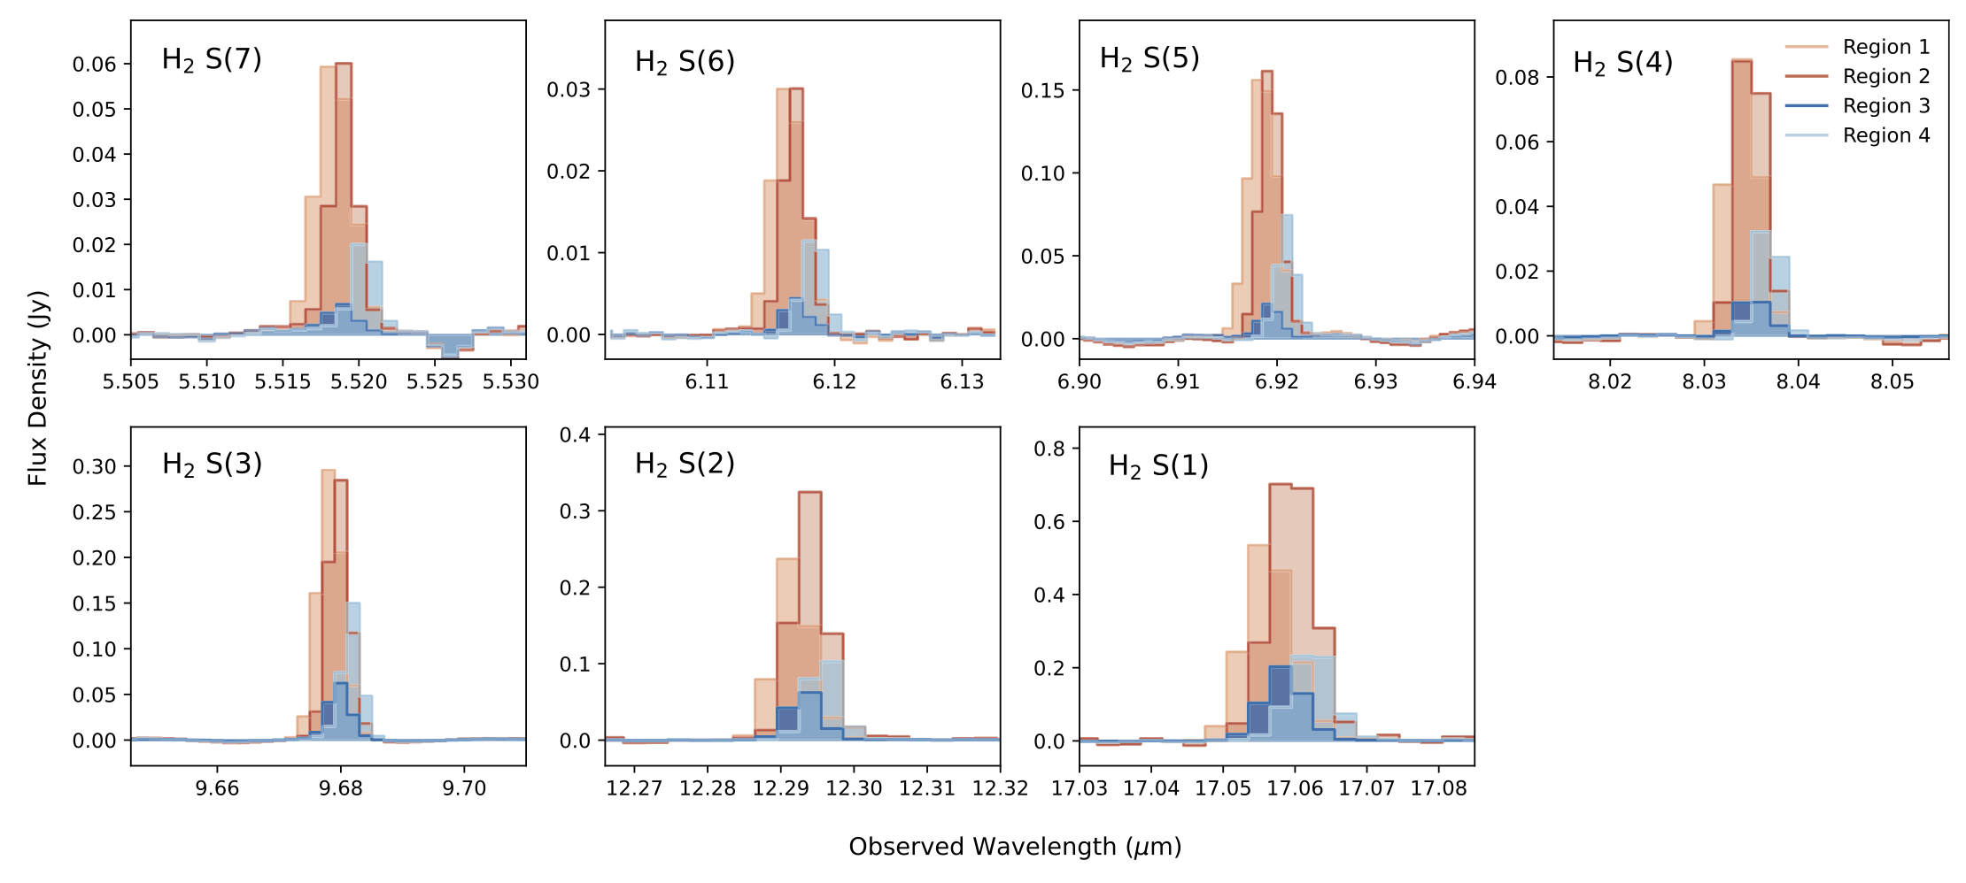


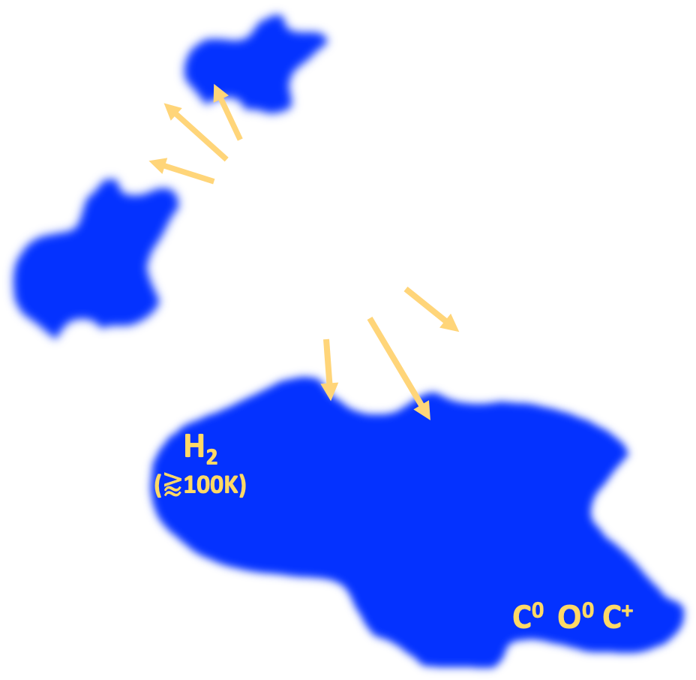
M83: Molecular Gas in Intense Environments
T=7196 K
T=5828K
T=4585K
T=3473K
T=2503 K
T=1681 K
T=1015 K
Hernandez+23
The lowest upper energy levels at H₂ 0-0 S(1)-(2) are well populated at excitation temperatures of ~100-150 K (Togi & Smith 16)
H2
CO
~(10-20K)
Warm H₂
CO-dark gas
(e.g., Wolfire+10, Madden+20)

Slide 5

M83: Molecular Gas in Intense Environments
L. Jones
A. Togi
1-2 Myr
3-5 Myr
L. Smith
18-25 Myr
Jones+25
Jones+25

Slide 6
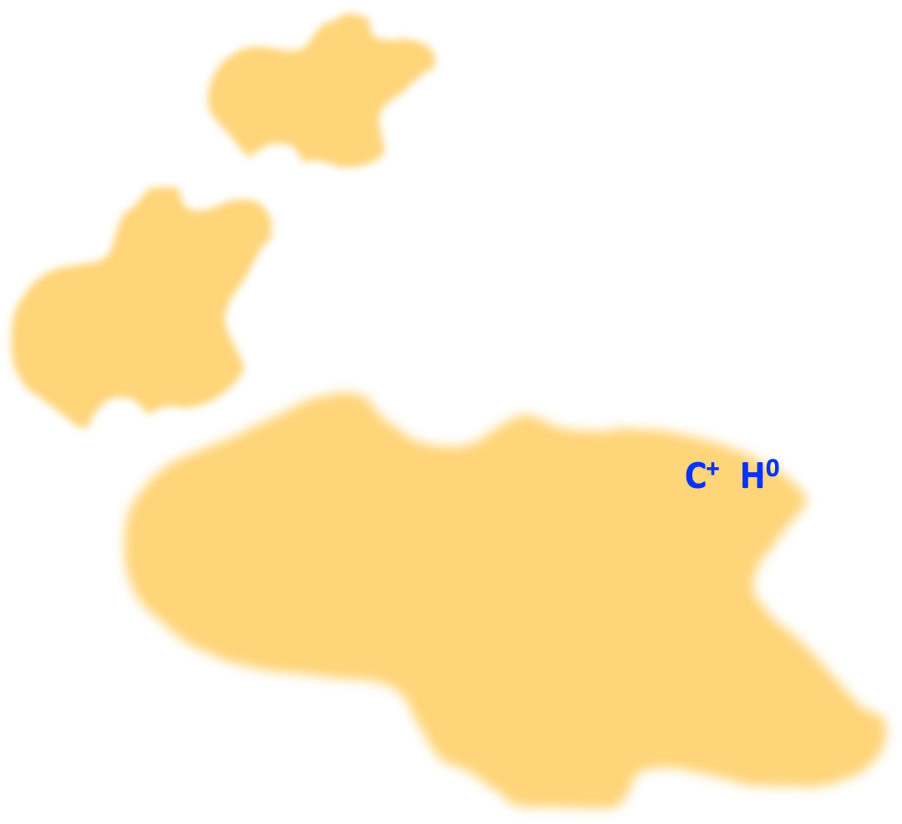
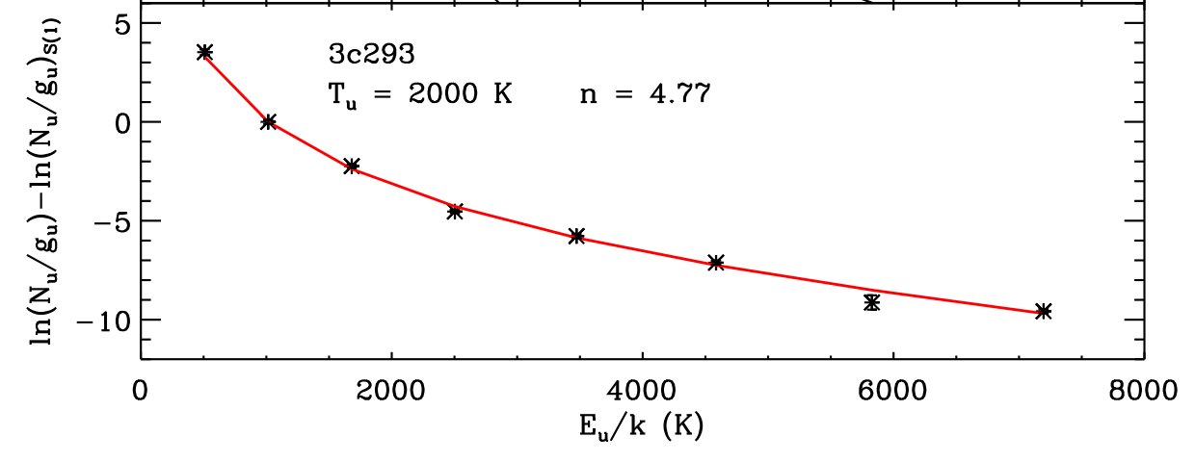
M83: Molecular Gas in Intense Environments
1-2 Myr
Togi & Smith 16
Continuous-temperature model by Togi & Smith 16 to recover H₂ gas masses
3-5 Myr
18-25 Myr
When compared to total H₂(CO) masses, we find CO-dark fractions of <26-46%

Slide 7
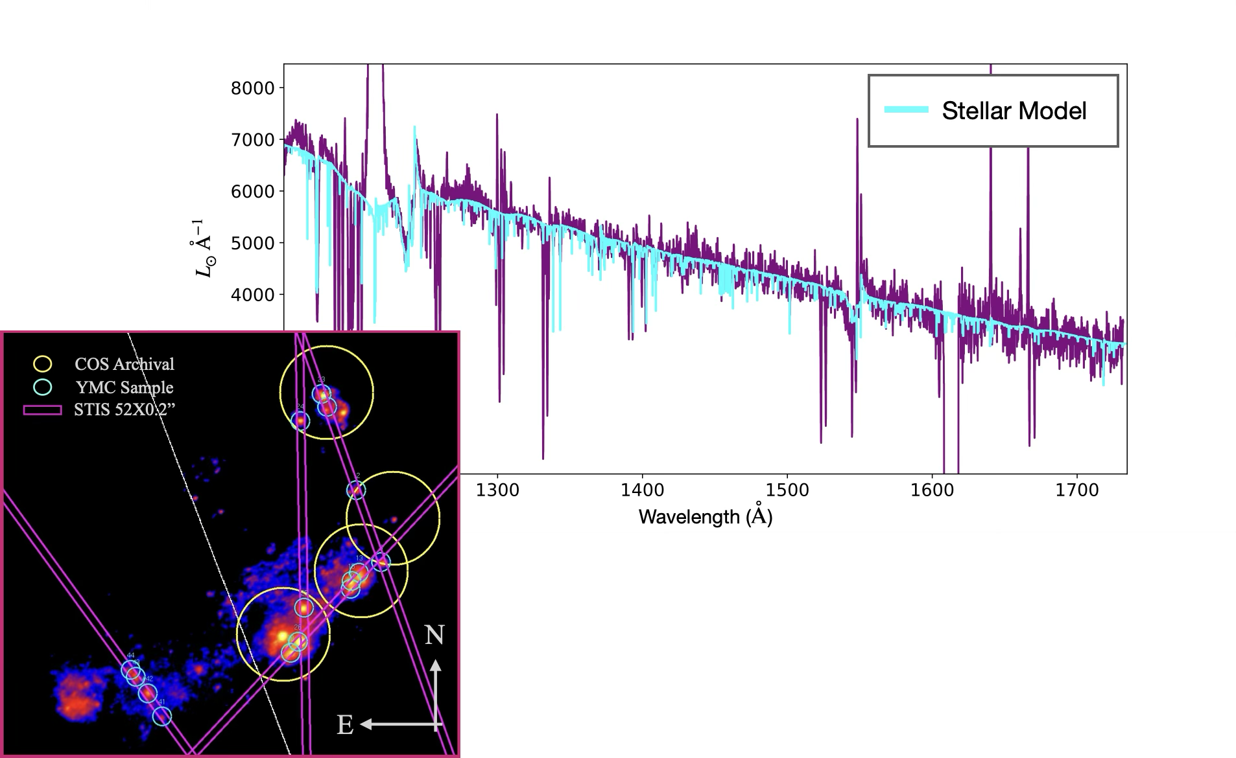
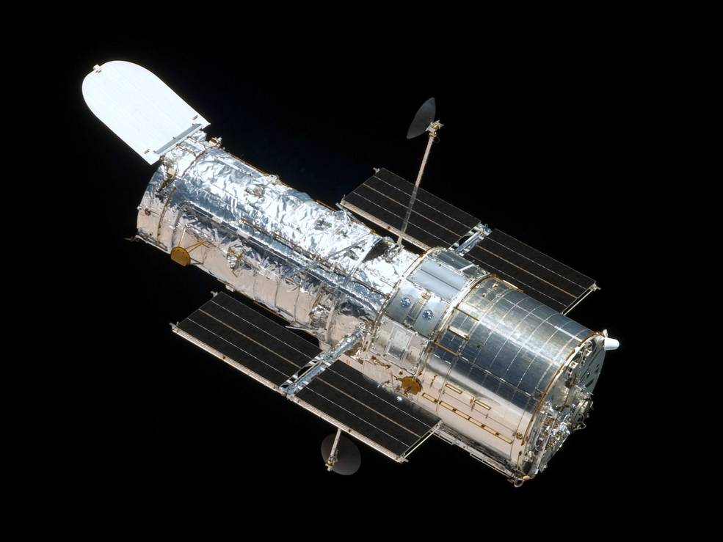
True impact of young massive clusters
Spatially resolving star cluster with HST/STIS in the UV: Correlate the ionizing/mechanical feedback from these massive stellar populations with the observed properties of the ionized and warm molecular gas (PID: 17821)

Slide 8
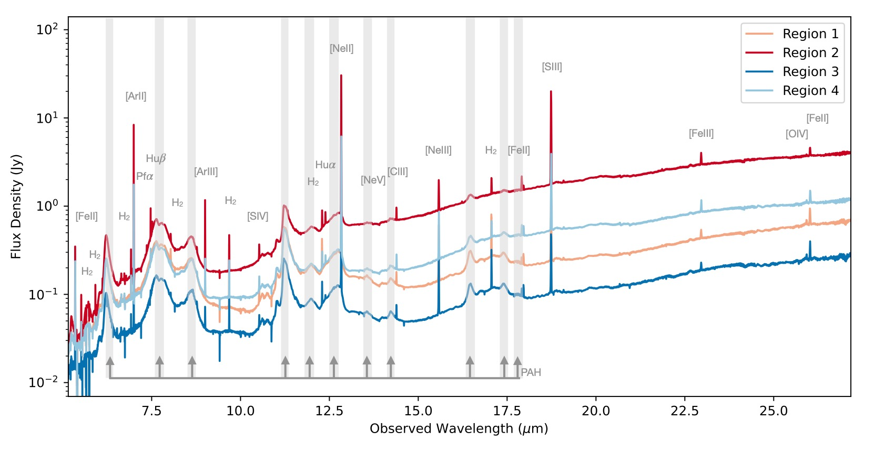
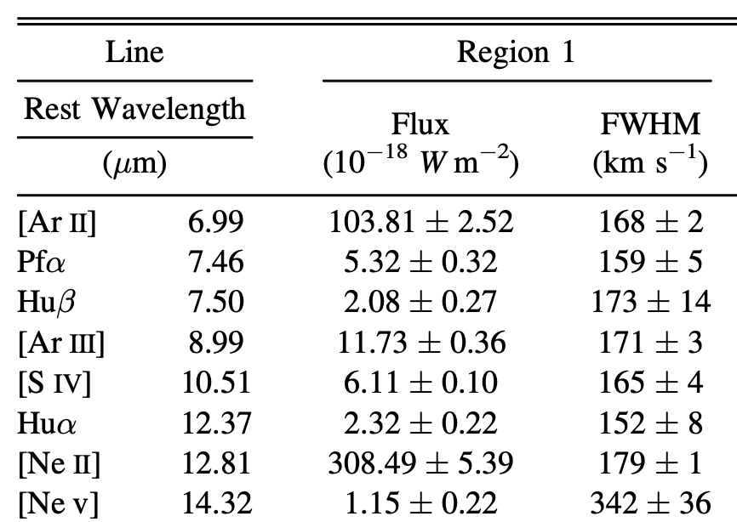
M83: Unexpected high-ionization gas
Hernandez+23

Slide 9
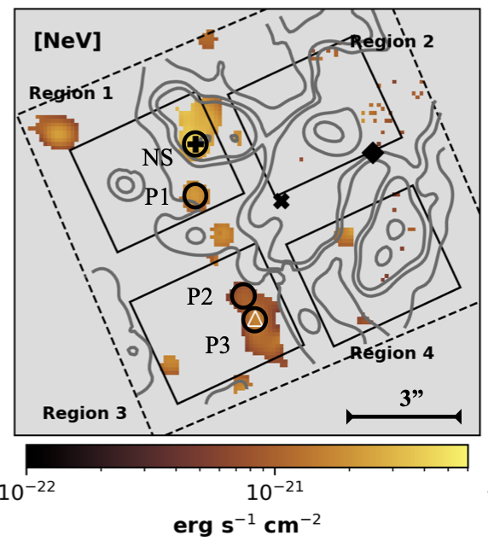
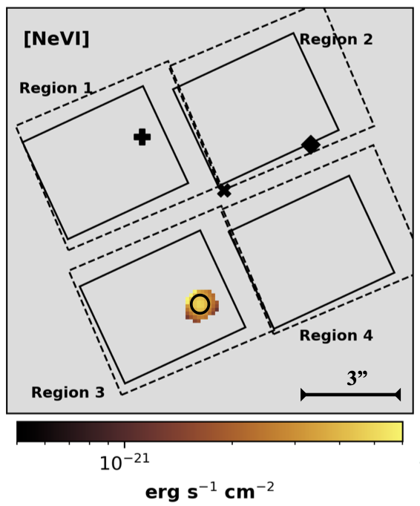
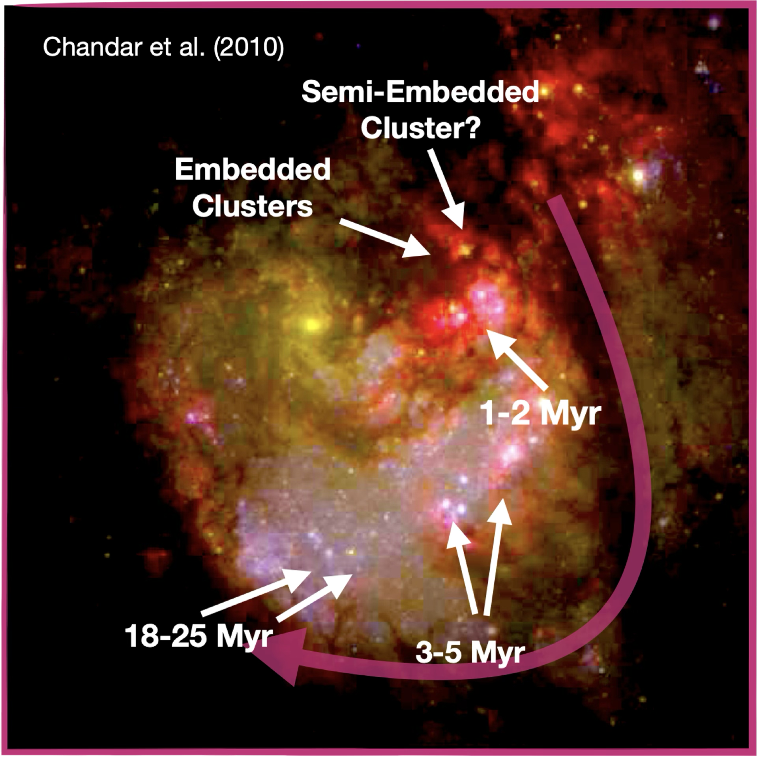
[Ne V] & [Ne VI] emission:
[Ne V]
IP = 97 eV
[Ne VI]
IP = 126 eV
What is the source of this high ionization?
Hernandez+25

Slide 10
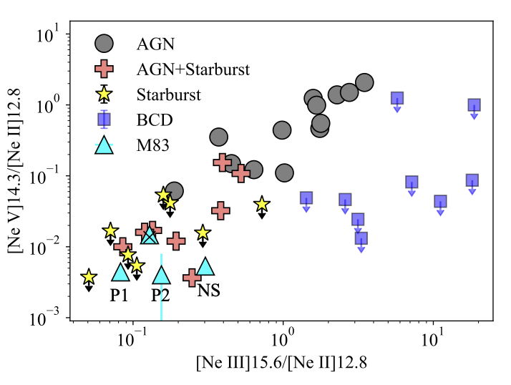

[Ne V] sources:
(Satyapal+08)
JWST is starting to push beyond Spitzer’s limits for BCDs (Mingozzi+25)
Starburst with JWST?
Hernandez+25

Slide 11
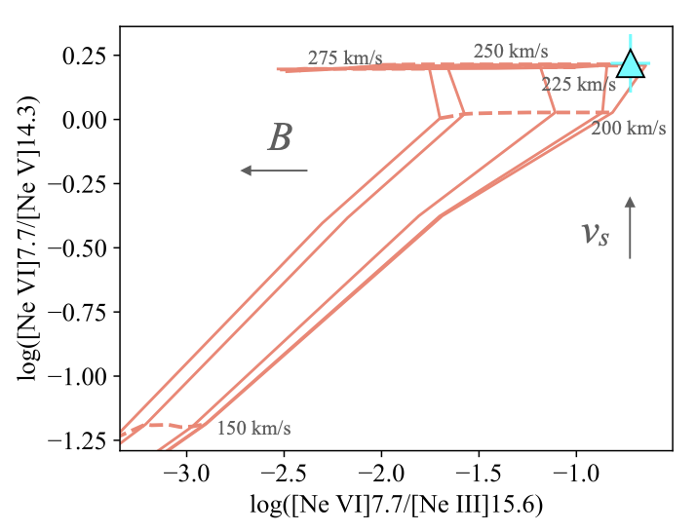
Origin of most extreme ionization – [Ne VI]
Radiative Shocks?
Neon ratios in P3 ([Ne VI] source) agree with radiative shock models with velocities of ~225-250 km/s and a low pre-shock transverse magnetic field of B= 0.001 µG (these require the lowest pre-shock density available, n= 0.01 cm⁻³)

Slide 12
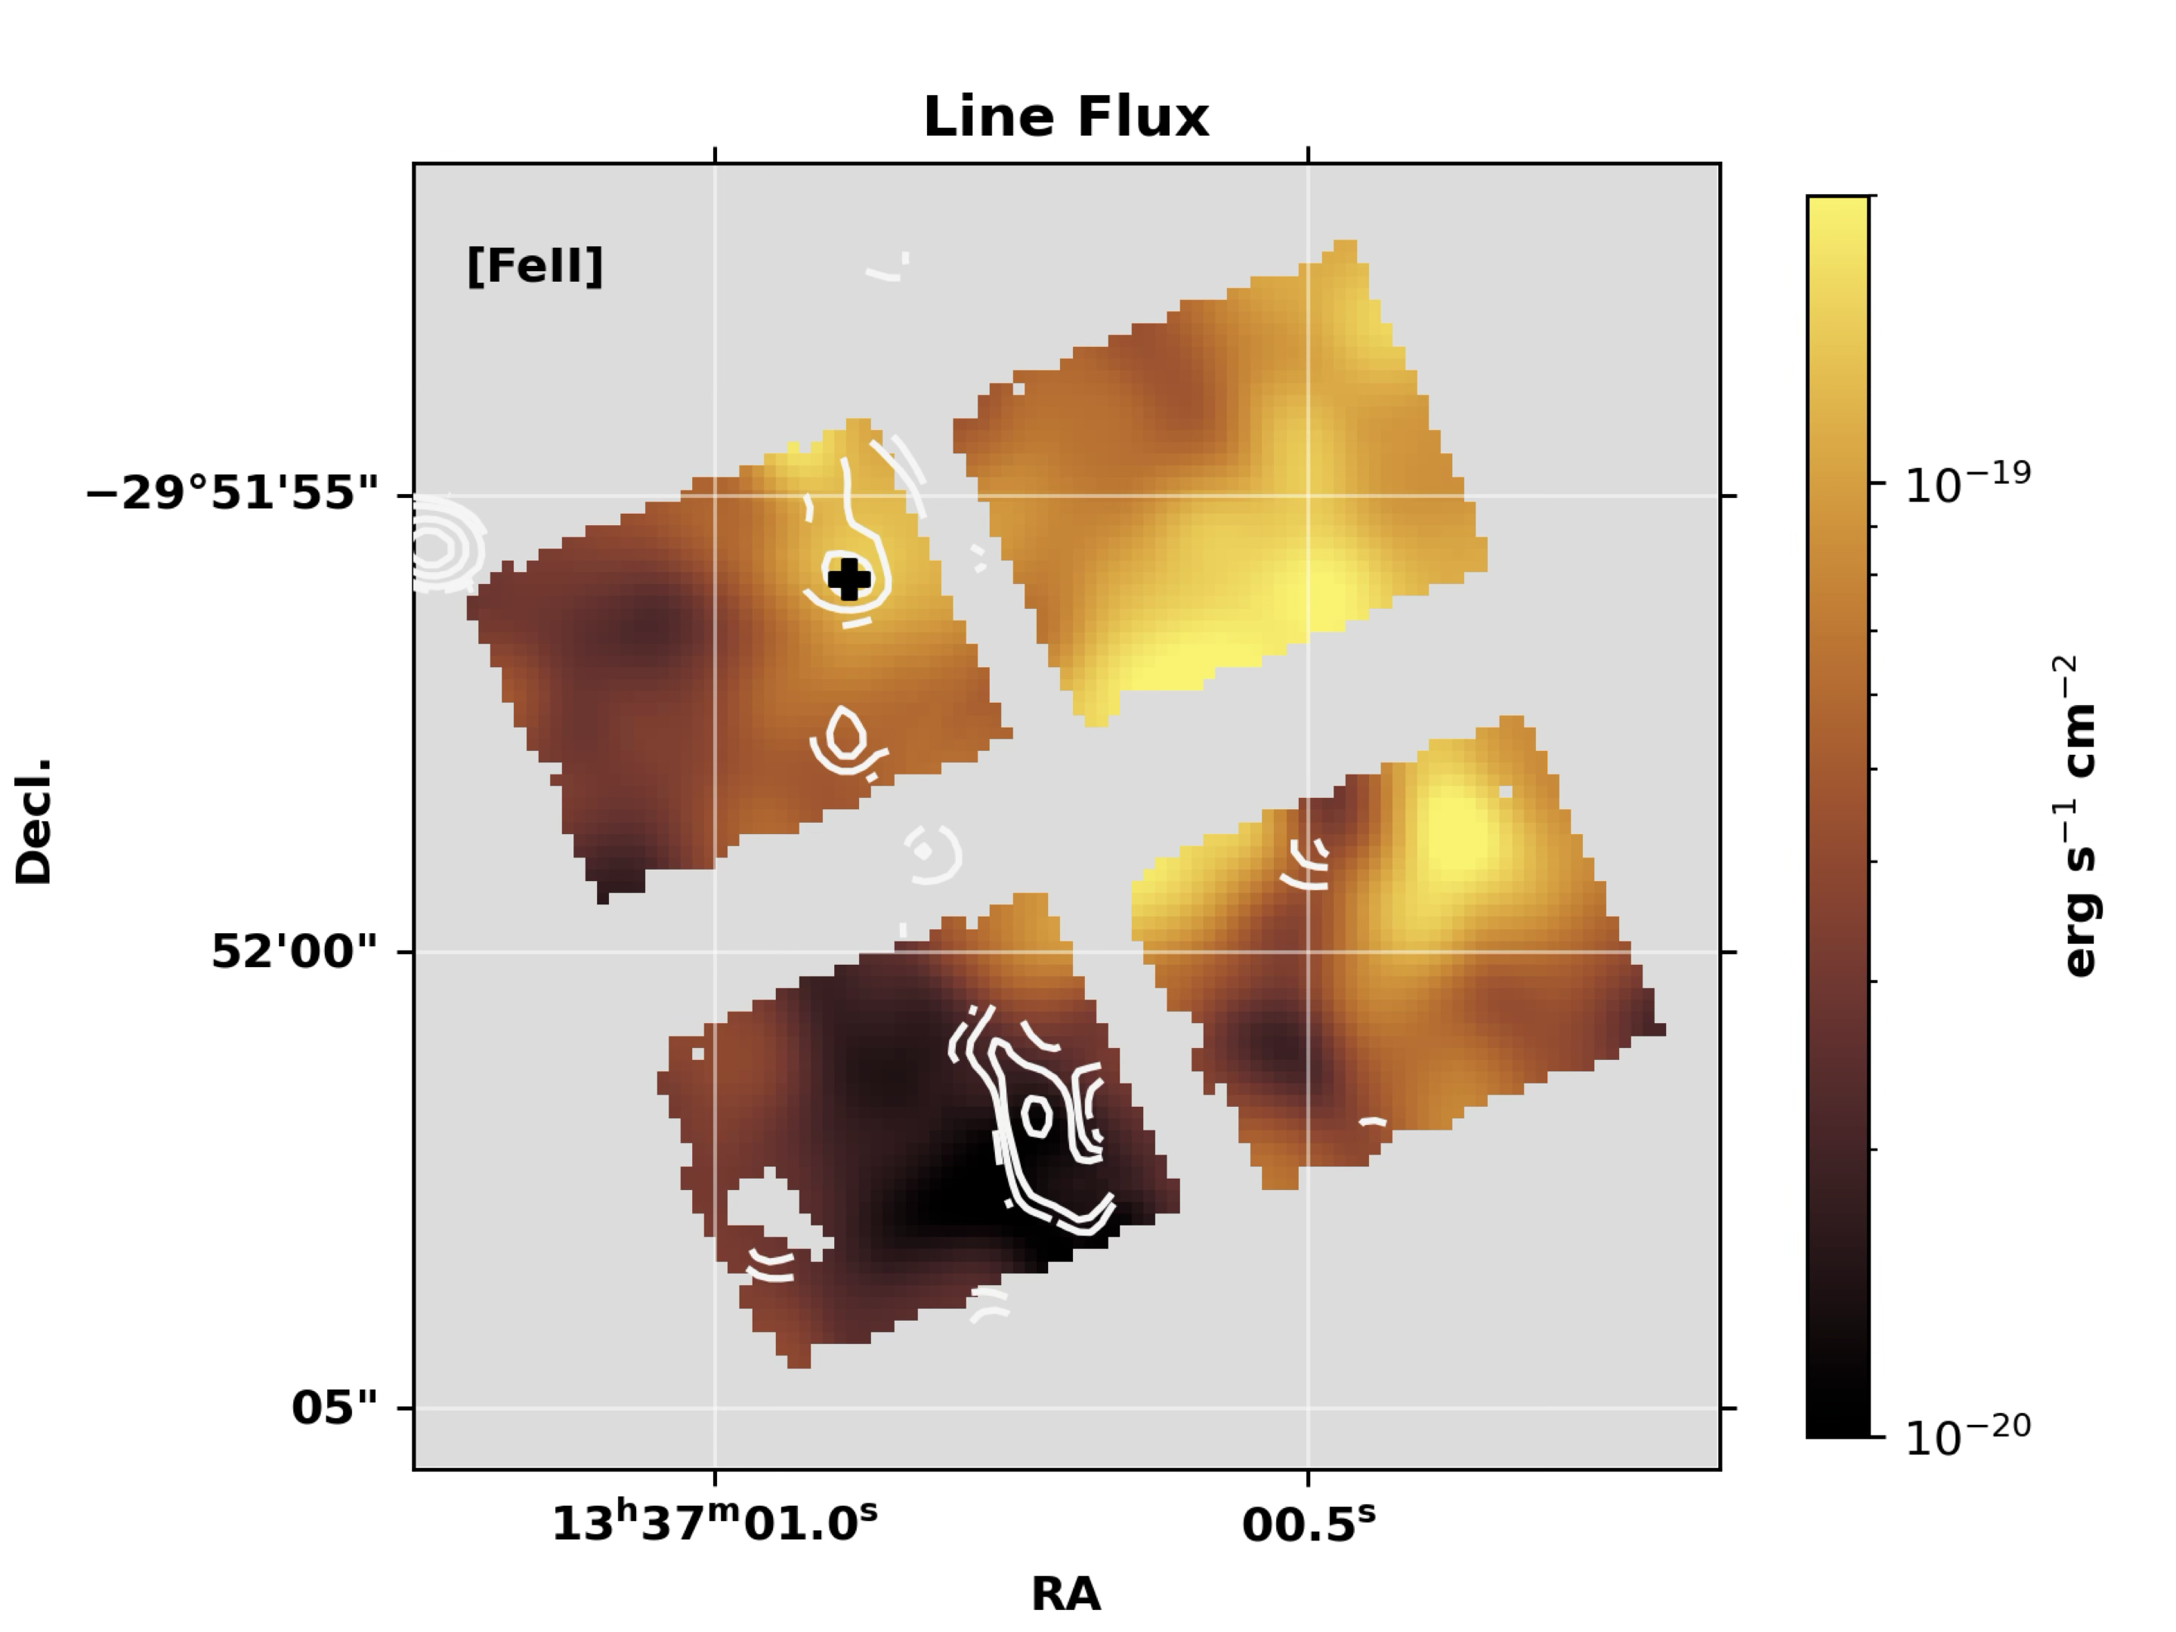
Origin of most extreme ionization – [Ne VI]
Radiative Shocks?
Neon ratios in P3 ([Ne VI] source) agree with radiative shock models with velocities of ~225-250 km/s and a low pre-shock transverse magnetic field of B= 0.001 µG (these require the lowest pre-shock density available, n= 0.01 cm⁻³)

Slide 13
Origin of most extreme ionization – [Ne VI]
AGN?
Ionization ratios along with AGN modeling align well with the previously proposed scenario of an SMBH accreting at a very low level (Soria & Wu 03; Long+14; Yukita+16)

Slide 14
AGN or Starburst?
[Ne VI]
IP = 126 eV
With the unparalleled infrared sensitivity and spatial resolution of JWST, we are uncovering unexpected regimes (?):
How common is this high ionization emission in purely starburst systems?
Are we missing hidden AGN in these active environments?
Notes:
Mentioned future programs approved, and what they are doing?

