Slide 1
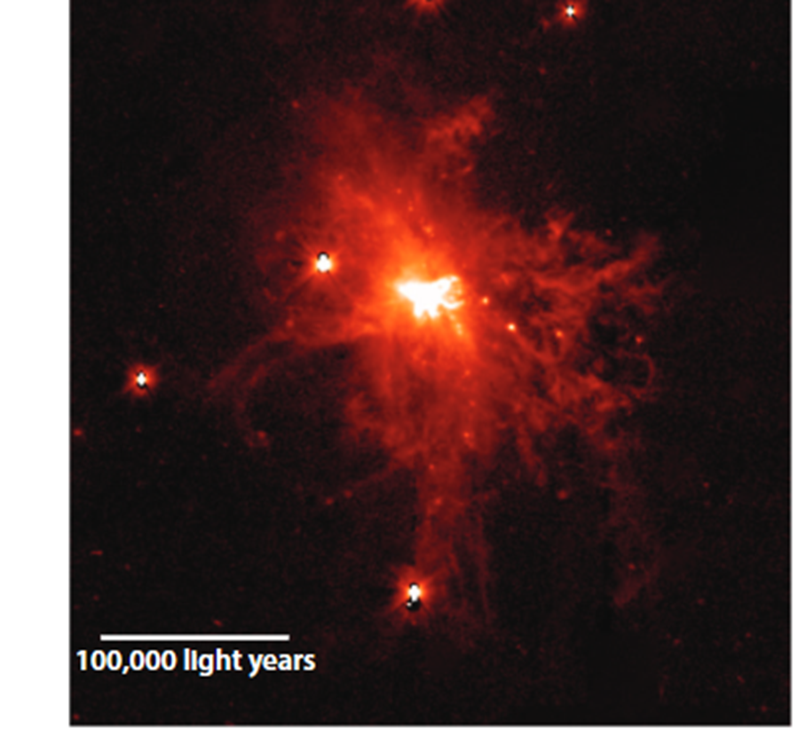
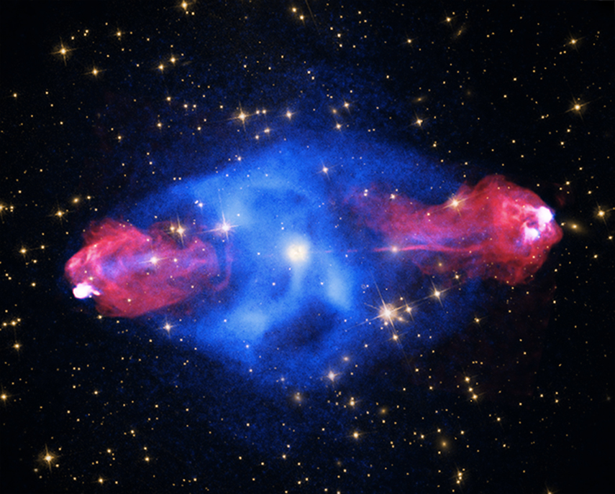
Feedback from Stars and Black Holes: How do they work? What are they good for?

Slide 2
Outline: At the top rung of John’s feedback ladder
1) Why do we need global scale feedback?
2) How does feedback from stars work on global scales?
3) How does feedback from supermassive black holes work?
3) A cosmic inventory of global-scale feedback
5) What is global-scale stellar feedback good for?
6) What is supermassive black-hole feedback good for?
7) Summary

Slide 3
1) Why do we need global-scale feedback?
There are many scaling relations between the global properties of galaxies, and also between those of clusters of galaxies
These cannot be explained purely through the gravitational processes that assembled the dark matter halos in which the galaxies and clusters live
The feedback of mass/metals/momentum/energy supplied by massive stars and supermassive black holes is crucial
Here are some examples of relations that require feedback to understand them

Slide 4
What sets the ratio of galaxy stellar to halo mass?
Ratio of stellar to dark-matter halo mass shows a strong mass-dependence
Black/Cyan line excludes/includes satellite galaxies (Mitchel & Schaye 2022)
Feedback needed to explain the drop in mass ratio at low halo mass

Slide 5
What determines the chemical composition of galaxies?
There is a tight relation between galaxy mass and the abundance of heavy elements in galaxies, which evolves significantly with time. Why? Urbaneja et al. 2023

Slide 6
Why are most heavy elements far outside galaxies?
UV and X-ray observations show that a significant fraction of all the heavy elements ever forged in stars have been ejected out into the galaxy halo and beyond
Left: CGM - Werk et al. (2013) Right: ICM out to 600 kpc – Mernier et al. (2015)

Slide 7
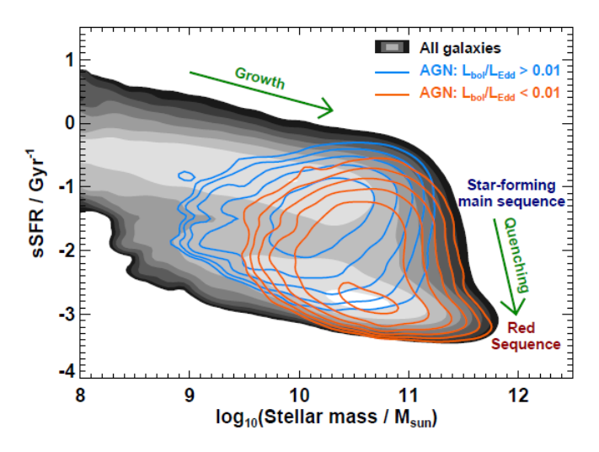
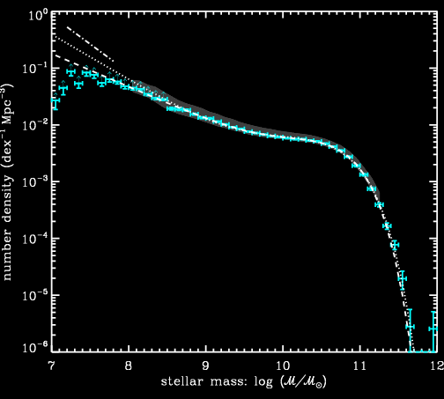
What quenches star formation in massive galaxies and sets a maximum stellar mass?
Star formation (fueled by cold gas) occurs mainly in lower mass galaxies today
Some quenching process shuts down star formation above a maximum mass

Slide 8
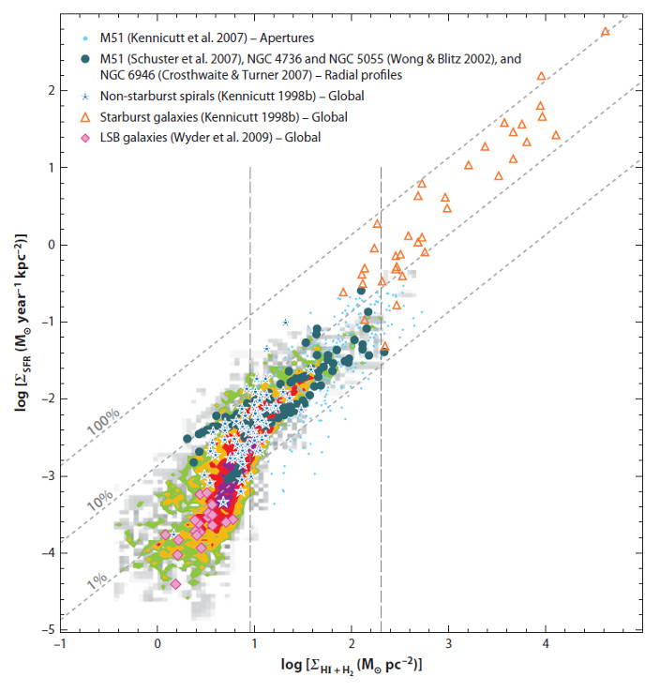
How is star-formation regulated?
How is the tight “star-forming main sequence” regulated? RMS scatter ±0.1 dex (Popesso+23)
How does relationship between gas mass and SFR per unit area arise? Kennicutt & Evans (2012)

Slide 9
How is the empirical relation between black hole mass and galaxy velocity dispersion (σ) established?

Slide 10
How are the scaling relations for hot gas in galaxy groups and clusters set? Donahue & Voit 2022
The L_{x} vs T_{x} relation
The mass-dependence of baryon fraction

Slide 11
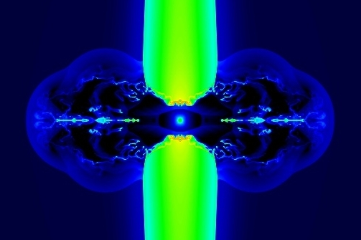
2) How does global-scale stellar feedback work?

Slide 12
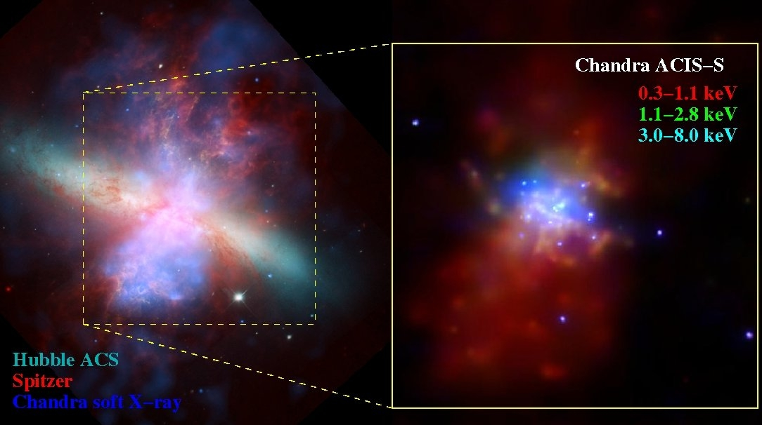
The “Power Source”
● SNe & stellar winds create a central region of very hot (10⁸ K) gas
●The T and L of this gas implies radiative losses there are small: SNe & winds expand into a cavity created by their predecessors
● Hot gas blows out of the disk to form a bi-polar wind (wind speed up to 3000 km/sec)
This hot wind shock-heats, ionizes, and accelerates gas clouds to v ≈ 10² to 10³ km/s in the halo (feedback)

Slide 13
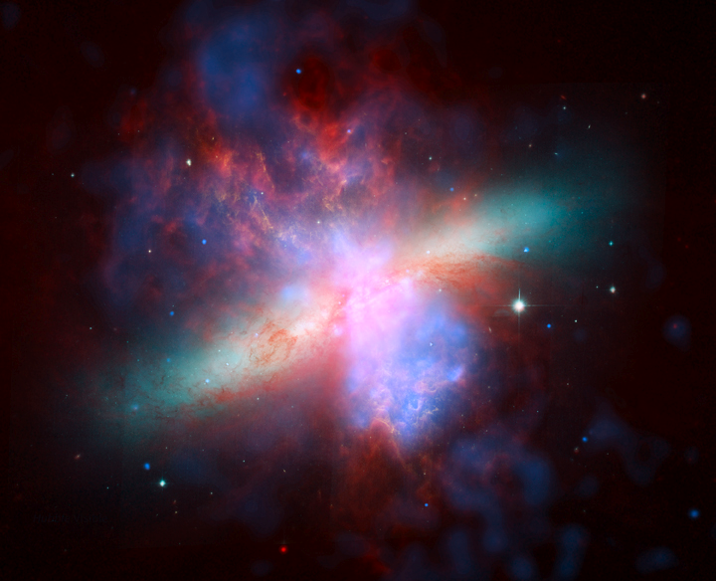
The Outflow is Complex & Multiphase
Hard X-rays from the wind fluid: 10⁸ K
Soft X-rays from hot gas: 10^{6.5 -7} K
UV and optical emission and absorption-lines, warm gas: 10^{4-5.5} K
PAHs/PDR
HI – cool neutral phase
CO and H₂
Far-infrared dust emission
Radio synchrotron emission from relativistic particles and magnetic field

Slide 14
These global-scale winds rare today (starbursts only) but ubiquitous at cosmic noon
Traced by Doppler-shifted Lyα emission-line and absorption-lines from outflowing gas
Typical star-forming galaxies then were like starbursts today (very high SFR/A and SFR/M)
Cf. talk today by Bron Reichardt Chu on DUVET results

Slide 15

3) How does global-scale feedback from black holes work?

Slide 16
The interaction of jets and their environment
Kinetic energy is transported from the supermassive black hole by jets
The jets terminate in strong shocks (bright “hot spots” of radio synchrotron emission).
This shocked jet fluid has a very high pressure and it expands laterally and then “backflows” creating an expanding cocoon
This cocoon creates an expanding cavity in the gas surrounding the galaxy (Begelman & Cioffi 1989)
This delivers energy to this gas (Roy +24; Perucho+22)

Slide 17
4) A Cosmic Inventory of Energy Feedback
FROM STARS
Core collapse supernovae and winds from hot massive stars are the dominant source of kinetic energy input
The supply rate is given by:
dE/dt = 4.3×10⁴¹ SFR erg/s
The cosmic evolution in SFR(z) then yields evolution of dE/dt
Some fraction ͼ* not lost to radiation: likely grows with z as global winds seen in typical galaxies
Madau & Dickinson (2014)

Slide 18
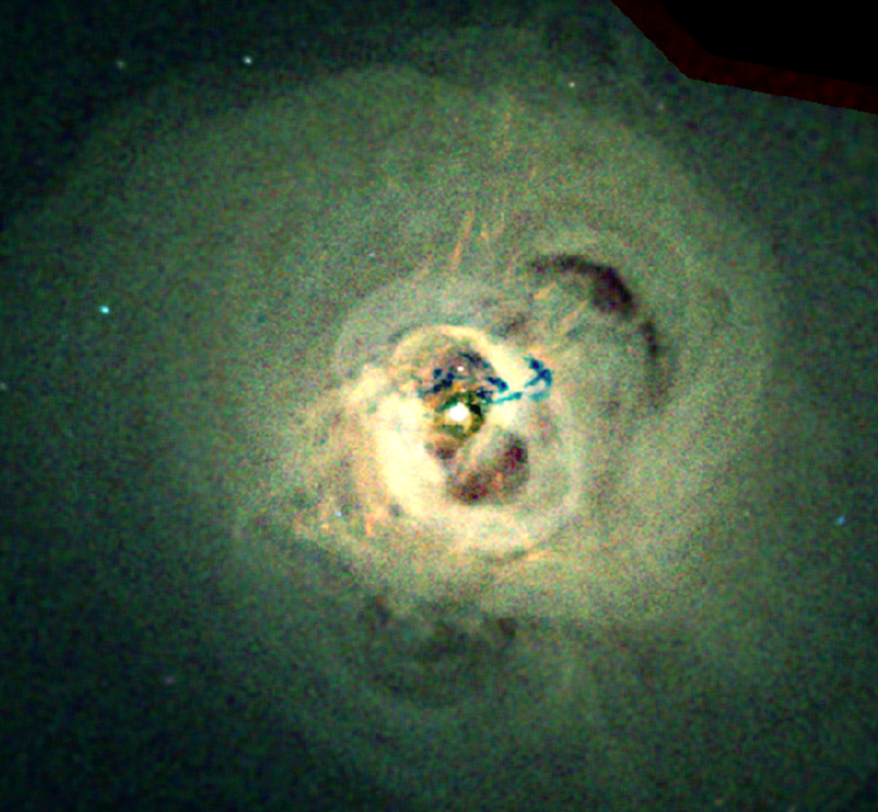
A Cosmic Inventory of SMBH/Jet Feedback Method #1
Jets excavate cavities in the hot rapidly-cooling halo gas in massive galaxies (B. McNamara and colleagues)
Can calculate the rate at which the jets carry the energy that inflates these cavities:
P_{jet} = 4 PV/t_{exp} where t_{exp} assumes these “hollow” cavities in the hot gas expand due to buoyancy

Slide 19
Method #2
Use combination of radio synchrotron and X-ray inverse Compton emission to measure total energy in relativistic electrons and magnetic field (e.g Hardcastle & Croston 2005)
Derive a source lifetime by using X-ray data to measure shock velocity at the jet/ICM impact
t = size/v_{s}
E/t = jet kinetic luminosity
Ineson et al. 2017

Slide 20
Quantifying Energy Injection by AGN Jets
Can calculate the rate of kinetic energy carried by jets
It is about two orders-of-magnitude larger than the radio synchrotron luminosity
Empirical fit to relationship (Croston+2018)
We can now convert radio luminosity into kinetic energy flux
Can do this as a function of redshift using observed radio luminosity functions

Slide 21
The Bottom Line: Stars vs. Black Holes
Massive stars and BH jets have delivered similar amounts of kinetic energy over cosmic time
The energy input from jets occurred at a later time
Jets peak at z ≈ 1
Massive stars peak at z ≈ 2 (AKA “cosmic noon”)
Heckman & Best (2023)

Slide 22
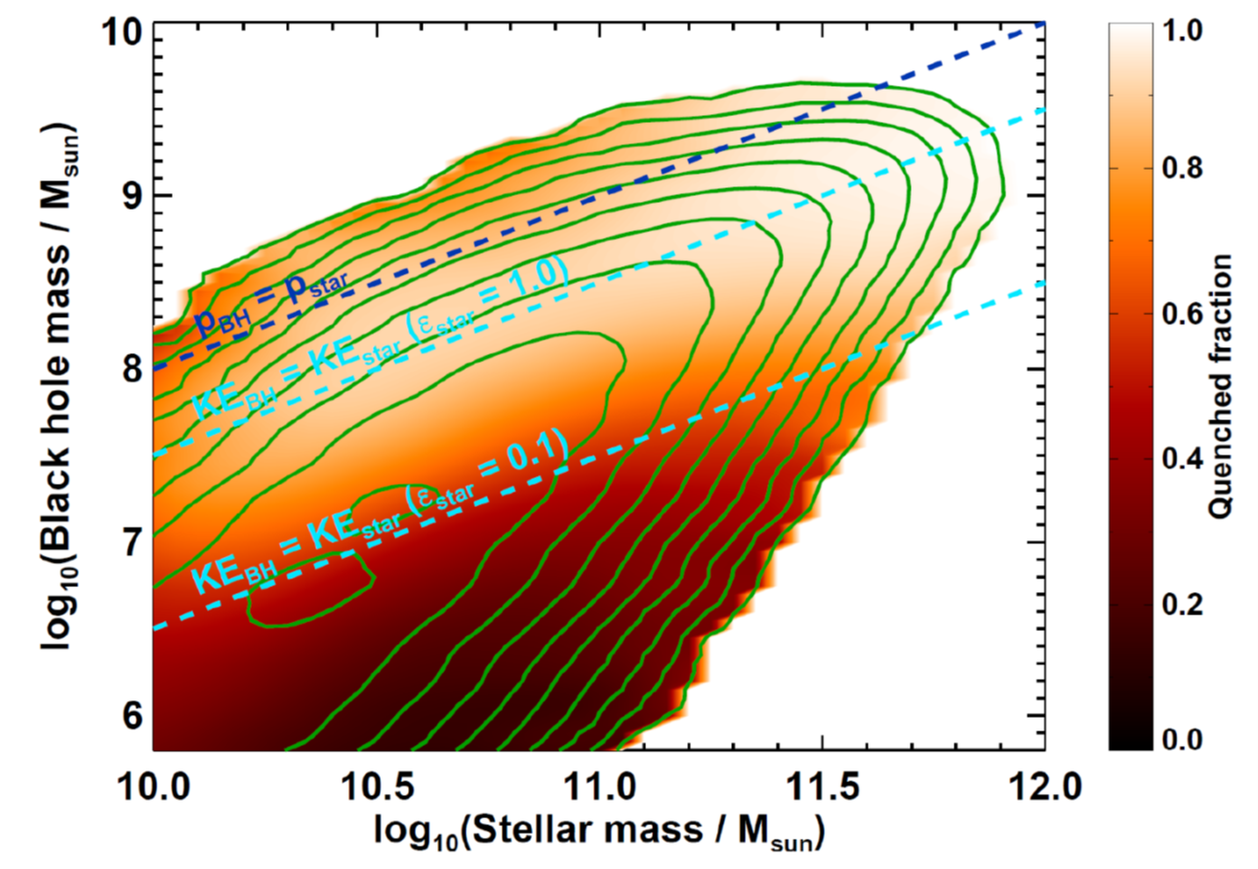
Stellar vs. BH Feedback as a function of Mass
The ratio of black hole/galaxy mass is much larger in the more massive galaxies
Black holes play a more dominant role than stars for feedback in more massive galaxies and vice versa
Heckman & Best 2023

Slide 23
Numerology of the mass-dependent energetics
For stellar feedback, can calculate the total amount of KE released per unit mass in stars formed over cosmic time
Get E*/M* = 7 x 10¹⁵ ͼ* erg/gm
Define E_{bind} = ½ M_{baryon} v_{esc}² and use Tully-Fisher relation to relate M_{baryon} to v_{esc}
Result: E*/E_{bind} ≈ 9 ͼ*^{-1/2} (M_{baryon}/10¹¹ M_{Ꙩ})^{-1/2}
Stellar feedback has a stronger effect at lower masses
For BH feedback, empirically we find that the amount of jet energy per unit stellar mass depends strongly on stellar mass
E_{jet}/M* = 1 x 10¹⁶ (M*/10¹¹ M_{Ꙩ})^{3/2} erg/gm
Here E_{jet}/E_{bind} ≈ 6 (M_{baryon}/10¹¹ M_{Ꙩ})
Jet feedback has a stronger effect at higher masses

Slide 24
5) What is global-scale stellar feedback good for?
1) Shaping the low-mass end of the stellar mass function:
Fraction of available baryons converted into stars drops steeply as halo mass declines (below M_{halo} ≈ 10¹² M_{Ꙩ}
Lower mass halos with lower escape velocities have lost more baryons
Silk & Mamon 2012

Slide 25
Consistent with observed properties of wind-blown gas
The outflow velocities are ≈ 3 (1) times the escape velocity for lowest (highest) mass galaxies
The ratio of the mass-outflow rate to SFR decreases steeply with mass (from 30 to 0.3)
These outflows have a much more significant impact on low-mass galaxies (Xinfeng Xu, TH+22)

Slide 26
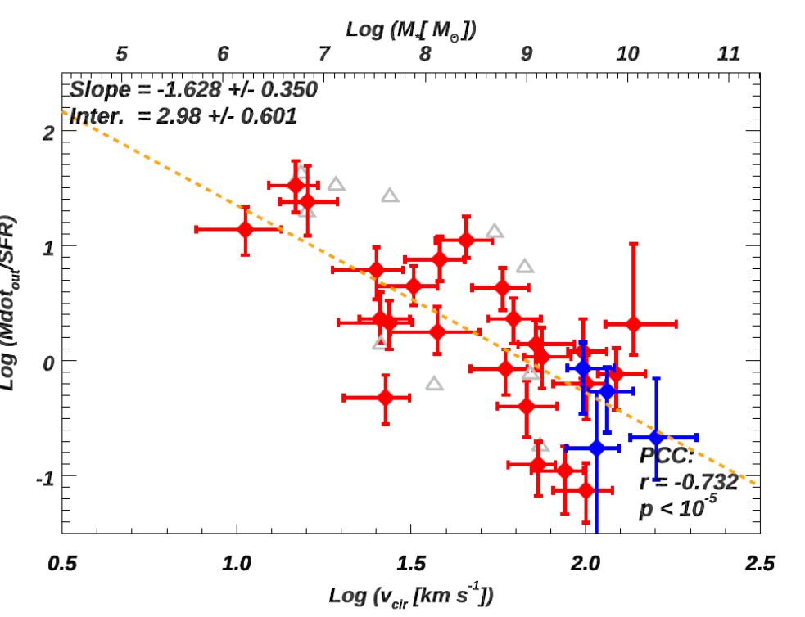
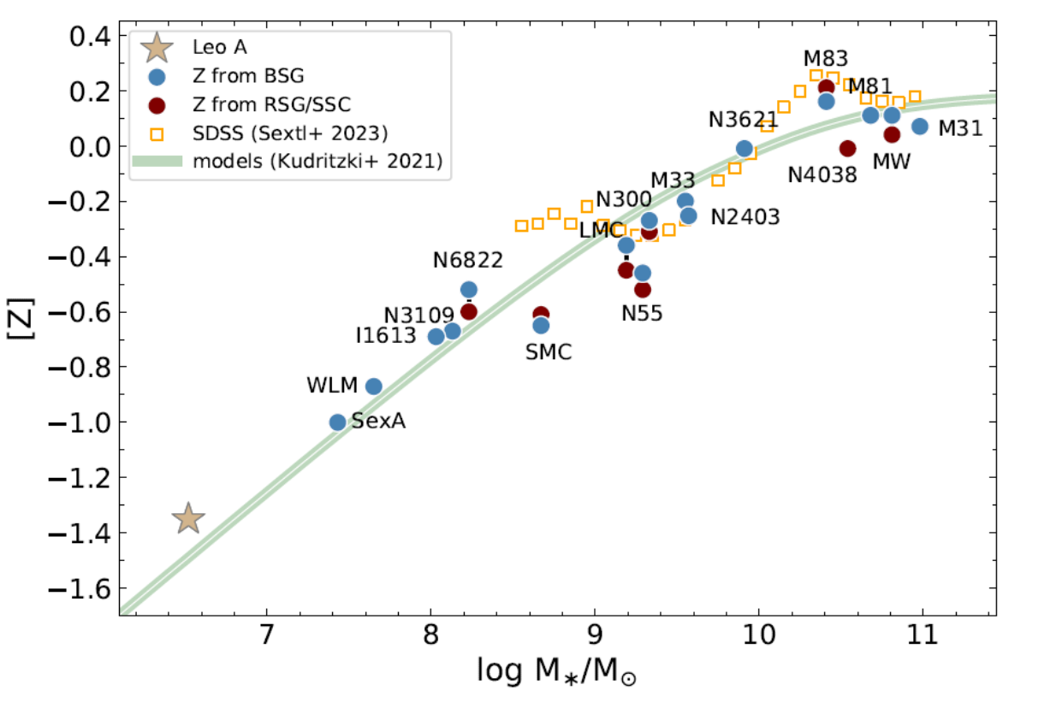
Forming the mass-metallicity relation & polluting the IGM
Mass-loss/SFR is ≈ 30 at M = 10^{6.5} M_{Ꙩ} dropping to ≈0.1 at M = 10^{10.5} M_{Ꙩ}
Consistent with steep M-Z relation at low mass (strong mass-dependent metal loss) and flattening at high mass (nearly full metal retention)

Slide 27
The self-regulation of star-formation
Gas pressure in ISM vs. the star-formation rate per unit area: Ellison+2024
Good fit to Krumhloz et al. 2018 model where the ISM pressure set by stellar feedback
A true feedback loop:
If SFR goes up, the disk gas expands vertically, the density drops and SFR drops back down
If SFR drops, the disk gas sinks, densities increase and SFR goes back up
(Stellar feedback may also explain the K-S relation - Steffi Walch talk)

Slide 28
6) What is Black Hole Feedback Good For?
Quenching star-formation in more massive galaxies, thereby setting a maximum stellar mass

Slide 29

Quenched (SF) galaxies have high (low) ratios of black hole to stellar mass

Slide 30
The co-evolution in the total stellar mass in quenched galaxies and that of the energy delivered by jets
There is a near-perfect synchronization between the cumulative growth in the total stellar mass in quenched galaxies (red and orange points) and the total amount of kinetic energy carried by AGN jets (blue and cyan)
The kinetic energy in jets disrupts the gas in around the galaxy and quenches star-formation
Heckman et al (2024)

Slide 31
The properties of hot gas in galaxy groups and clusters: Donahue & Voit 2022
The L_{x} vs T_{x} relation
The mass-dependence of baryon fraction

Slide 32
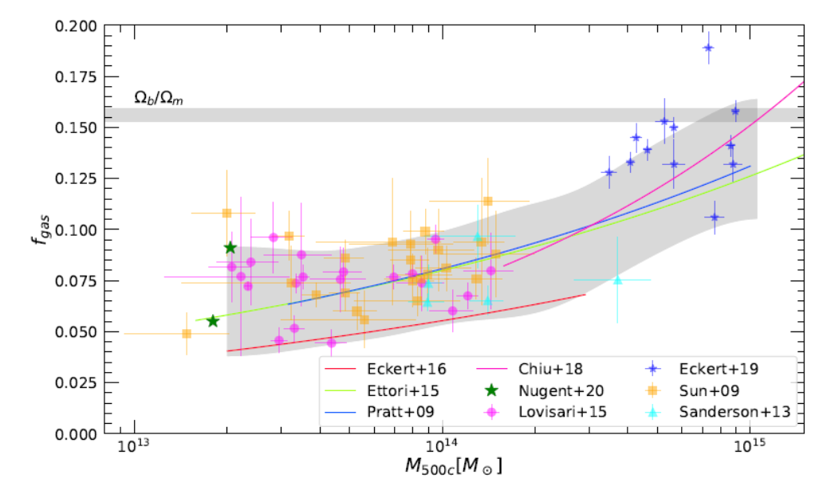
Let’s quantify this
Consider cluster with M_{halo} =10¹⁴ M_{ꙩ}
It has lost about 50% of its gas (a mass of 7.5 x 10¹² M_{ꙩ})
Given v_{Vir} ≈ 600 km/s, removing this gas would take about 3 x 10⁶¹ ergs
The total mass of quenched galaxies in this cluster is ≈ 1.6 x 10¹² M_{ꙩ} = 3.2 x 10⁴⁵ gm
The accumulated jet energy for this mass is 3.5 x 10⁶¹ ergs
Q.E.D!

Slide 33
Establishing the relation between black hole mass and galaxy velocity dispersion. But how?

Slide 34
7) Summary
Feedback is required to understand essentially all the scaling relations and global properties of baryons in galaxies and galaxy clusters
The two dominant forms of this feedback appear to be due to the kinetic energy released by populations of massive stars (supernovae and stellar winds) and by jets launched by supermassive black holes
While their global energy contents are similar, the BH-driven jet feedback occurs at later times than that from massive stars (z ≈ 1 vs. z ≈ 2, respectively)
BH-driven feedback is more important in high mass systems (galaxies and clusters) and stellar feedback is more important in low-mass galaxies
They have different origins and different effects, but together can help to explain the properties of baryons in galaxies and galaxy clusters

Slide 35
Bonus question for this audience – What causes the small-scale arcs/filaments in the ionized gas in the M 82 wind?
Thompson & Heckman ARA&A 2023
Communities working on outflows/feedback at all scales need to talk more often!

