Slide 1

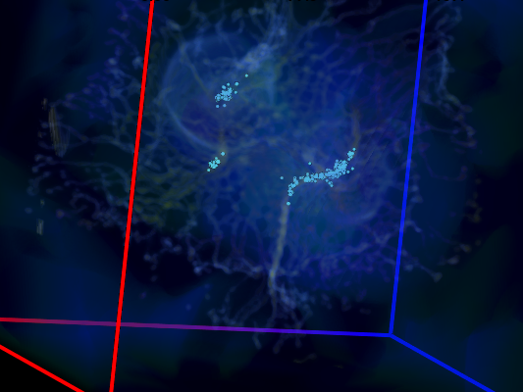

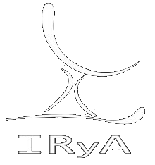
SN and HII-region feedback: cloud formation, support, or destruction?
Enrique Vázquez-Semadeni
Instituto de Radioastronomía y Astrofísica, UNAM
México

Slide 2

Collaborators:
Christian Alig (LMU, Munich)
Andi Burkert (LMU, Munich)
Pedro Colín (IRyA)
Gilberto Gómez (IRyA)
Alejandro González-Samaniego (UAM Lerma)
David Whitworth (IRyA)
Manuel Zamora-Avilés (INAOE/LMT)

Slide 3
I. The many tasks we demand from HII-region and SN feedback

Slide 4
  Massive-star feedback (mainly photoionizing radiation and SN driving) has been blamed for:

Slide 5
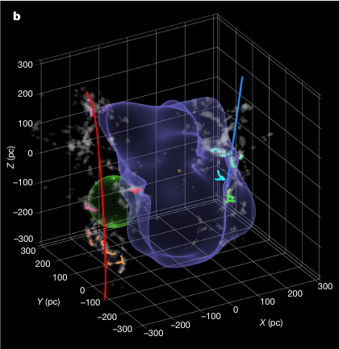
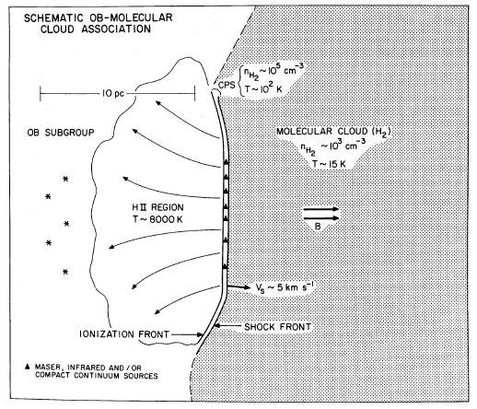
Cloud formation by compression:
Zucker+22: “We find that nearly all of the star-forming complexes in the solar vicinity lie on the surface of the Local Bubble... providing robust observational support for the theory of supernova-driven star formation.”
Elmegreen & Lada 77 “Collect & collapse.”

Slide 6
  Massive-star feedback (mainly photoionizing radiation and SN driving) has been blamed for:
    Cloud formation (e.g., Elmegreen & Lada 77: “Collect and collapse”; Zucker+22: solar neighborhood clouds lie on surface of Local Bubble).
    Driving of clouds’ internal turbulence by nearby SNe (e.g., Mac Low & Klessen 04, Padoan+16; although see Seifried+18).
    Cloud dispersal and regulation of the SFR (by HII regions; e.g., Matzner 02; Colín+13; Mac Low+17; Haid+19).

Slide 7
  So, how do all three of these effects combine, and what is the net result?
  Does feedback (and which kind) promote or inhibit SF?

Slide 8
II. What is the main mechanism of molecular gas formation?

Slide 9
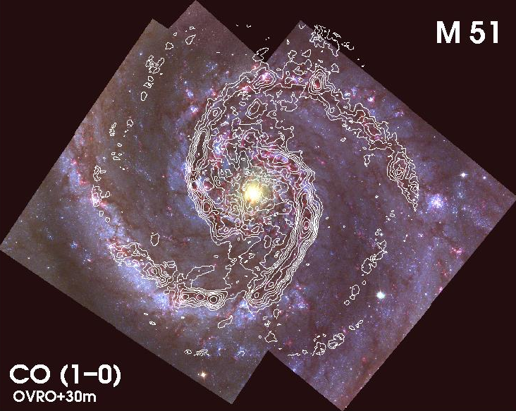
  Molecular gas in galaxies is distributed in large, kpc-long complexes. Along spiral arms in grand-design ones:
Credit: NRAO

Slide 10
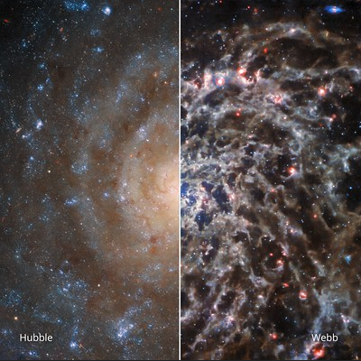
  SNe explode there.

Slide 11
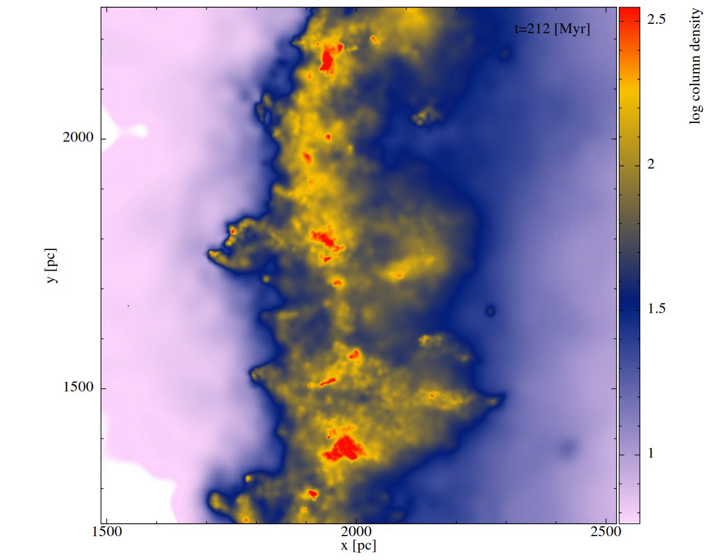
  A simplified, rotation-less simulation (VS+25, subm., by C. Alig and A. Burkert):
    A 4-kpc GADGET3 simulation with a straight-arm potential in the middle.
    Gas enters on the left with v = 15 km s⁻¹, n = 0.2 cm⁻³. Outflow conditions on the right.
SNe tend to explode outside MCs (Mélanie’s talk), so they mainly rearrange and destroy part of the dense gas initially formed by the arm potential.
“Sculpting” the gas (Joao’s talk), not forming it.
(The destructive effect of SNe in this simulation is exaggerated because the SNe explode inside the clouds.)
1 kpc

Slide 12
III. The effect of HII regions inside molecular clouds

Slide 13
  Inside the clouds, the dominant effect is that of the HII regions (Matzner 02; Colín+13; Haid+19; Steffi’s and Angela’s talks).
    How does stimulated SF compare to “primordial”?
    Is the net effect to induce or suppress SF?
  González-Samaniego & VS (2020, MNRAS, 499, 668): a comparison of two simulations, with and without UV feedback:
    H-ART code (Kravtsov 2003).
    256-pc box, colliding flows, multiphase.
    Stellar-mass sink particles, Salpeter IMF.
    Simplified radiative transfer → UV radiation.
    Self-consistent turbulence (driven by instabilities of compressed, cold layer).

Slide 14
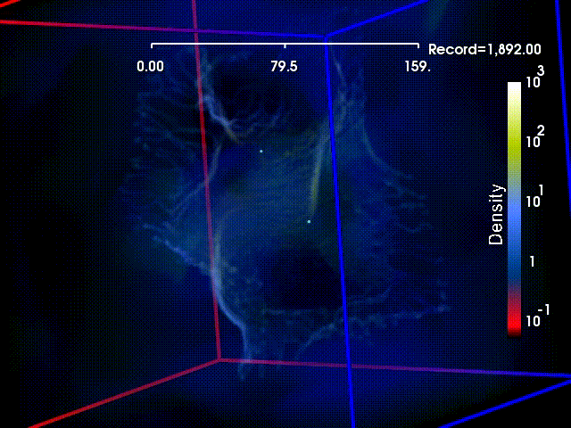
x10⁴ yr
160 pc
Cluster 2
Colín+13, MNRAS, 435, 1701: run LAF1

Slide 15
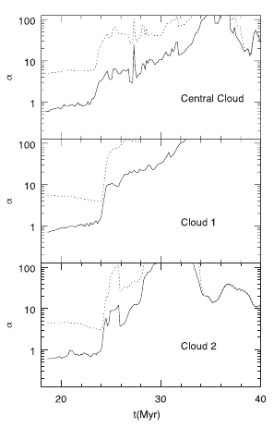
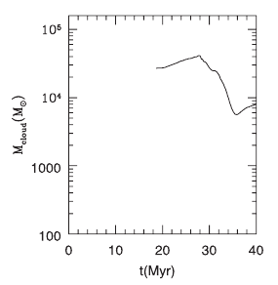
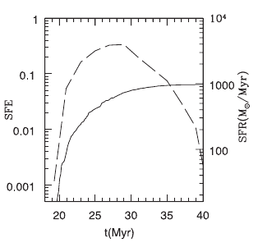
  Dense gas mass first increases by accretion, then decreases by cloud erosion.
  Similarly for SFR.
  Virial parameter ~ 1 during collapse, increases during feedback stage.
SFR
M_{cloud} (M_{sun})
SFE
Colín+13, MNRAS, 435, 1701.

Slide 16
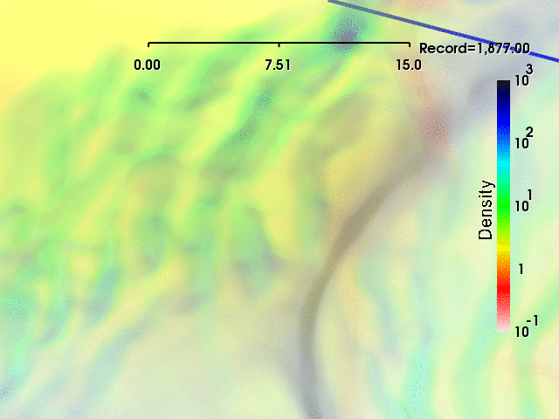
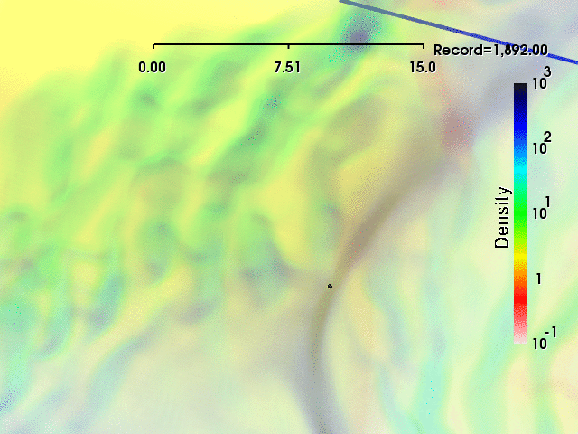
  Zoom into Cluster 2, comparing two runs with and without feedback:
15 pc
15 pc
With fdbck.
19 – 29 Myr
Without fdbck.
González-Samaniego & VS 2020, MNRAS, 499, 668

Slide 17
HIGHLIGHTS:
  A filament forms and grows by continued accretion from the cloud.
    A main hub forms and grows roughly simultaneously.
    Slow longitudinal inflow motion develops in the filament towards the central hub.
  Several secondary stellar subgroups appear later in the filament.
    As a consequence of the filament’s line mass growth.
    Cluster assembles hierarchically due to hierarchical collapse of parent cloud.
      “Conveyor-belt” flow (Longmore+14).
    Since they form in both simulations, their formation is primordial.

Slide 18
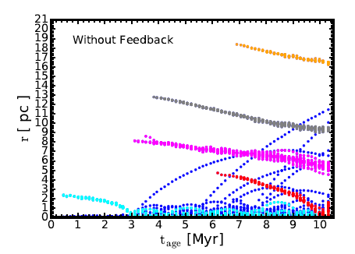
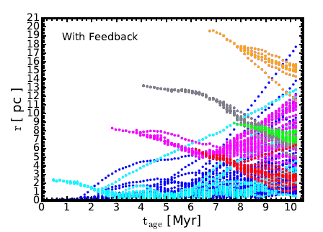
  However, out of six secondary subgroups, one does form in the run with feedback that does not form in the non-feedback run.
  A case of stimulated formation.
Distances of individual stars to cluster’s center of mass vs. time.

Slide 19
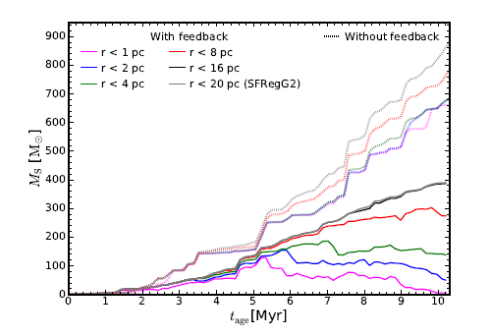
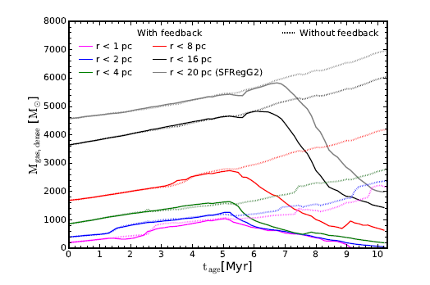
  Yet, the net SFR is always lower in the run with feedback:
  Hub gas mass increases by accretion onto cloud faster than stellar mass! (González-Samaniego & VS, 2020, 499, 668)
    Maintains a low measured SFE even before cloud dispersal.
    At t_{age} = 7 Myr, SFE_{no fbck} ~ 6.5% SFE_{fbck} ~ 4%.
    The SFE_{ff} becomes a competition of accretion rates! (Zamora-Avilés+25, subm.)
Stellar mass within sphere of radius r [M_{sun}]
Gas mass within sphere of radius r [M_{sun}]

Slide 20
IV. The effect of SNe outside molecular clouds

Slide 21
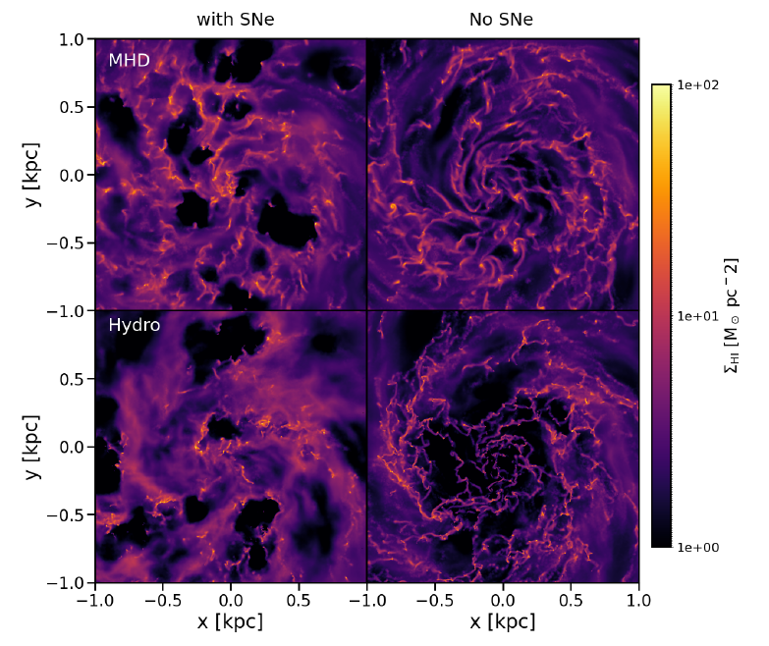
  Whitworth, VS, +25, in prep.: dwarf-galaxy simulations with and without SN feedback and B field:

Slide 22
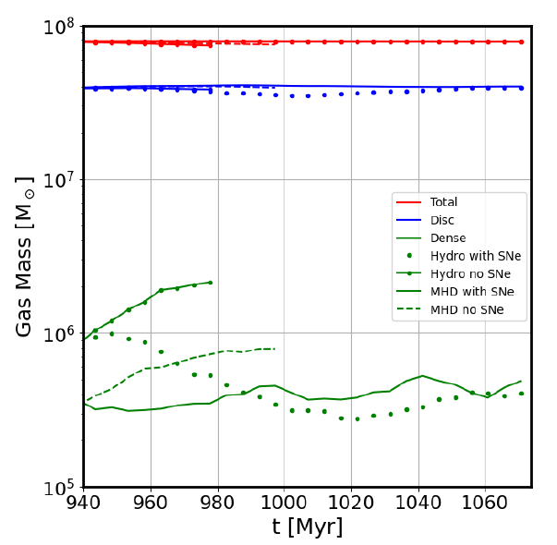
Result:
The dense (n > 100 cm⁻³) gas mass is smaller in the runs with SNe...
HD no SNe
MHD no SNe
MHD w/ SNe
HD w/ SNe

Slide 23
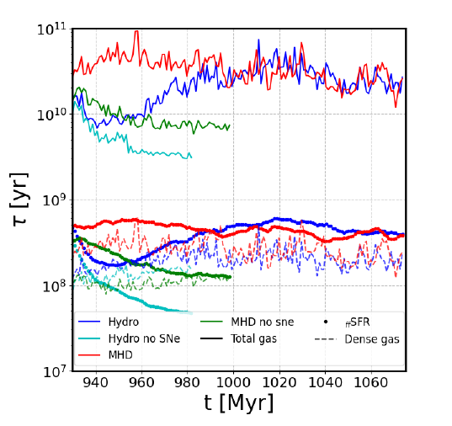
Result:
Yet the specific SFR for the dense gas is virtually unchanged from with to without SNe!

Slide 24
Conclusion:
  SN feedback prevents the formation of dense gas, or destroys some of it, ...
  ... but the existing dense gas collapses at the same rate as the case without SNe.

Slide 25
IV. Conclusions

Slide 26
  At least in grand-design spiral galaxies, most molecular gas is probably made by the arm potential.
    SNe exploding outside of MCs mainly rearrange or destroy part of that gas.
  Inside MCs,
    SF appears driven by primordial, hierarchical collapse.
    A minority of cases of triggered SF, but main effect of HII region feedback is cloud destruction/dispersal and SF suppression.
    SFR first increases by accretion onto cloud, then decreases by destruction/dispersal.
      α_{vir} ~ 1 during collapse, jumps to >>1 during cloud dispersal.
    Accretion onto clouds causes always-low measured SFE.
      A matter of accretion rate competition between cloud and stars.
  Outside MCs, SNe:
    Reduce global SFR by reducing the net amount of dense gas...
    ...not by retarding its collapse.
  In no case are nearly hydrostatic, turbulence-supported clouds observed.

Slide 27
A commercial...

Slide 28
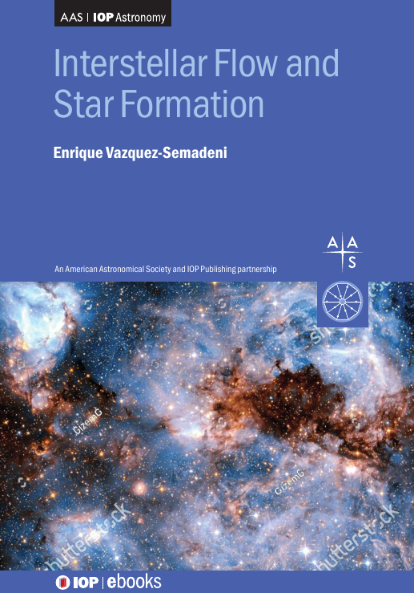
Coming soon:
Part I: Expanded views on basic physics:
  turbulence,
  thermodynamics
  out-of-equilibrium virial theorem,
  anisotropic and outside-in collapse.
Part II: An account of molecular cloud formation and evolution.

Slide 29
THE END

Slide 30
Outline:
  The many tasks we demand from HII-region and SN feedback.
  Who’s the main driver of molecular gas formation in galaxies?
  Does feedback...
    promote formation, support, or destruction of molecular clouds?
    promote or reduce star formation?

Slide 31
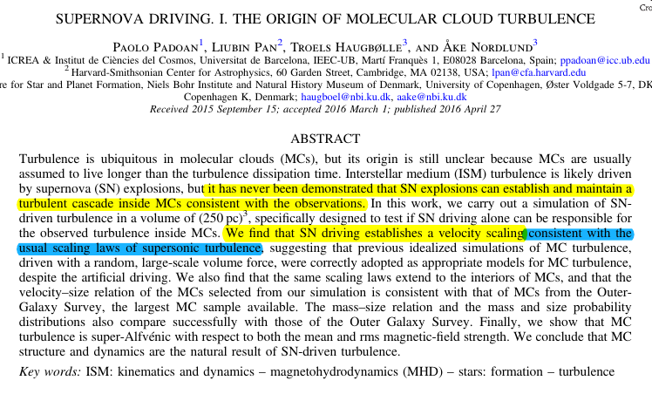
Cloud turbulence driving by SNe:
  Although see Seifried+18...
Padoan+16

Slide 32
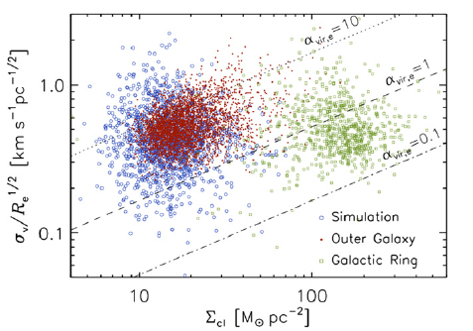
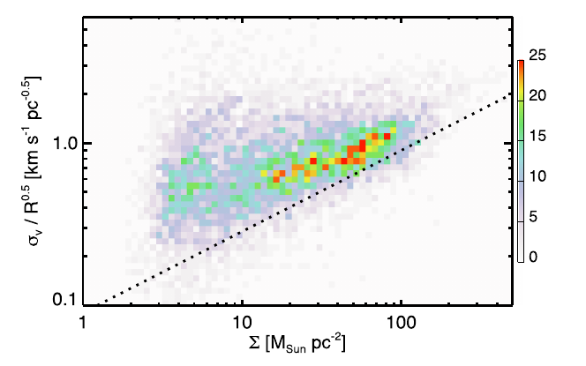


  Except that the usual scaling laws of supersonic turbulence are not consistent with observations!
Turbulence: $σ∝R^{1/2}$
Molecular clouds: $\frac{σ}{R^{1/2}}∝Σ^{1/2}$
Padoan+16
Miville-Deschênes+17

