Slide 1
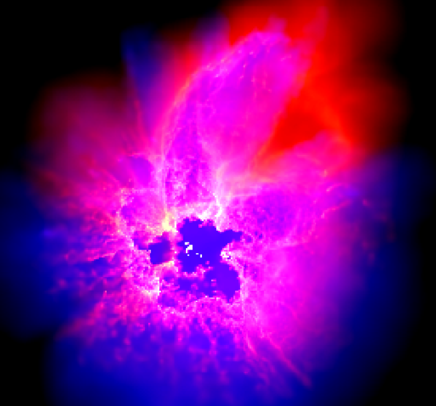
Semi-confined Supernova in H II region bubbles
Bally Fest 2025 - Stellar feedback and galactic ecology -
SPH simulations of stellar feedback in Molecular Clouds
and how it differs to 1-D SN models in galaxy sims
Cheryl Lau
Prof. Ian Bonnell
University of St Andrews, Scotland, UK
(Dale et al. 2014)
1 Semi-confined Supernova in HII region bubbles Cheryl Lau

Slide 2
Pre-SN feedback is important
Stellar winds
Ionizing radiation
SN
+
Wind-blown bubbles
H II regions
Explodes in a cavity
Determines cooling of SN
2 Semi-confined Supernova in HII region bubbles Cheryl Lau

Slide 3
Current SN models
For sub-grids!
(typically)
Based on spherical blast wave solutions (Sedov/Snowplough)
+ Interaction with pre-SN feedback bubble
Modified environment
+ cooling
+ stellar models ….. etc.
E.g. Wind-blown bubbles, HII regions
3 Semi-confined Supernova in HII region bubbles Cheryl Lau

Slide 4
Current SN models
For sub-grids!
(typically)
Based on spherical blast wave solutions (Sedov/Snowplough)
+ Interaction with pre-SN feedback bubble
But most are 1-D
Assumes spherical symmetry; or
Injected in homogeneous /
homogeneously turbulent mediums
Modified environment
+ cooling
+ stellar models ….. etc.
E.g. Wind-blown bubbles, HII regions
3 Semi-confined Supernova in HII region bubbles Cheryl Lau

Slide 5
Before SN: HII region in GMC
warm
envelope
The most massive sink
Lau, Bonnell & Lucas (2025) in prep.
4 Semi-confined Supernova in HII region bubbles Cheryl Lau

Slide 6
Before SN: HII region bubble in GMC
Internal energy of a slice
Heated by photoionization
Lau, Bonnell & Lucas (2025) in prep.
5 Semi-confined Supernova in HII region bubbles Cheryl Lau

Slide 7
Before SN: Ionized channels in GMC
Internal energy
Ionic fractions
Ionized particles
Neutral particles
Lau, Bonnell & Lucas (2025) in prep.
6 Semi-confined Supernova in HII region bubbles Cheryl Lau

Slide 8
Before SN: Ionized channels in GMC
Internal energy
Ionic fractions
A different slice
Ionized particles
Neutral particles
Lau, Bonnell & Lucas (2025) in prep.
7 Semi-confined Supernova in HII region bubbles Cheryl Lau

Slide 9
Before SN: Ionized channels in GMC
Internal energy
A different cloud
Ionic fractions
Ionized particles
Neutral particles
Lau, Bonnell & Lucas (2025) in prep.
8 Semi-confined Supernova in HII region bubbles Cheryl Lau

Slide 10
Now with channels… Inject supernova
Column density
Column internal energy
Lau, Bonnell & Lucas (2025) in prep.
9 Semi-confined Supernova in HII region bubbles Cheryl Lau

Slide 11
Column densities seen from SN progenitor
Before SN
After SN
Lau, Bonnell & Lucas (2025) in prep.
10 Semi-confined Supernova in HII region bubbles Cheryl Lau

Slide 12
Internal energies seen from SN progenitor
Before SN
After SN
Lau, Bonnell & Lucas (2025) in prep.
11 Semi-confined Supernova in HII region bubbles Cheryl Lau

Slide 13
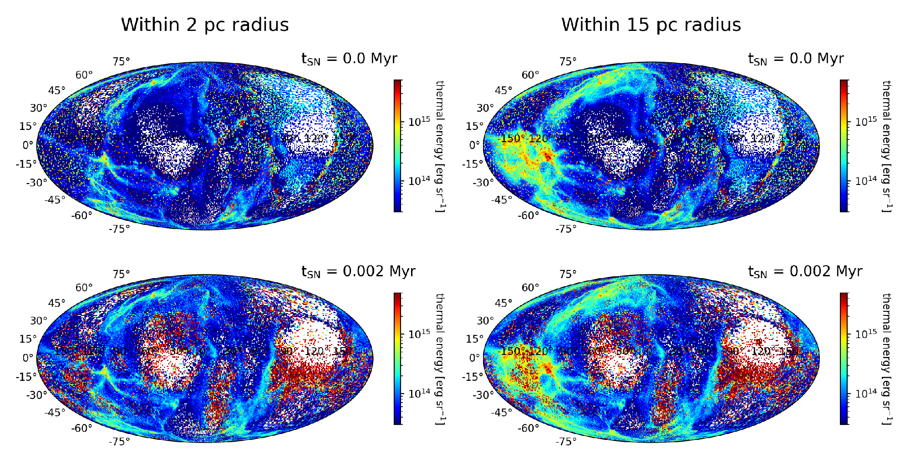
Internal energies seen from SN progenitor
Before SN
Feedback goes through paths of least resistance in cloud
After SN
Lau, Bonnell & Lucas (2025) in prep.
11 Semi-confined Supernova in HII region bubbles Cheryl Lau

Slide 14
Breaking the symmetry
What is the difference in energy/momentum output between a typical 1-D spherical blast model and …
if we don’t resolve it?
12 Semi-confined Supernova in HII region bubbles Cheryl Lau

Slide 15
An idealized model
Lau & Bonnell (2025)
13 Semi-confined Supernova in HII region bubbles Cheryl Lau

Slide 16
An idealized model
Compare:
Energy/momentum output
Strength of the outflow
How perturbed the gas is after the shock
Lau & Bonnell (2025)
13 Semi-confined Supernova in HII region bubbles Cheryl Lau

Slide 17
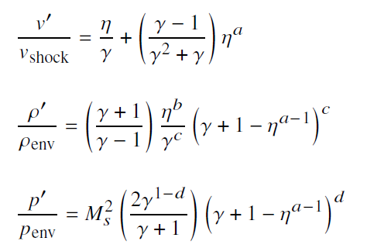
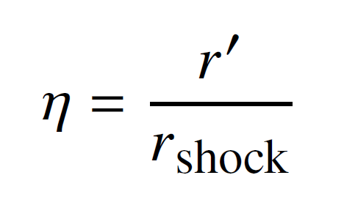
Analytical model of free-field SNe
Sedov solution –
velocity $v_{shock}$ as a function of $r_{shock}$
Assume it remains self-similar
Gas properties in post-shock region:
Gives:
Variation of $v,ρ,P$ at detector location
with Rankine-Hugoniot relations
where
Lau & Bonnell (2025)
14 Semi-confined Supernova in HII region bubbles Cheryl Lau

Slide 18
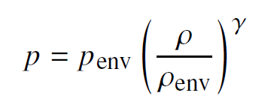
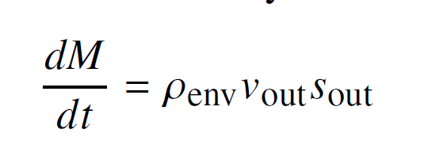
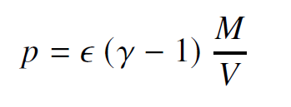
Analytical model of semi-confined SNe
Two major considerations:
Expansion of HII region shell after SN
Venting of gas during pressure-relief phase
Few assumptions:
SN energy completely thermalized upon colliding with shell
Properties are uniform inside cavity
Gas at detector is only affected by pressure gradient, i.e. not the direct impact from SN
Gas remains adiabatic
Shell EOM
Mass loss
Cavity pressure
Gives:
Variation of $v,ρ,P$ at detector location
Outflow velocity
Lau & Bonnell (2025)
15 Semi-confined Supernova in HII region bubbles Cheryl Lau

Slide 19
Idealized simulations adiabatic & cooling
Manually carved a
low-density channel
Inject ionizing radiation
Lau & Bonnell (2025)
16 Semi-confined Supernova in HII region bubbles Cheryl Lau

Slide 20
Idealized simulations adiabatic & cooling
With 4 channels
Lau & Bonnell (2025)
17 Semi-confined Supernova in HII region bubbles Cheryl Lau

Slide 21
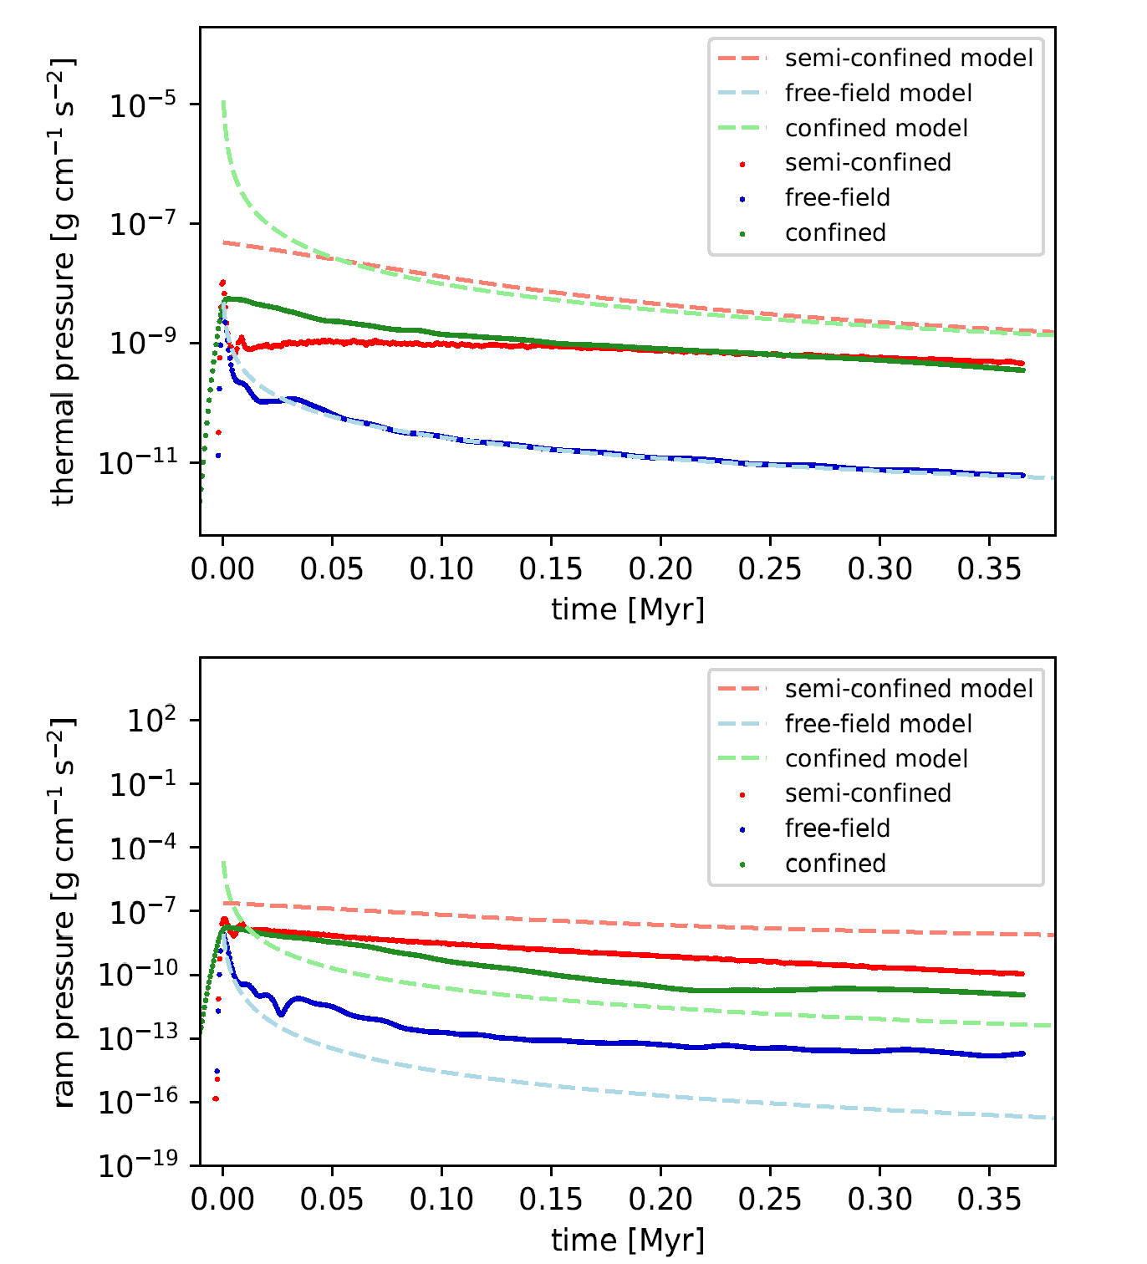
Gas properties at detector
Thermal pressure
Velocity
Ram pressure
Semi-confined
Free-field
Fully-confined
Agrees with analytical model!
Dashed - model
Lau & Bonnell (2025)
18 Semi-confined Supernova in HII region bubbles Cheryl Lau

Slide 22
Flow velocities at detector with multiple channels
Outflow velocity
Surprisingly similar
Lau & Bonnell (2025)
19 Semi-confined Supernova in HII region bubbles Cheryl Lau

Slide 23
Flow velocities at detector with bigger channels
Outflow velocity
Lau & Bonnell (2025)
20 Semi-confined Supernova in HII region bubbles Cheryl Lau

Slide 24
More energy deposited at closer radii
Semi-confined
Free-field
Fully-confined
radius
Total energy
Kinetic energy
Lau & Bonnell (2025)
21 Semi-confined Supernova in HII region bubbles Cheryl Lau

Slide 25
More momentum deposited at closer radii too
radius
Radial momentum
Terminal radial momentum of SN:
Semi-confined
Free-field
Fully-confined
Cioffi et al. (1988)
Kimm & Cen (2014)
Lau & Bonnell (2025)
22 Semi-confined Supernova in HII region bubbles Cheryl Lau

Slide 26
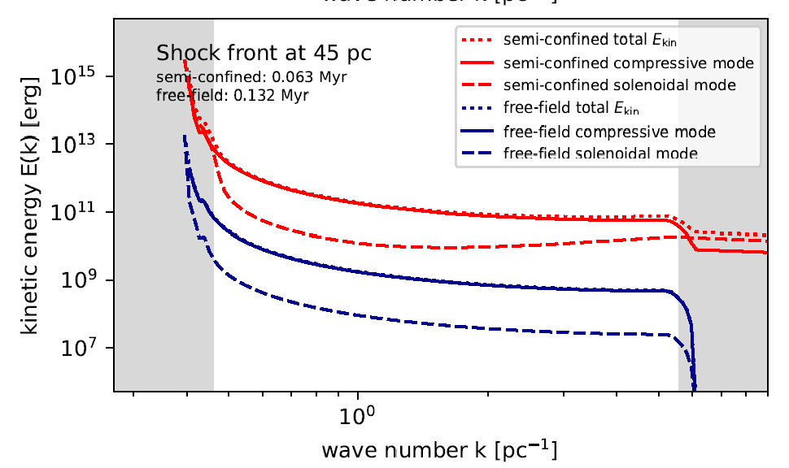
Turbulence in the outflow
Solid – compressive
Dashed – solenoidal
Semi-confined
Free-field
Kinetic energy spectrum
Post-shock region only
Beyond resol limit
Beyond resol limit
A little higher at small length-scales
Lau & Bonnell (2025)
23 Semi-confined Supernova in HII region bubbles Cheryl Lau

Slide 27
Findings so far…
Semi-confined SNe:
Sustain stronger perturbations – higher velocity and pressure
Deposit more kinetic energy and momentum at small scales
Sustain solenoidal turbulence behind the shock
24 Semi-confined Supernova in HII region bubbles Cheryl Lau

Slide 28
Findings so far…
Semi-confined SNe:
Sustain stronger perturbations – higher velocity and pressure
Deposit more kinetic energy and momentum at small scales
Sustain solenoidal turbulence behind the shock
Higher dynamical impact on local environment
Smaller supernova impact sizescale?
Possibly better for regulating SF
We probably should account for partial confinement in 1-D sub-grid models!
24 Semi-confined Supernova in HII region bubbles Cheryl Lau

Slide 29
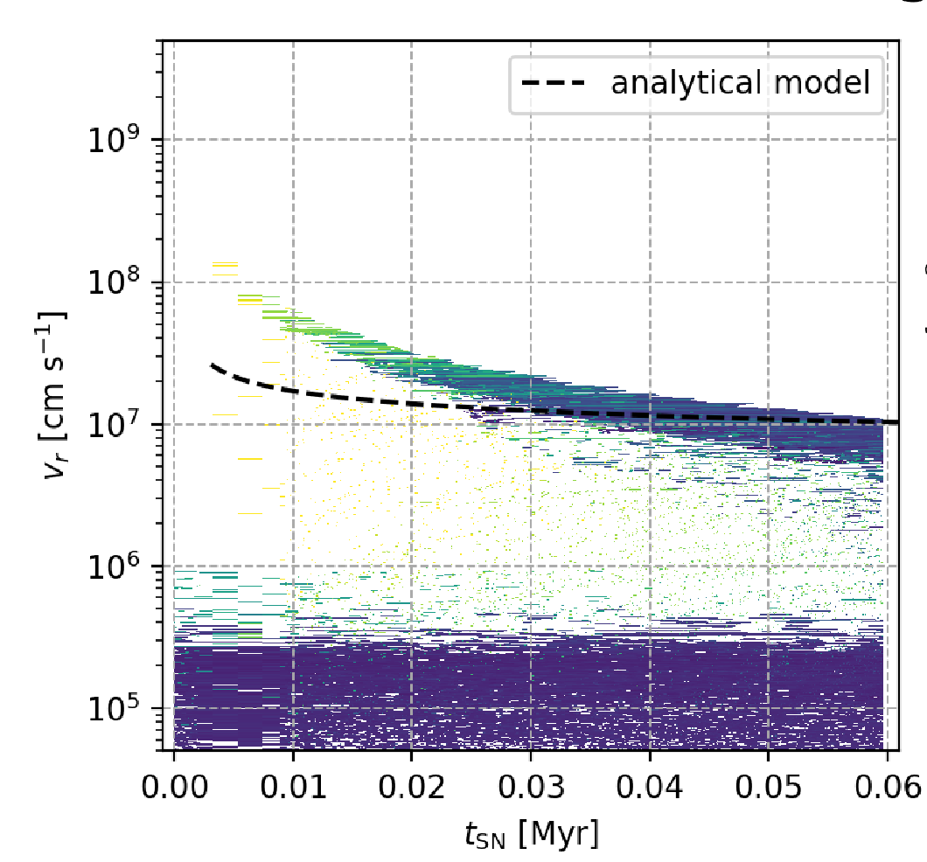
How can we turn this into a 1-D model?
SN in turbulent cloud
SN in homogenously turbulent medium
Outflow velocity
Mimic the local perturbation from cloud-confined SN
25 Semi-confined Supernova in HII region bubbles Cheryl Lau

Slide 30
How can we turn this into a 1-D model?
SN in turbulent cloud
SN in homogenously turbulent medium
Outflow velocity
Not for every density or every clumpiness
Mimic the local perturbation from cloud-confined SN
25 Semi-confined Supernova in HII region bubbles Cheryl Lau

Slide 31
Conclusion
SN energy from cloud usually leaves preferentially through the low-density channels, largely not a 1-D problem
Analytical models for interior explosions can describe this scenario
Semi-confined SNe produce higher outflow velocity from bubble
Semi-confined SNe make stronger perturbation and larger energy/momentum deposition at small-scale environment
Using clumpy medium for SN models may be the solution
26 Semi-confined Supernova in HII region bubbles Cheryl Lau

Slide 33
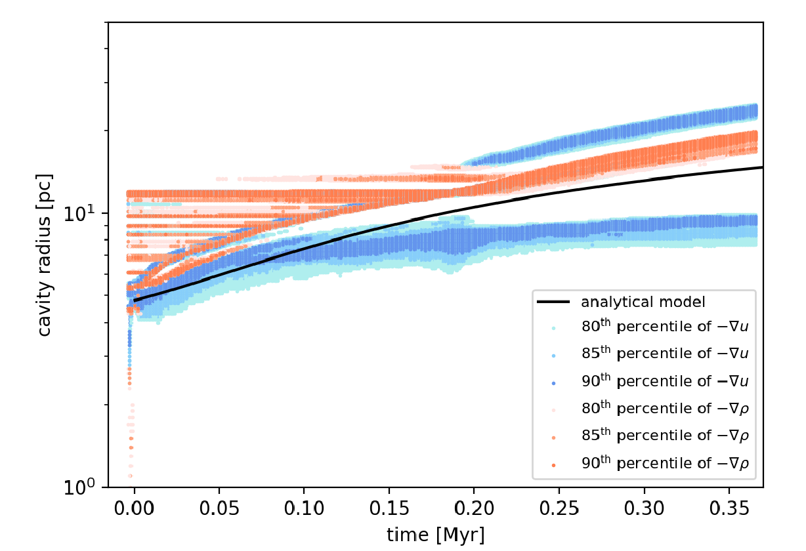
Collision of SN on cavity shell
Cavity radius traced by density and IE gradients
Adiabatic run
Semi-confined Supernova in HII region bubbles Cheryl Lau

Slide 34
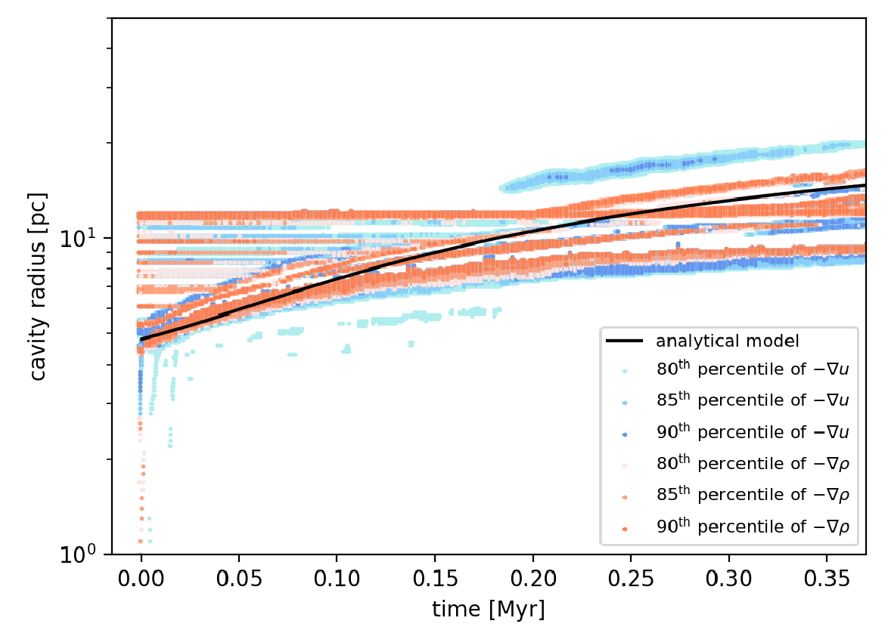
Collision of SN on cavity shell
Cavity radius traced by density and IE gradients
Cooling run
Semi-confined Supernova in HII region bubbles Cheryl Lau

Slide 35
Cooling at a similar rate
Semi-confined Supernova in HII region bubbles Cheryl Lau

Slide 36
Molecular clouds
density
Virial ratio
Semi-confined Supernova in HII region bubbles Cheryl Lau

Slide 37
HII region in molecular clouds
Semi-confined Supernova in HII region bubbles Cheryl Lau

Slide 38
Kinetic energies seen from SN progenitor
Before SN
After SN
Semi-confined Supernova in HII region bubbles Cheryl Lau

Slide 39
Turbulent free-field cases
Semi-confined Supernova in HII region bubbles Cheryl Lau

Slide 40
Kicks by SNe in turbulent cloud vs turbulent free-field
Semi-confined Supernova in HII region bubbles Cheryl Lau

Slide 41
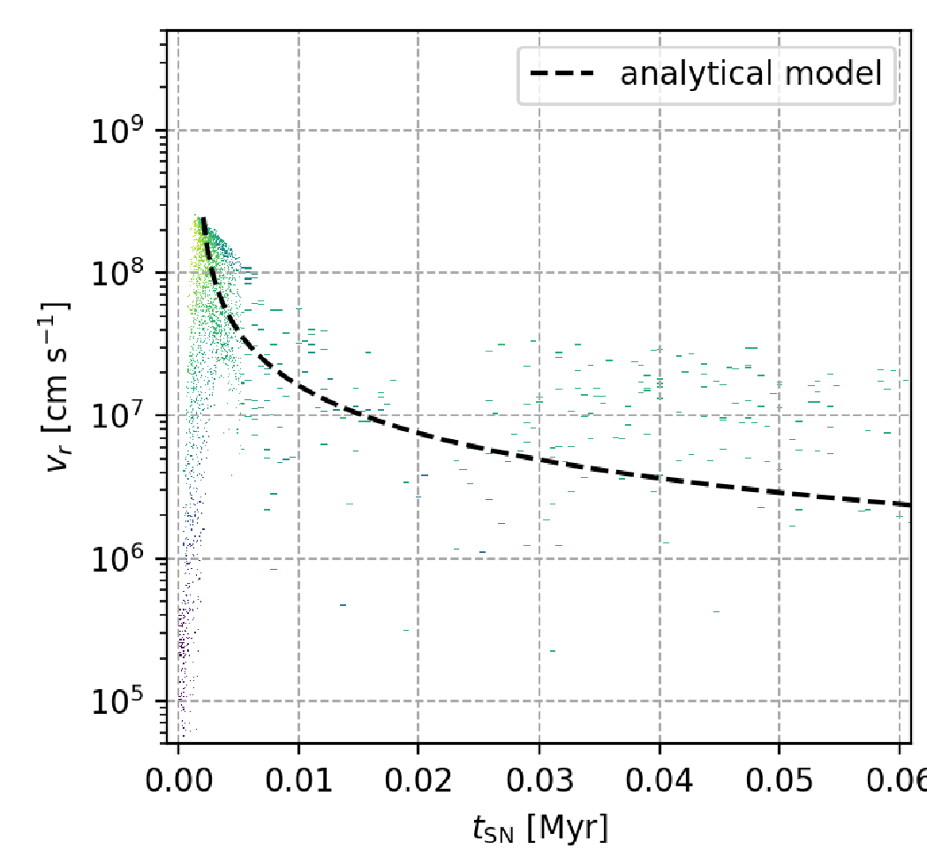
How can we turn this into a 1-D model?
SN in turbulent cloud
SN in homogenously turbulent medium
Outflow velocity
Velocities are too high
Semi-confined Supernova in HII region bubbles Cheryl Lau

Slide 42
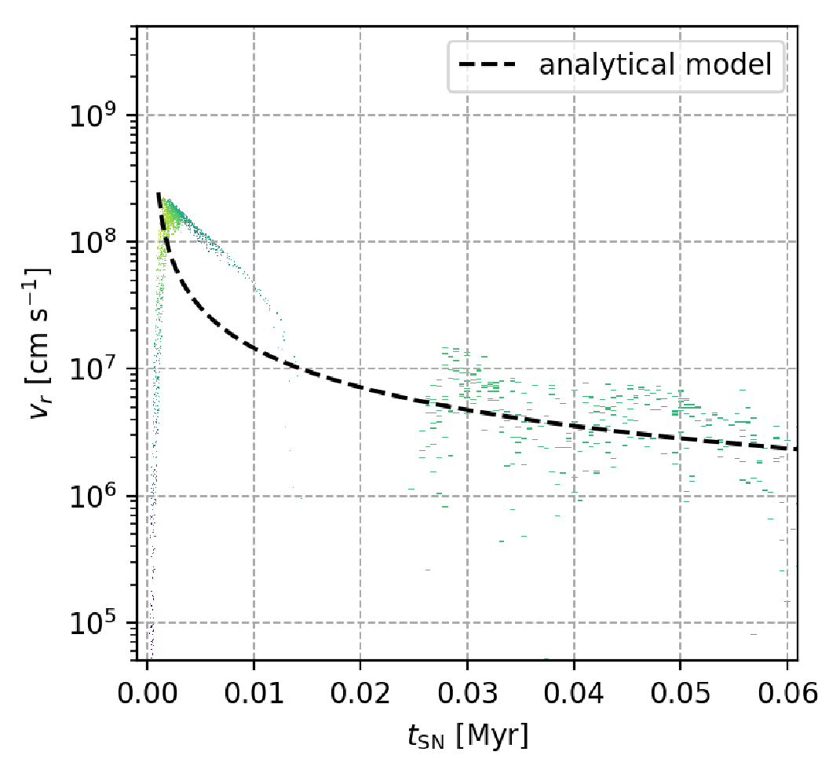
How can we turn this into a 1-D model?
SN in turbulent cloud
SN in homogenous uniform medium
Outflow velocity
Velocities are too low
Semi-confined Supernova in HII region bubbles Cheryl Lau

Slide 43
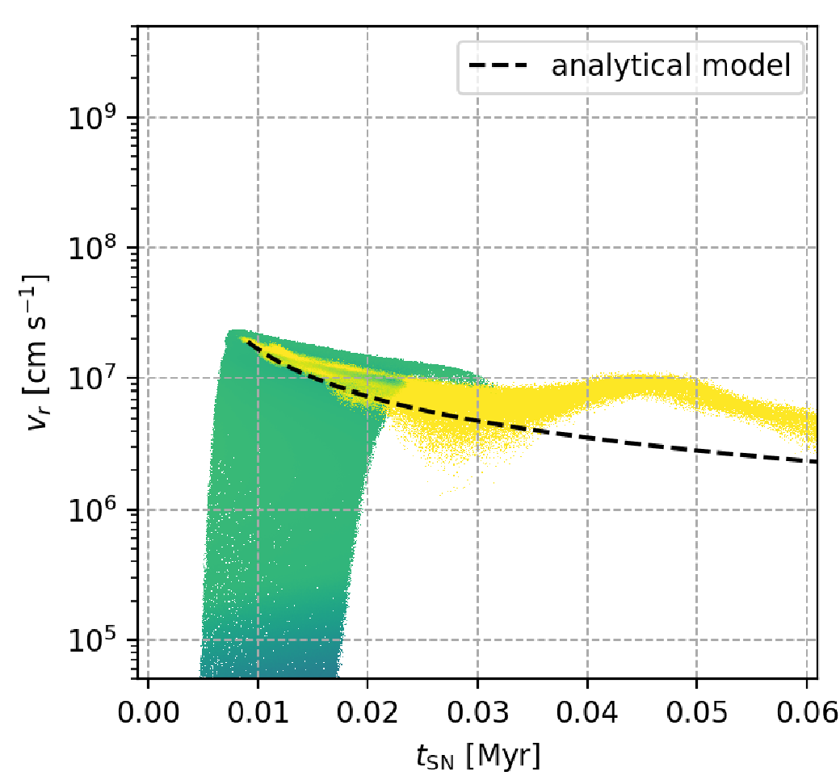
How can we turn this into a 1-D model?
SN in turbulent cloud
SN in homogenous uniform medium
Outflow velocity
Velocities are going down
Semi-confined Supernova in HII region bubbles Cheryl Lau

Slide 44
Energies of cloud vs turbulent free-fields
Total energy contained within each radius
Semi-confined Supernova in HII region bubbles Cheryl Lau

Slide 45
Energies of cloud vs turbulent free-fields
Energy binned by longitude contained within 10 pc
Semi-confined Supernova in HII region bubbles Cheryl Lau

Slide 46
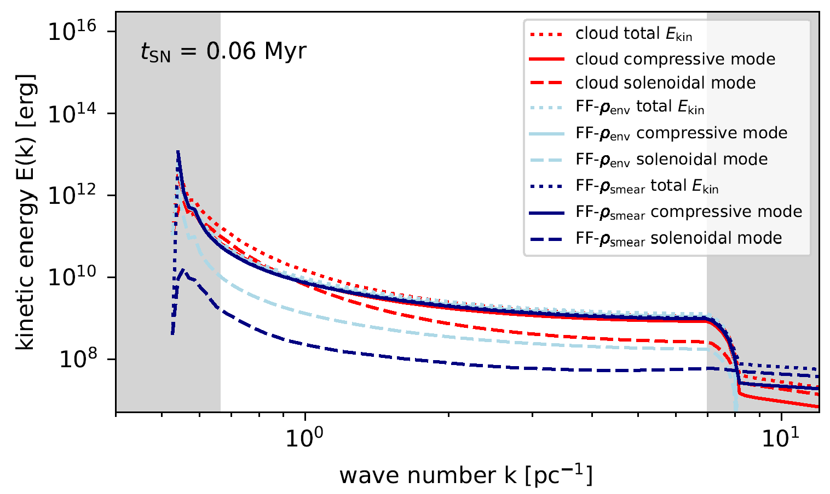
Turb spec – cloud vs uniform free-field
time
Solenoidal component of uniform case is much lower
Semi-confined Supernova in HII region bubbles Cheryl Lau

Slide 47
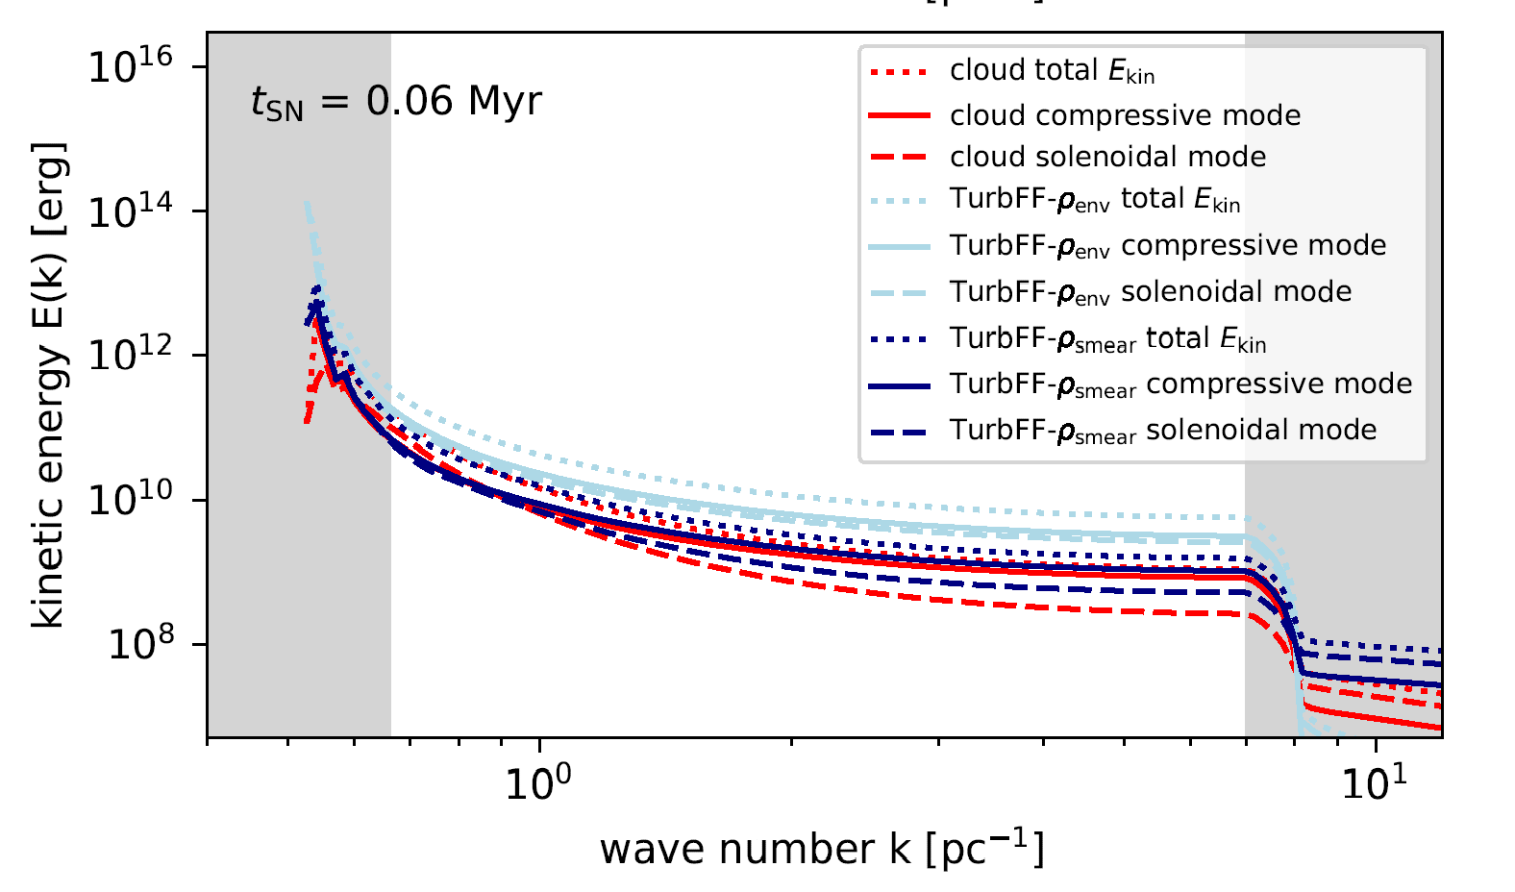
Turb spec – cloud vs turbulent free-field
time
Solenoidal component becomes similar
Semi-confined Supernova in HII region bubbles Cheryl Lau

