Slide 1
Department of Physics and Astronomy Rice University
Patrick Hartigan
Ballyfest
Visegrad Hungary
May 27, 2025
Dynamics of Carina’s Western Wall
Downes, Hartigan & Isella 2023, MNRAS 519, 5427: Length Scales and Dynamics of Carina’s Western Wall
Hartigan et al. 2022, AJ 164, 267: ALMA Datacubes and Continuum Maps of the Irradiated Western Wall in Carina
Hartigan, P., Downes, T., & Isella, A. 2020, ApJL 902, 1: A JWST Preview: Adaptive-Optics Images of H2, Br-gamma, and K-continuum in Carina's Western Wall

Slide 2
Why Choose This Irradiated Interface to Study?
Interface Instabilities - AO Image
Layered Structure of PDR and Internal Cloud
Clump Mass Distribution and Internal Energies
Velocity Coherence
Analog of Feedback/Triggering
2

Slide 3
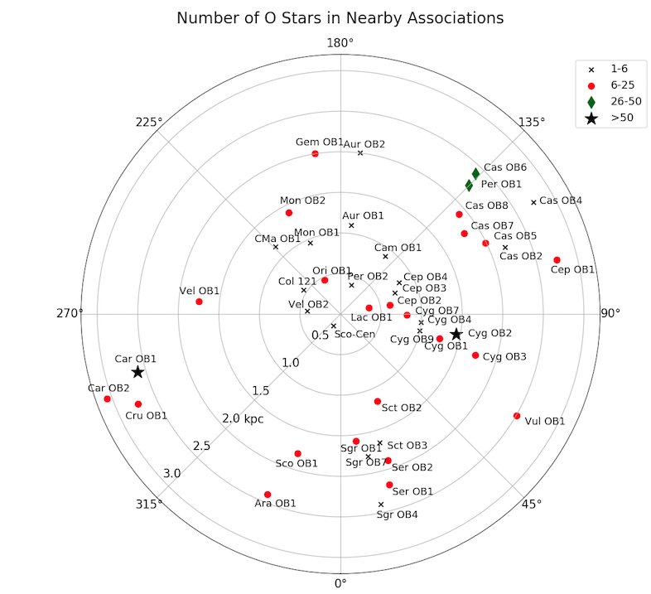
Where are the star-forming regions with lots of O stars?
3

Slide 4
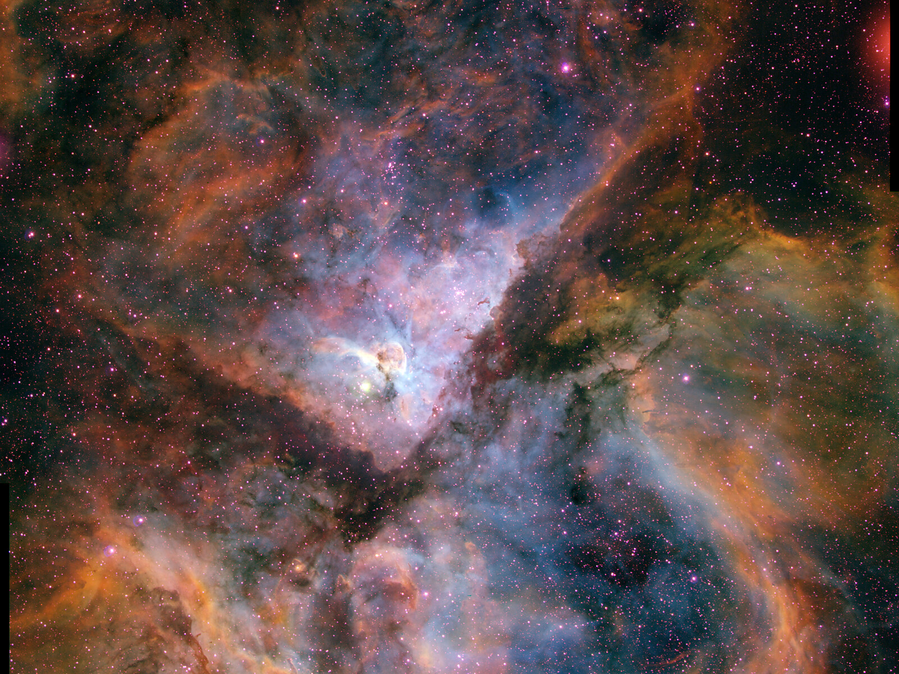
~ 100 O stars
~ 80 pc across
~ 2.3 kpc away
Over 14000 X-ray sources
A runaway B star; pulsar
LBV star η Car
“Cluster of Clusters”
1 - 3 My old
N. Smith/NOAO
4
N. Smith CTIO

Slide 5
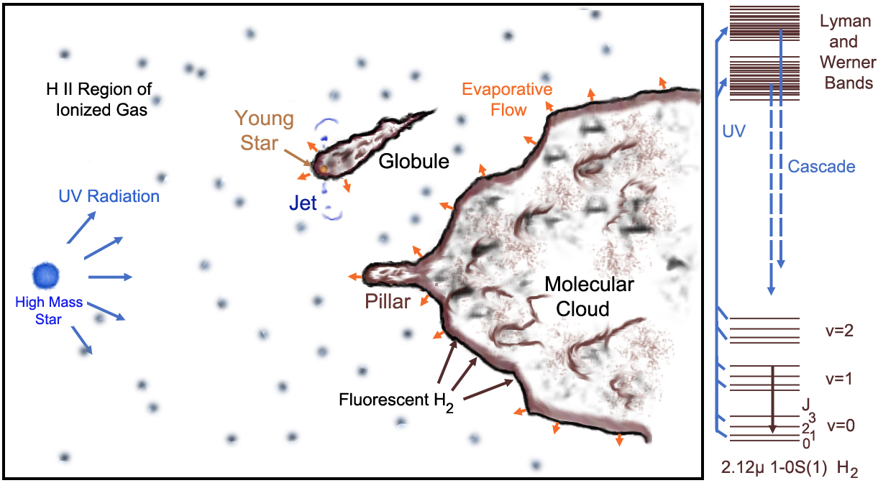
Fluorescence in Molecular Hydrogen
Hartigan, Palmer & Cleeves 2012
5

Slide 6
6

Slide 7
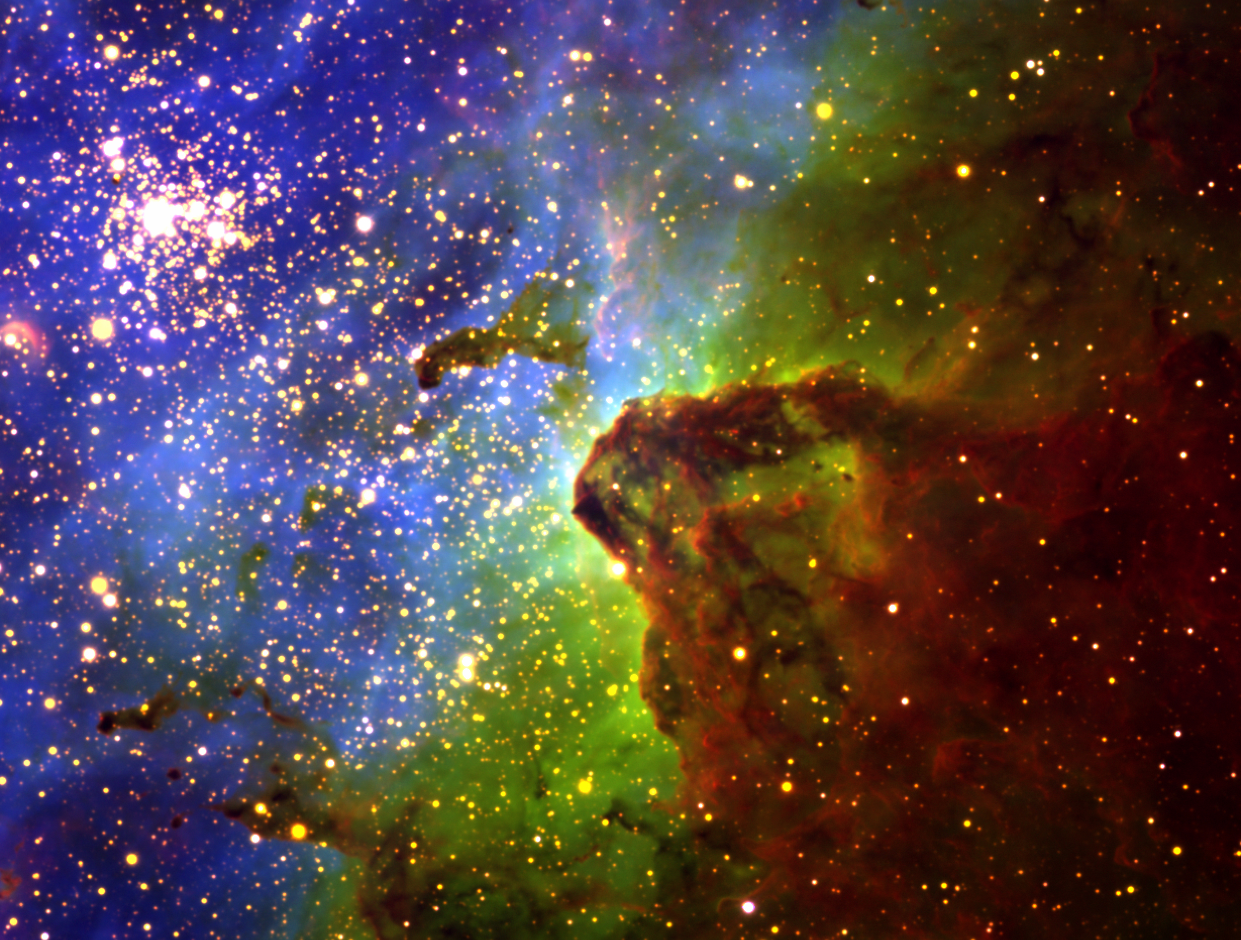
Carina’s Western Wall
Red: H₂
Grn: Brγ
Blu: [O III]
1 pc
Bright in H₂ and Brγ
(G₀ ~ 3x10⁴)
Big
Not too far away
Nice convex geometry
Hartigan, Reiter, Bally & Smith 2015 ApJ
7

Slide 8
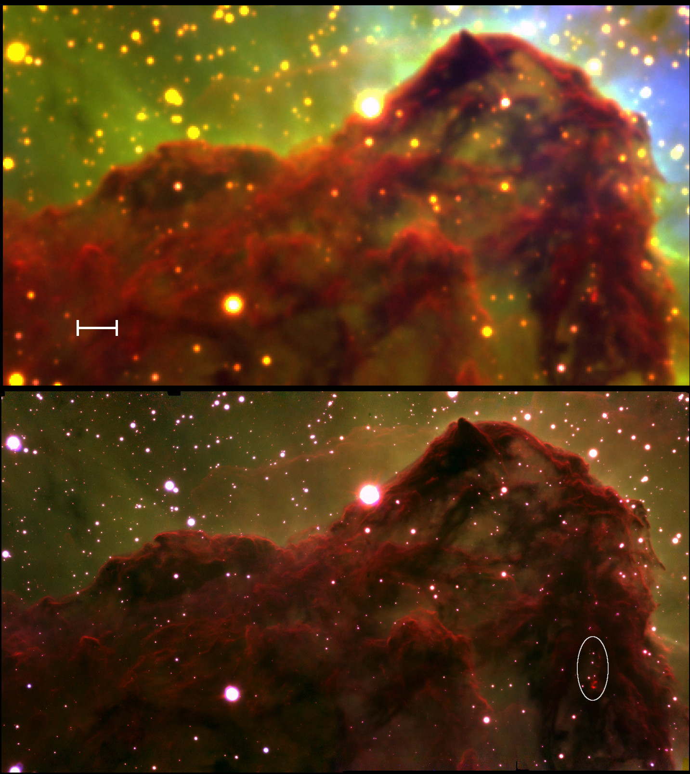
H₂ Interface and Fluid Dynamics
Ground-based
0.8” resolution
Hartigan et al. 2015 ApJ
0.1 pc
Adaptive Optics
0.065” resolution
Hartigan et al. 2019 ApJL
8

Slide 9
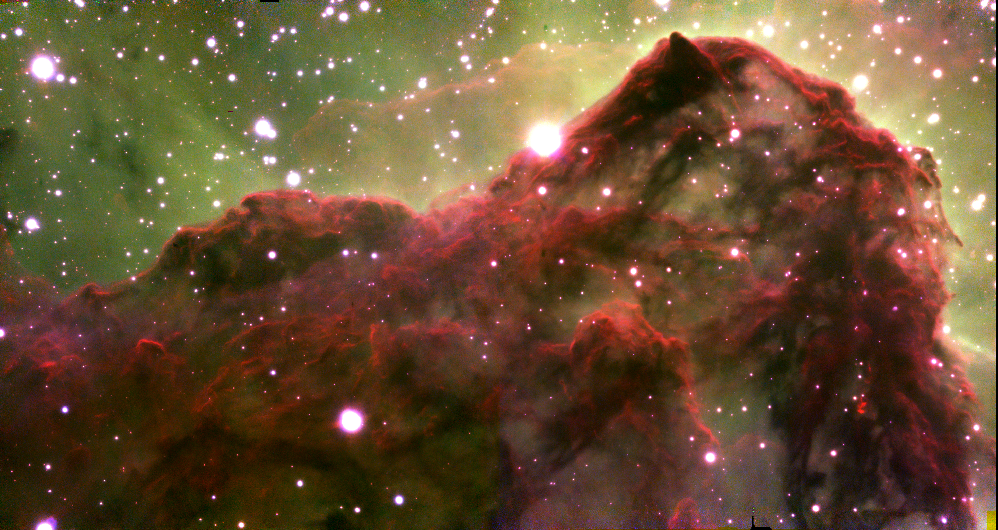
H₂ Interface and Fluid Dynamics
0.1 pc
H₂ Brγ K
Adaptive Optics
0.065” resolution
9

Slide 10
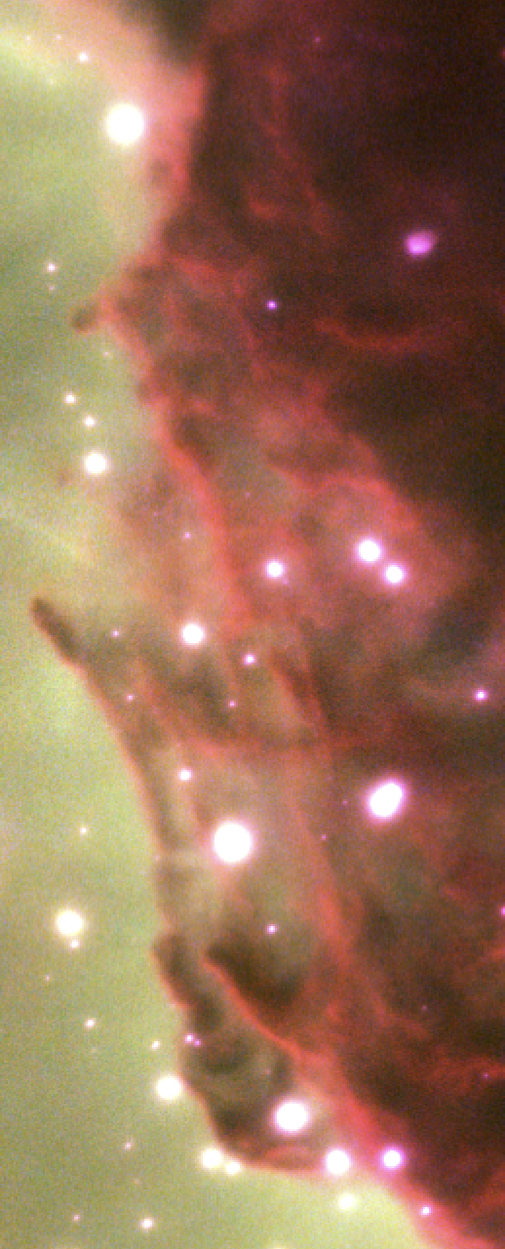
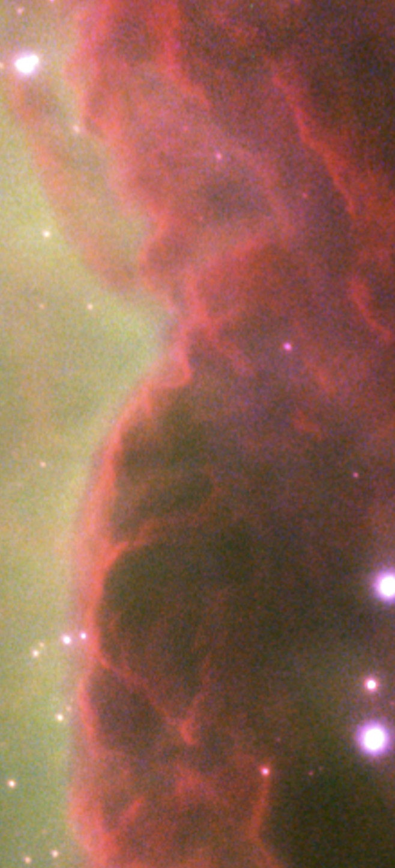
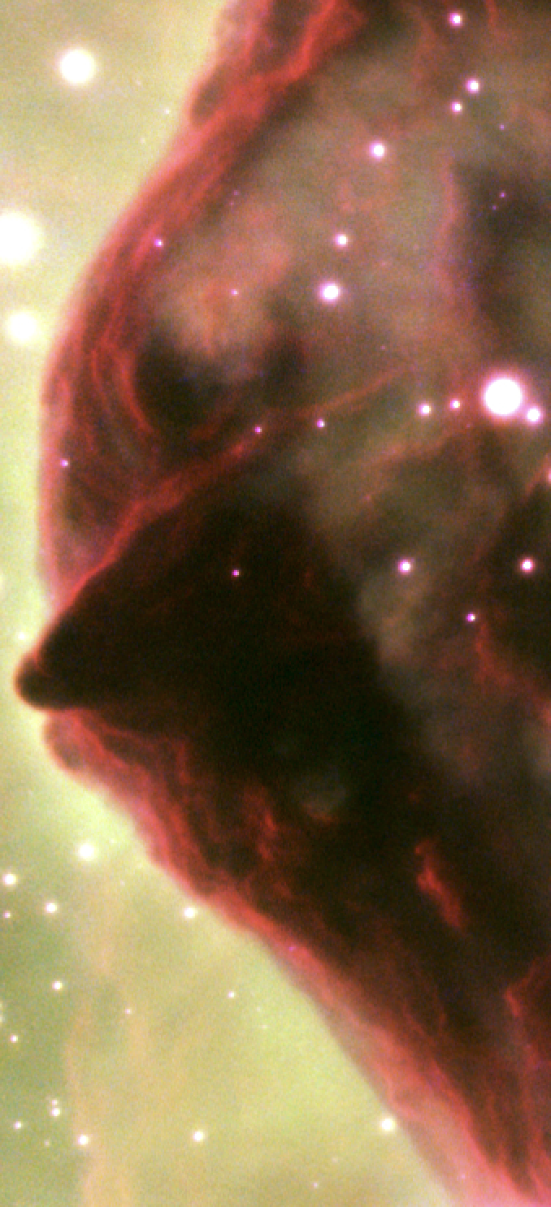
10

Slide 11
ALMA Maps
Compact Array
Wide Array
Total Power
1 pc
Lines
Band 6: 1.3mm 2-1 ¹²CO, ¹³CO, C¹⁸O
Band 8: 609μm [C I]
Continuum Maps
in Bands 6 and 8
11

Slide 12
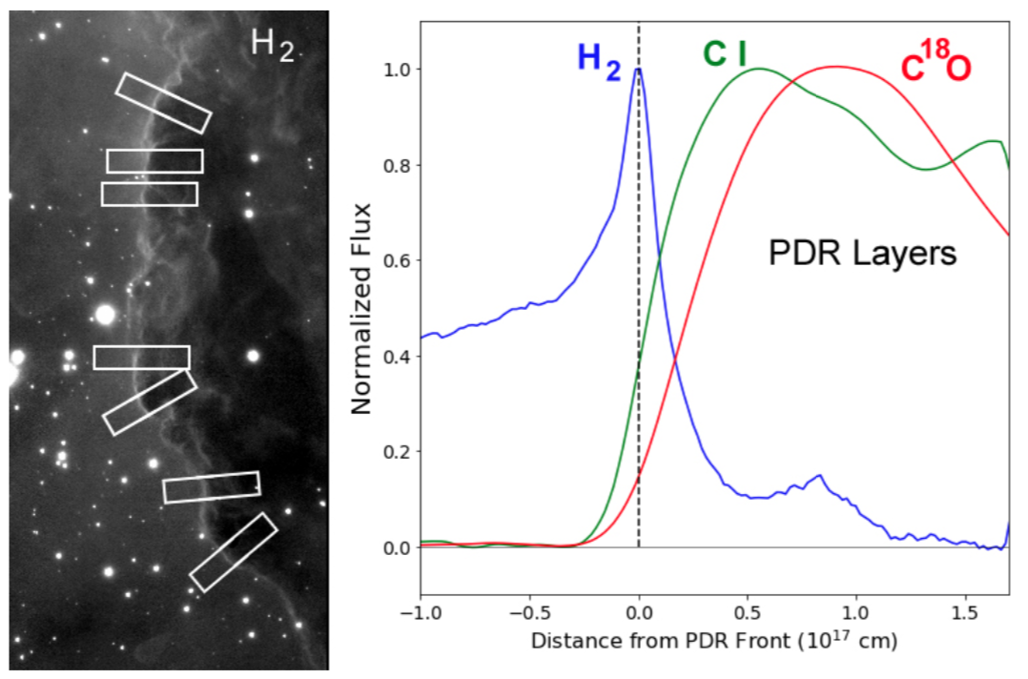
Photodissociation Layers
12

Slide 13
¹²CO Data Cube
1 arcsec²
x
0.17 km/s
13

Slide 14
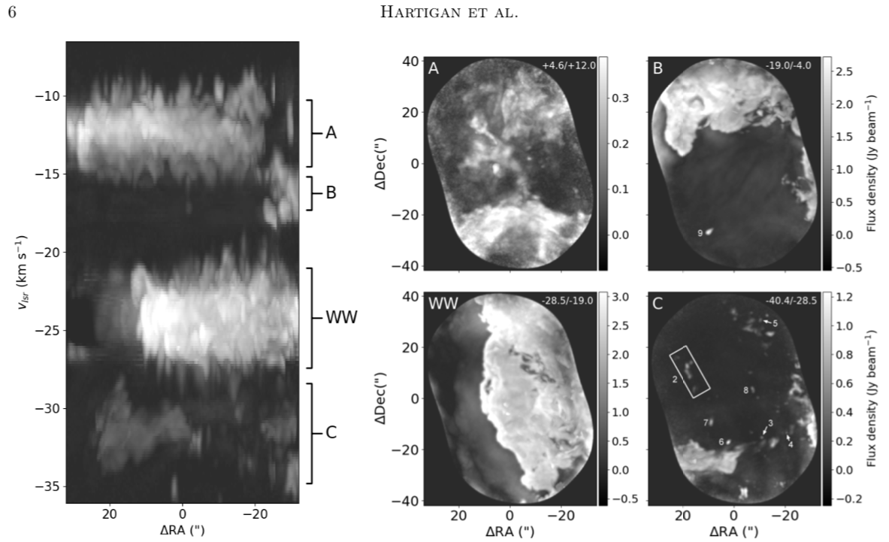
14

Slide 15
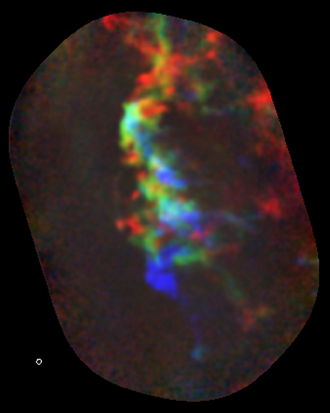
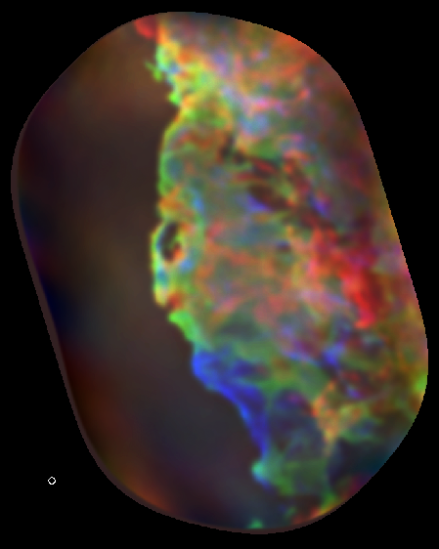
Velocity Gradient
Velocity Structure
¹²CO
C¹⁸O
B: -25.1 to -28.1 km/s
G: -24.1 to -25.1 km/s
R: -21.1 to -24.1 km/s
1 arcsecond = 2300 AU
Orbit around 1 Mo @ 2300 AU = 0.34 km/s
BEAM
15

Slide 16
Gaussian Clump Identification
16

Slide 17
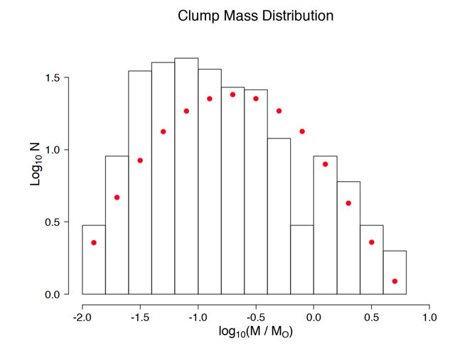
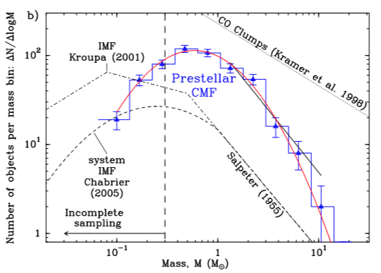
Clump Masses
ALMA maps of Carina’s Western Wall
75 M_{O} in 254 clumps; 84 M_{O} total
All Clumps appear starless
Andre et al 2014
Red Dots : 75 M_{O} from IMF
17

Slide 18
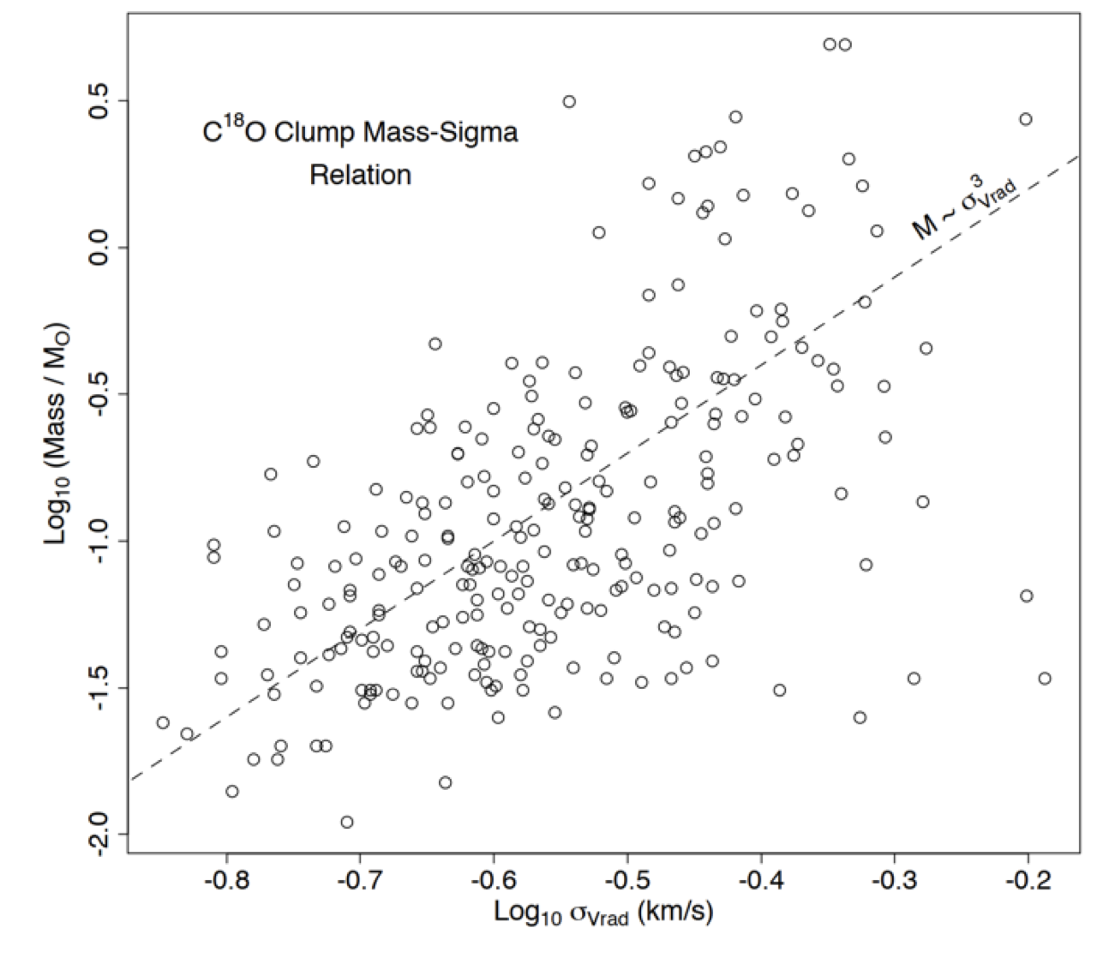
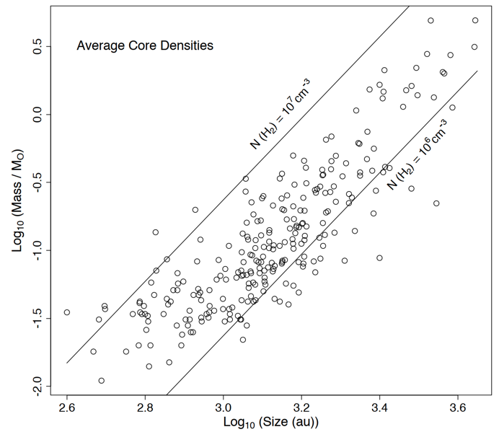
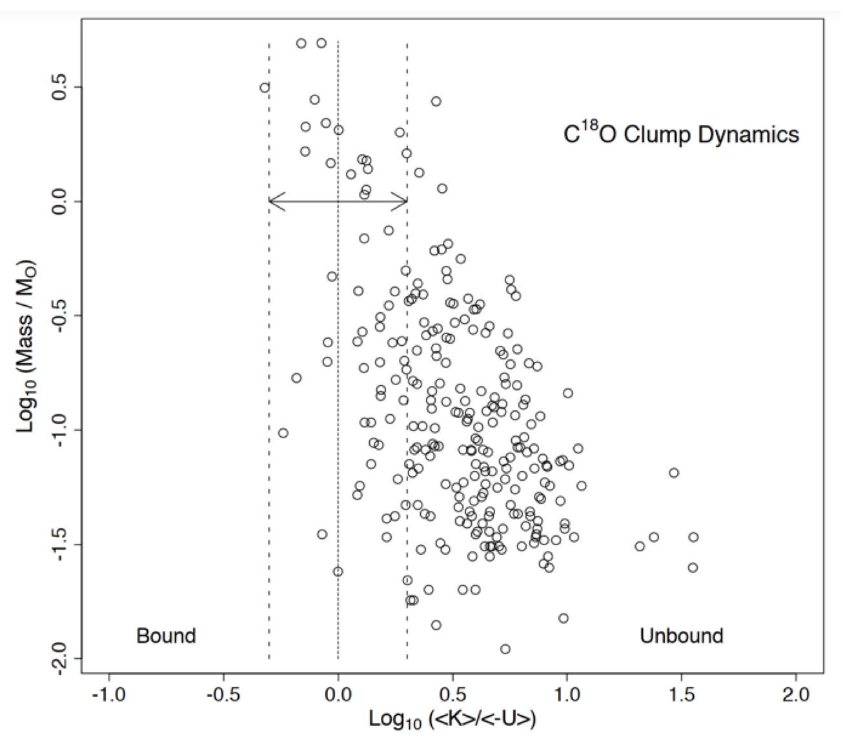
Internal Dynamics
<U> = $−$GM²/R; R = 3<σ_{R}>
<K> = $\frac{1}{2}$ M<v²>; <v²> = 3<v²_{rad}> = 3σ²(v_{rad})
<K> / <$−$U> < 1 for bound
18

Slide 19
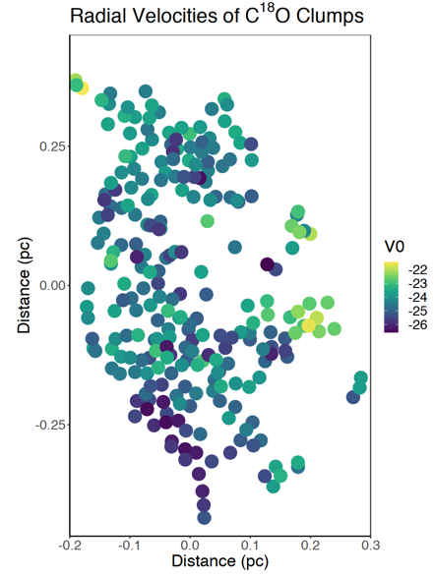
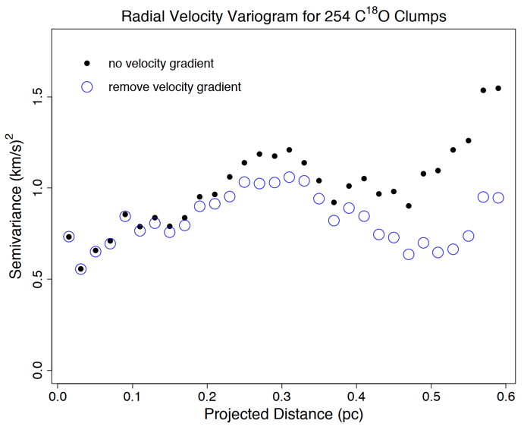
Internal Dynamics
Can also study velocity structure functions
19

Slide 20
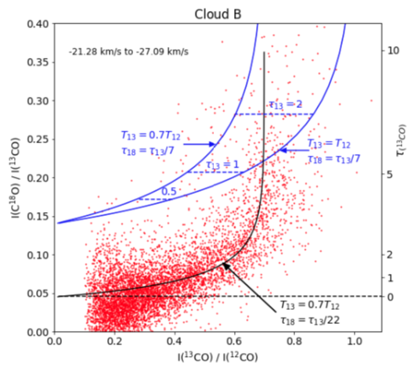
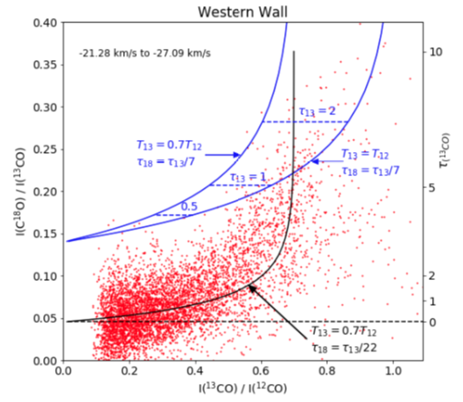
Irradiated Molecular Layers
¹²CO / ¹³CO = 77
¹³CO / C¹⁸O = 7
I_{ν} = (1 – e^{-τ}) B_{ν}(T)
¹³CO / C¹⁸O = 22, not 7
T(¹³CO) / T(¹²C)) = 0.7, not 1
Irradiated Wall fits less well
Not Irradiated (as much)
Irradiated
20

Slide 21
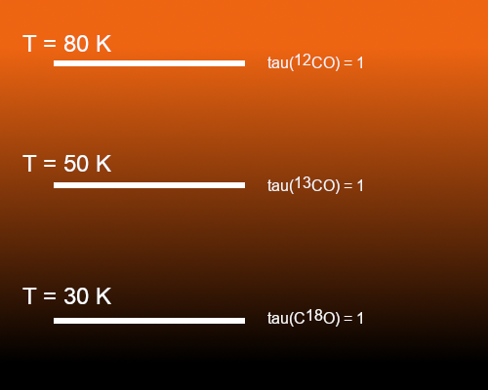
Irradiated Molecular Layers
43 Years ago John was here....
Photodissociation of CO occurs by absorption into discrete bands between 11.1 eV and 13.6 eV (Letzelter et al 1987; Bally & Langer 1982)
At low T get differential self-shielding
→ can raise ¹³CO / C¹⁸O
Hψ = (L² / 2I) ψ = ℏ² l (l +1)/2I ψ
E = ℏ² l (l +1)/2I
¹³CO
C¹⁸O
¹²C
|
¹⁶O
¹³C
|
¹⁶O
¹²C
|
¹⁸O
21

Slide 22
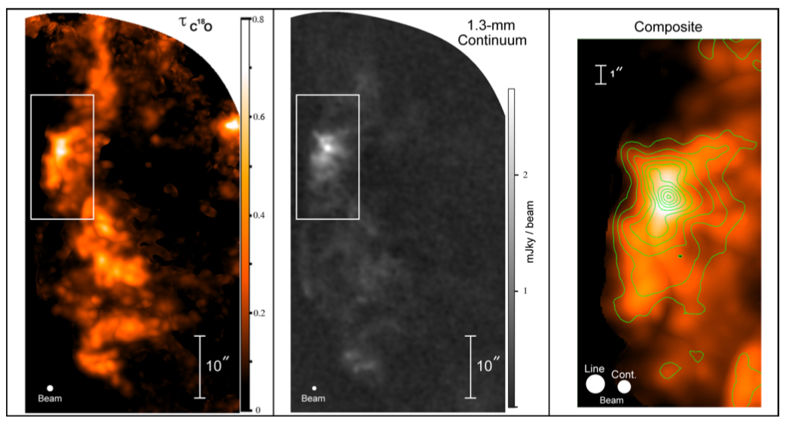
Triggering?
Concentrates mass along front
Creates a temperature gradient in the cloud
Flattens structures along front
Alters isotopolog CO line ratios
Clump mass distribution seems normal
No obvious wrap-around triggering
No observable turbulent driving scale
What doesn’t irradiation do?
So what does irradiation do?
22

Slide 23
Feedback and Triggering
Phenomenon [thunderstorm] happens sporadically in some region [humid region near the coast]
Phenomenon [thunderstorm] pushes material out and induces more activity within a growing spatial range
Large scale conditions [cold front] influence whether phenomenon happens at all
Phenomenon [star formation] happens sporadically in some region [molecular cloud]
Phenomenon [O star] pushes material out and induces more activity within a growing spatial range
Large scale conditions [spiral density waves] influence whether phenomenon happens at all
sunlight
Land
Land
Water
Water
Coastal Sea Breeze
23

Slide 24
Triggering?
ALMA maps of Carina’s Western Wall
24

Slide 25
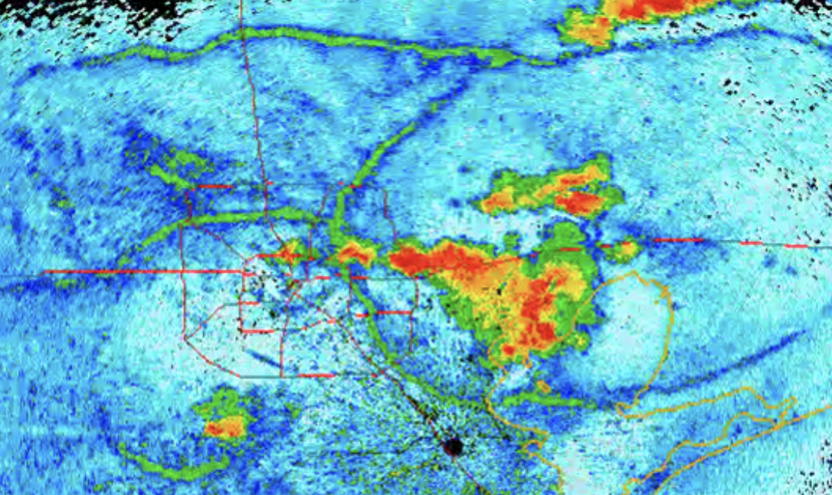
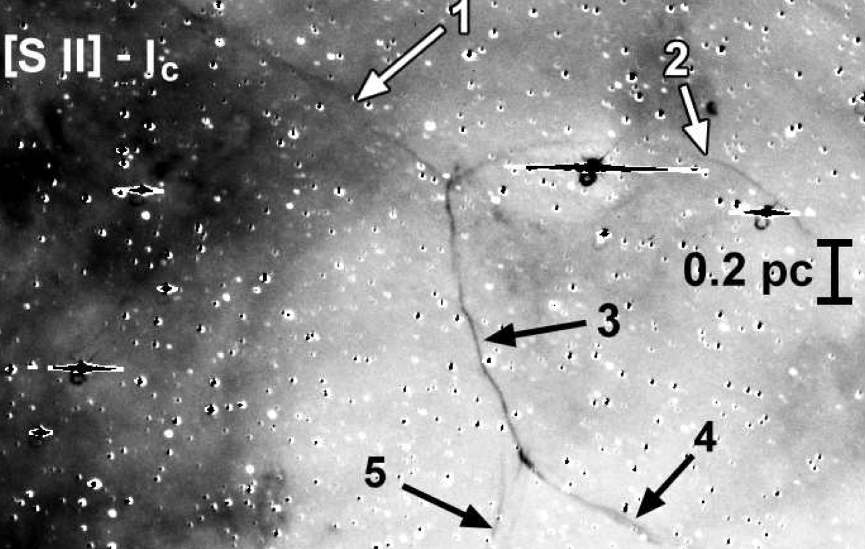
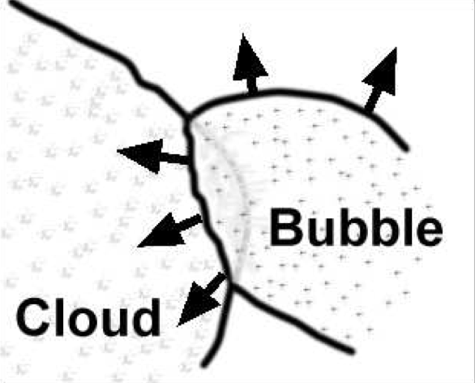
Houston Radar
Carina
Hartigan Reiter Bally & Smith 2015
25

Slide 26
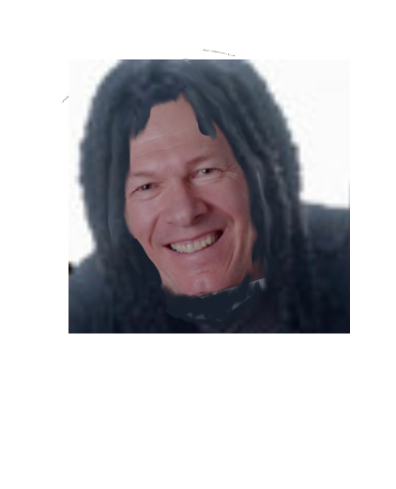
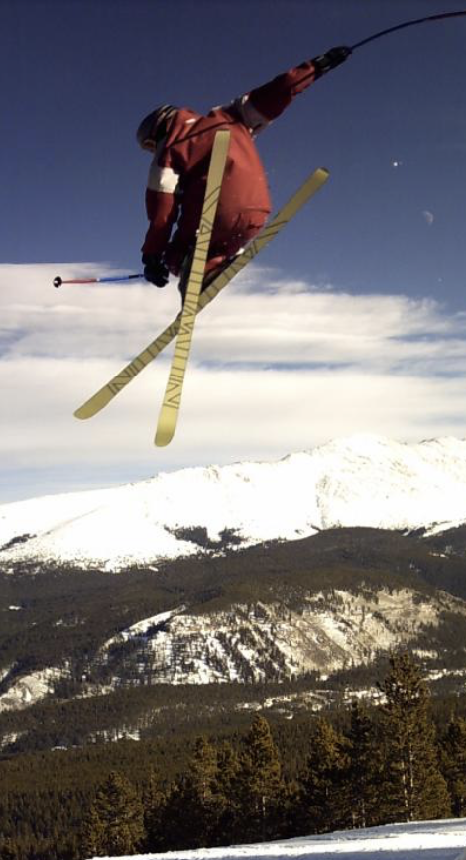
26

Slide 27
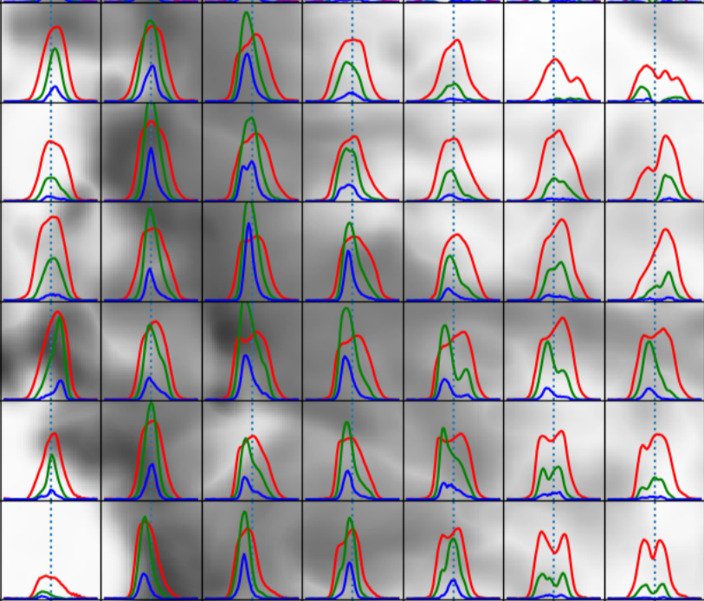
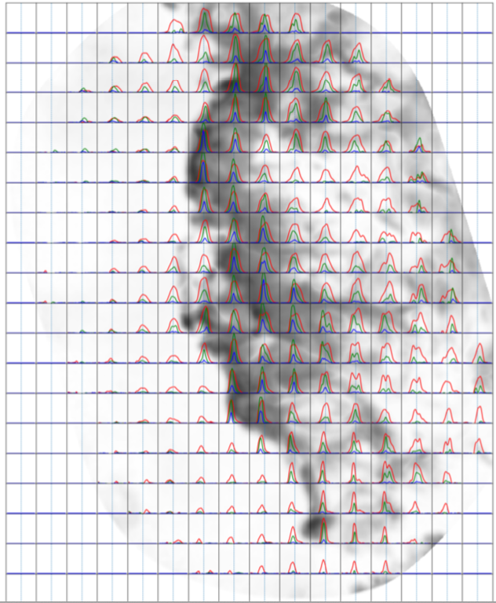
Multiple Components in the Data Cube
Resolution: 1.0”
Red: ¹²CO
Grn: ¹³CO
Blu: C¹⁸O
4”
ALMA maps of Carina’s Western Wall
27

