Slide 1
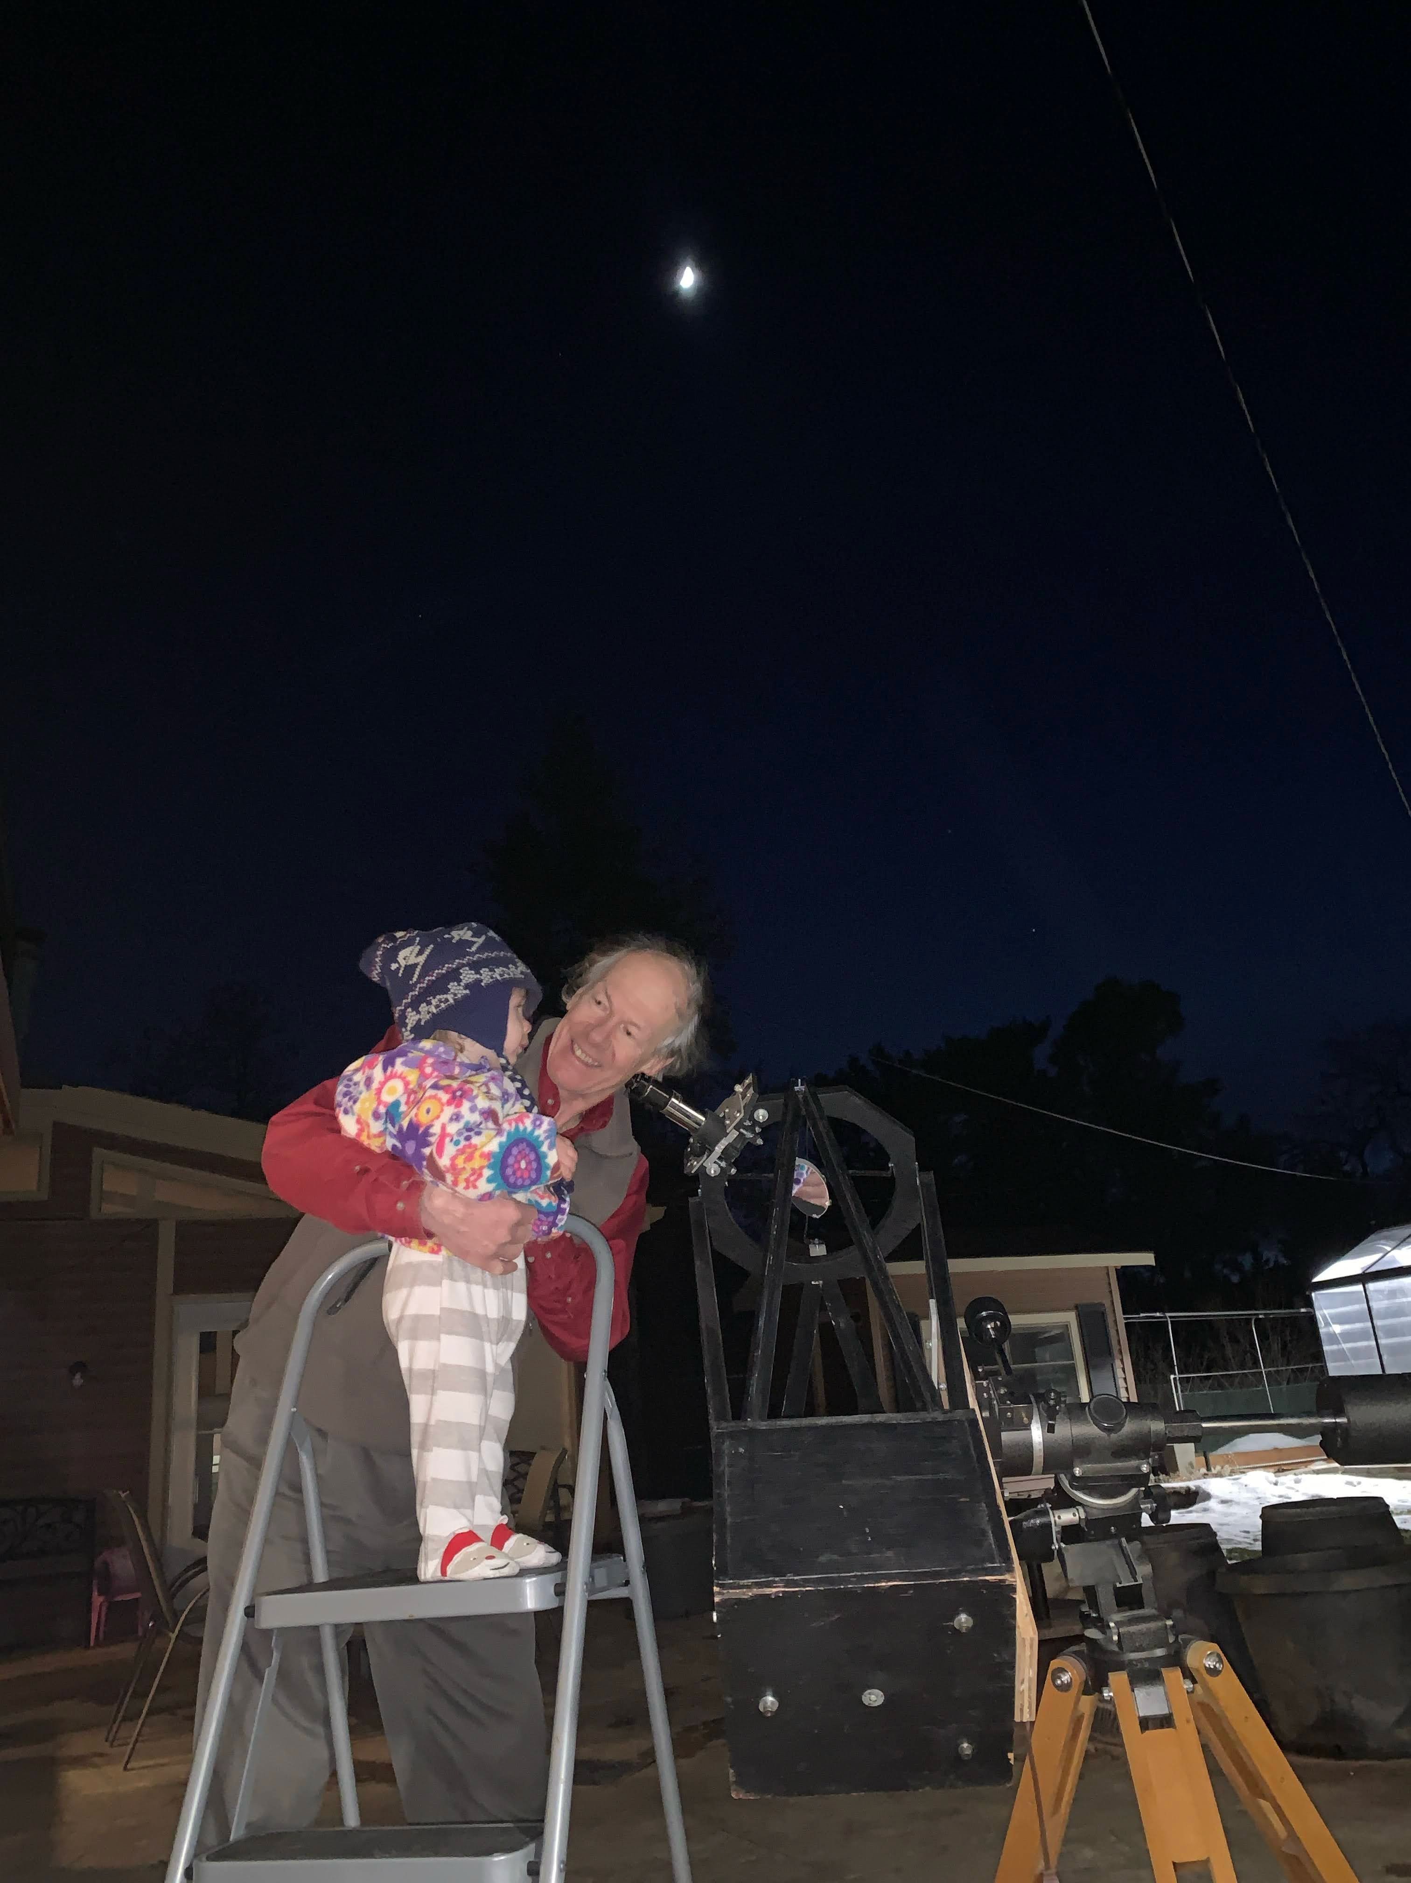
An Amateur’s View of Asteroids
Trina C.R.B. Ruhland
Community Astronomer

Slide 2
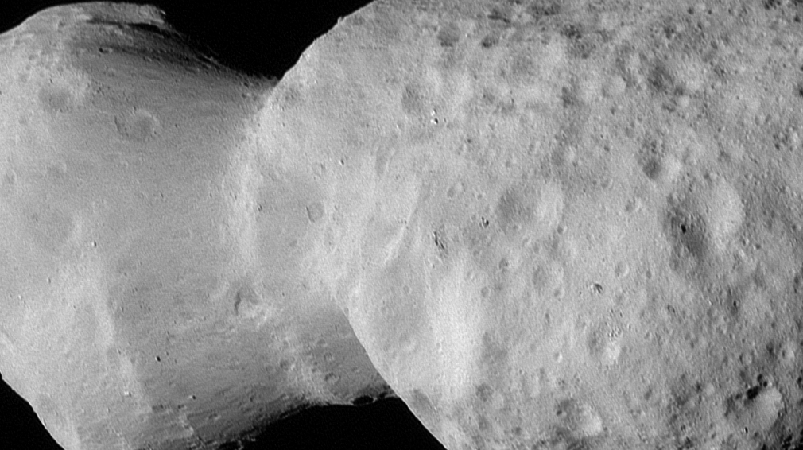
Asteroid Donald Johanson April 20, 2025 LUCY Spacecraft, NASA
Caption
Notes:
Asteroid DonaldJohanson April 20, 2025
Lucy Spacecraft, courtesy NASA
“Fossils of planet formation”.
Average diameter of 4 km
251-hour daily rotation
Carbon-rich composition
L’LORRI on the Lucy Spacecraft took this image from 660 miles away
The asteroid Donaldjohanson as seen by the Lucy Long-Range Reconnaissance Imager (L’LORRI). This is one of the most detailed images returned by NASA’s Lucy spacecraft during its flyby. This image was taken at 1:51 p.m. EDT (17:51 UTC), April 20, 2025, near closest approach, from a range of approximately 660 miles (1,100 km). The spacecraft’s closest approach distance was 600 miles (960 km), but the image shown was taken approximately 40 seconds beforehand. The image has been sharpened and processed to enhance contrast.
How a group of amateurs worked towards this picture and others like it. Will share some vignettes

Slide 3
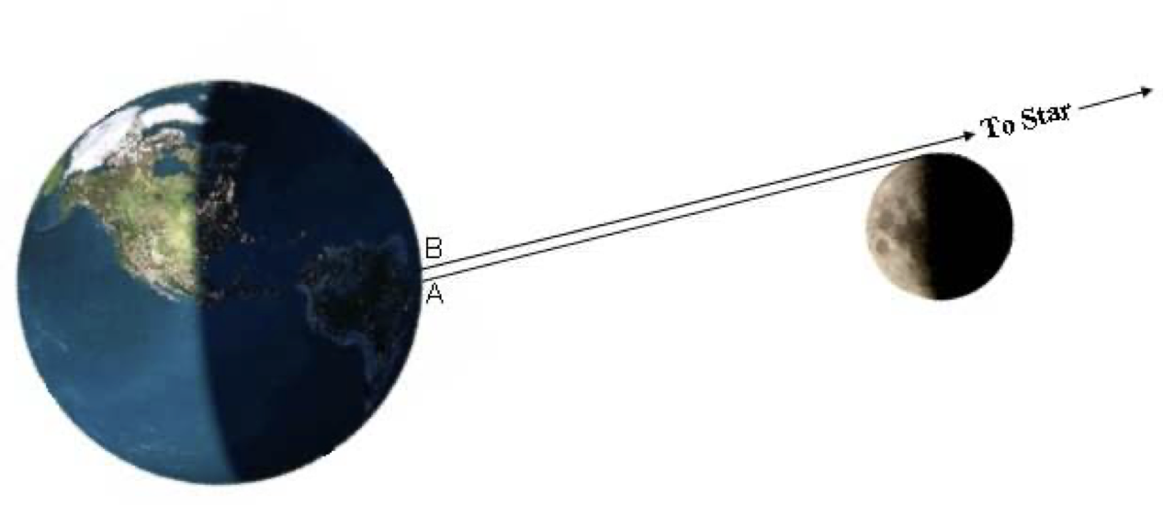
Lunar Occultation Basics
Notes:
Occultations at the most basic
Stories of Dr. Bally, I mean student John Bally doing moon occultations in California. Used hand timer and cables. Would pin down the lunar landscape for the Apollo spacecraft.

Slide 4
Notes:
Two things are very important for occultations:
When - time
Where - position on earth (longitude, latitude, elevation)

Slide 5
Science Value of Occultation
Shape of an object
Size of an object
Position of an object
Motion of object
Discover new objects (“mini moons”) (and double stars)
Composition
Whether an object has an atmosphere

Slide 6
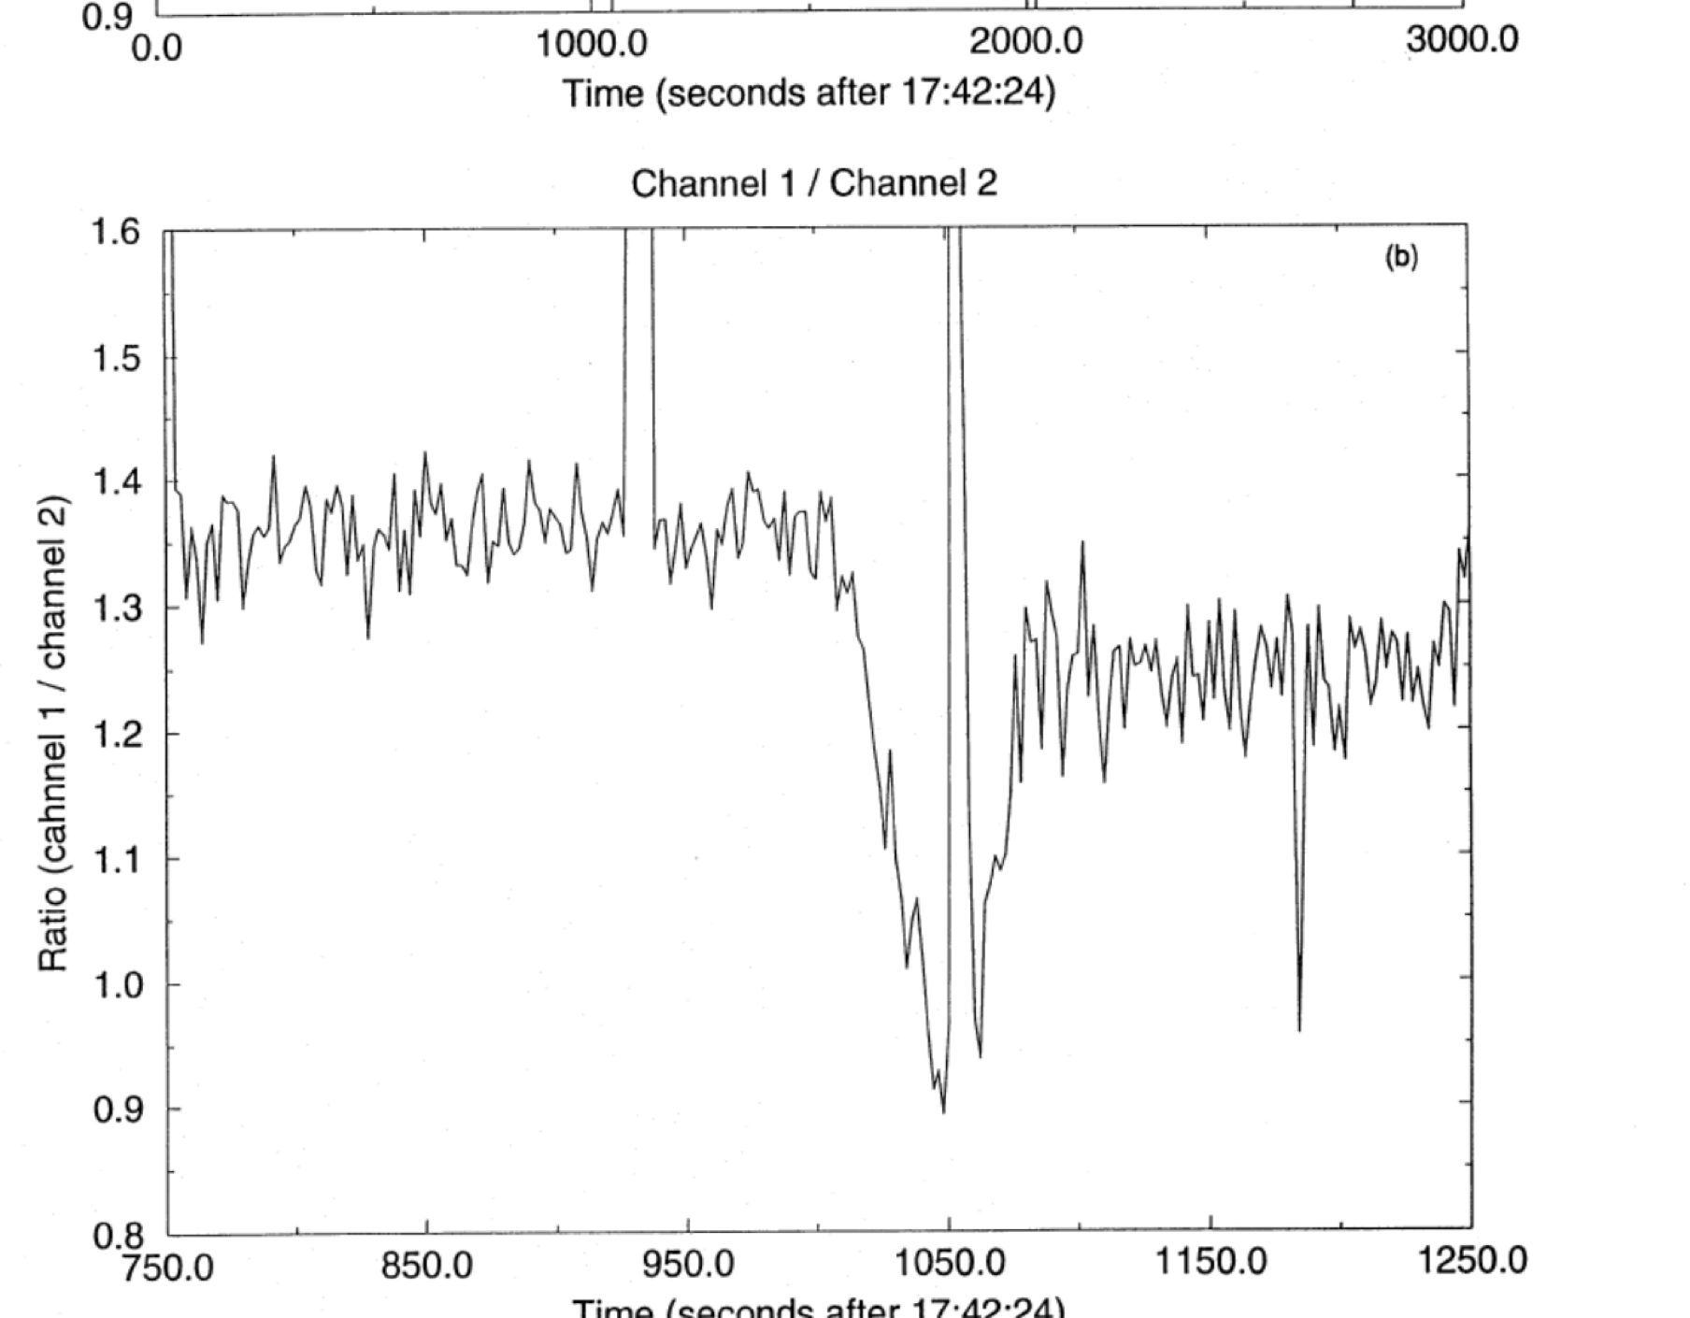
1980s: occultations Pluto has an atmosphere
Brosch et. al, The 1985 Stellar Occultation by Pluto
Notes:
In 1985 astronomers used an occultation technique to discover that Pluto had an atmosphere. Wise Observatory in Tel Aviv
Estimating surface temperature and radius of Pluto, able to determine the mean molecular weight. Scientists proposed it was Nitrogen.
Astronomers observed several occultations of Pluto and Charon in the 1980s in an attempt to learn about the existence of and composition of their atmosphere
In 2001 NASA approved the New Horizons Space Mission
In 2002 scientists discovered that over a 14 year period Pluto’s atmosphere had doubled in size

Slide 7
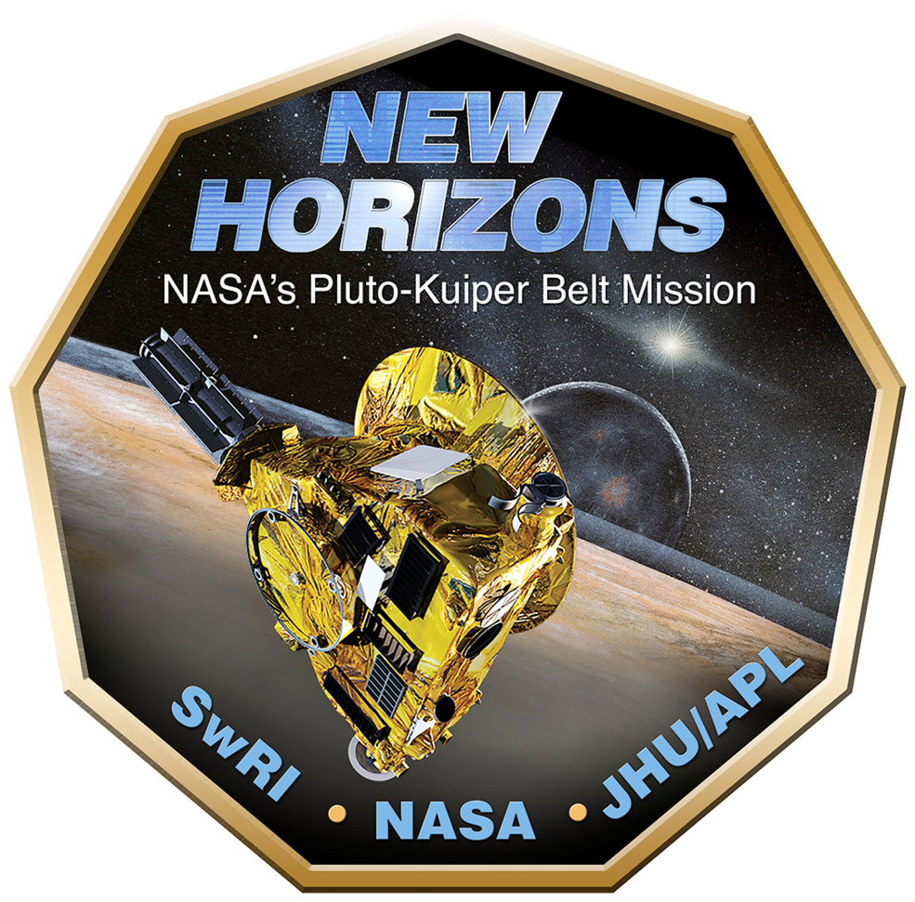
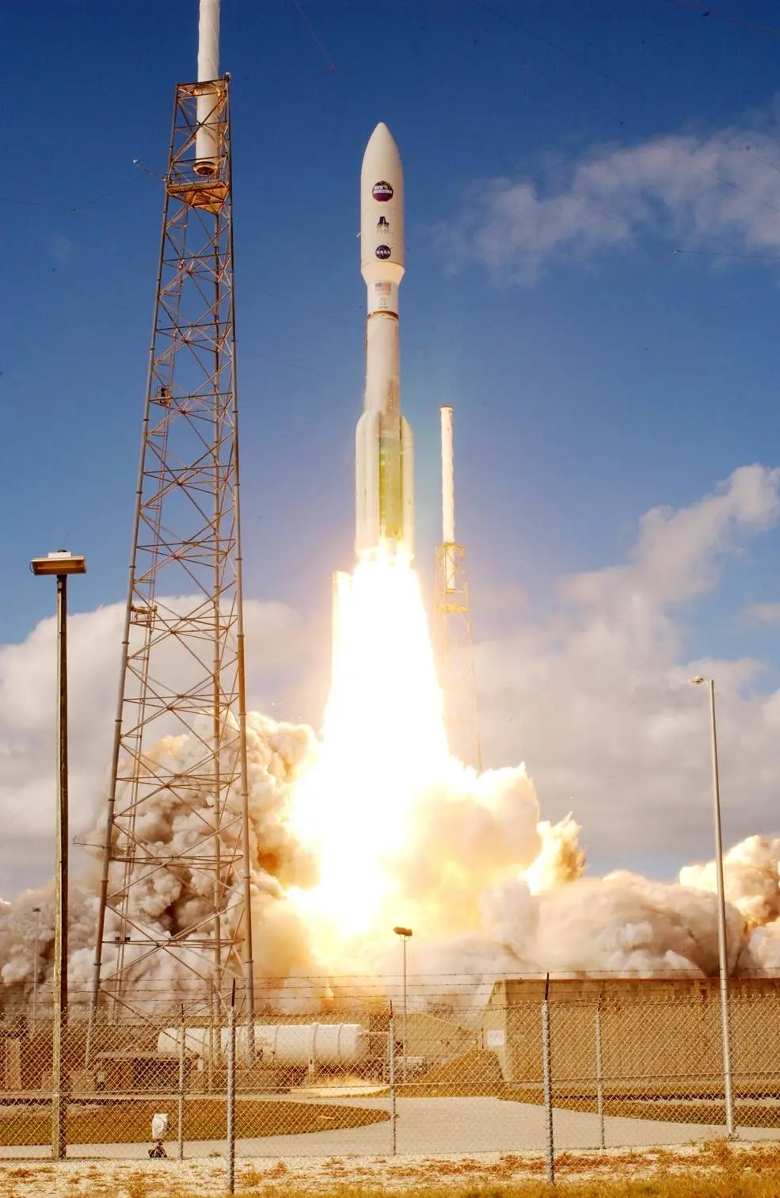
Notes:
2001 New Horizons Space Mission. Plan to go to Pluto and its moon, Charon.
Coincidentally, Pluto’s orbit taking it into the plane of the Milky Way as seen from earth.
A lot of more opportunities for Pluto to pass in front of stars.
2003 I entered college and, like any good mathematics and physics major, sought a summer job that paid.
2006 launch of the New Horizons spacecraft

Slide 8
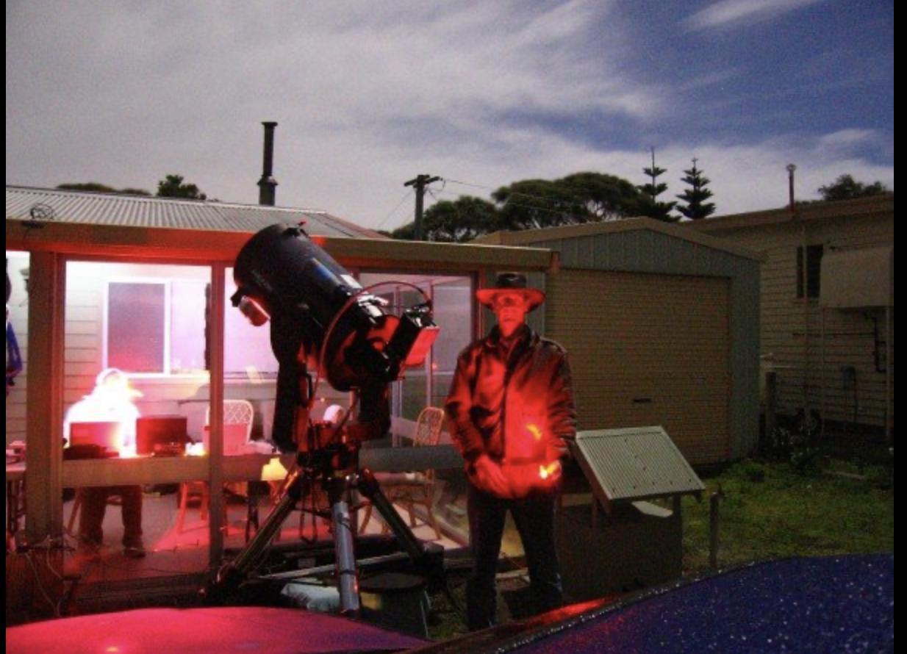
New Horizons
Pluto occultation
2007, Tasmania, AUS
Notes:
2007 - Pluto Occultation observed from Tasmania
Portable 14-inch Meade LX-200 telescope. “In case of bad weather”. Ended up being useful because we had a lot of clouds.
Observed from Musselroe Bay, Tasmania. We consulted with the New Zealand Weather service to locate the place with best probability for clear weather
Used a subframe of the entire frame
No filters
This maximizes speed of the readout
Recorded the first central-flash occultation by Pluto. Only get a central flash when there’s an atmosphere.
Radius of Pluto is 1150 meters (ish)

Slide 9
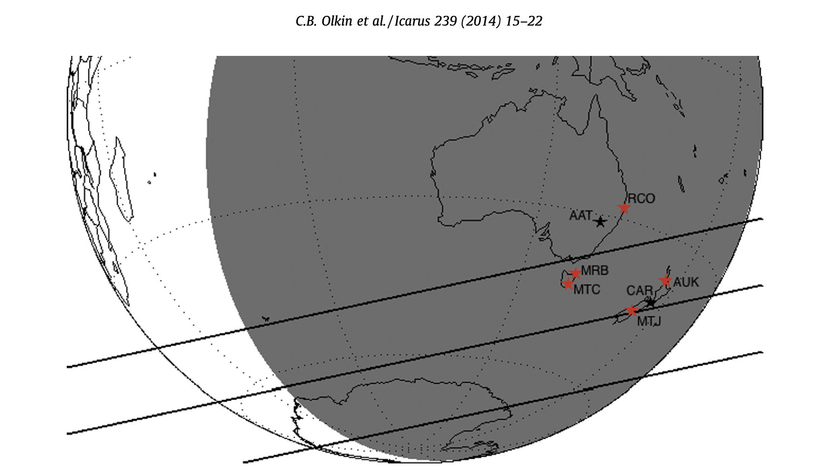
Notes:
2014 Paper about Pluto’s atmosphere.
Shows the locations of observatories for the 2007 occultation of Pluto by UCAC star P452

Slide 10
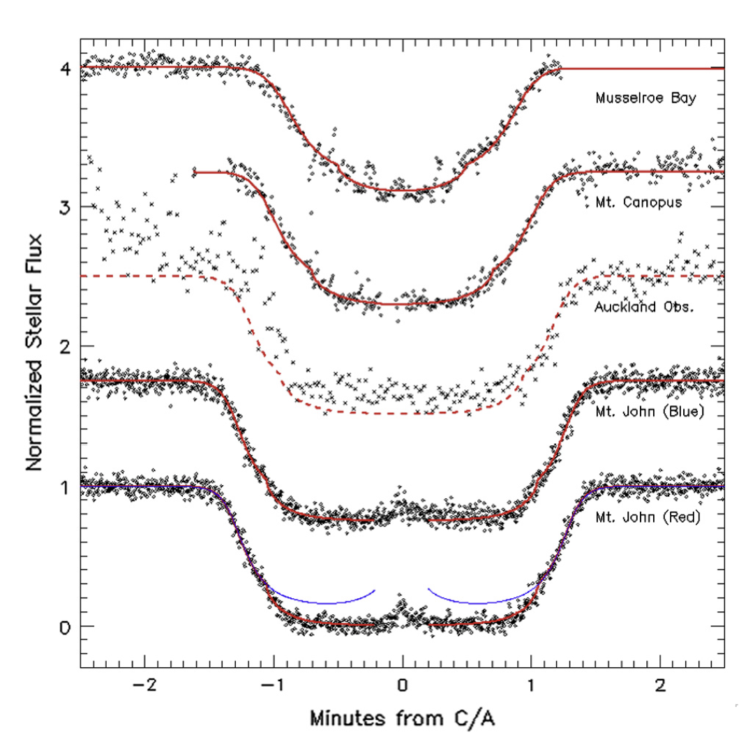
Data:
2007 Pluto Occultation

Slide 11
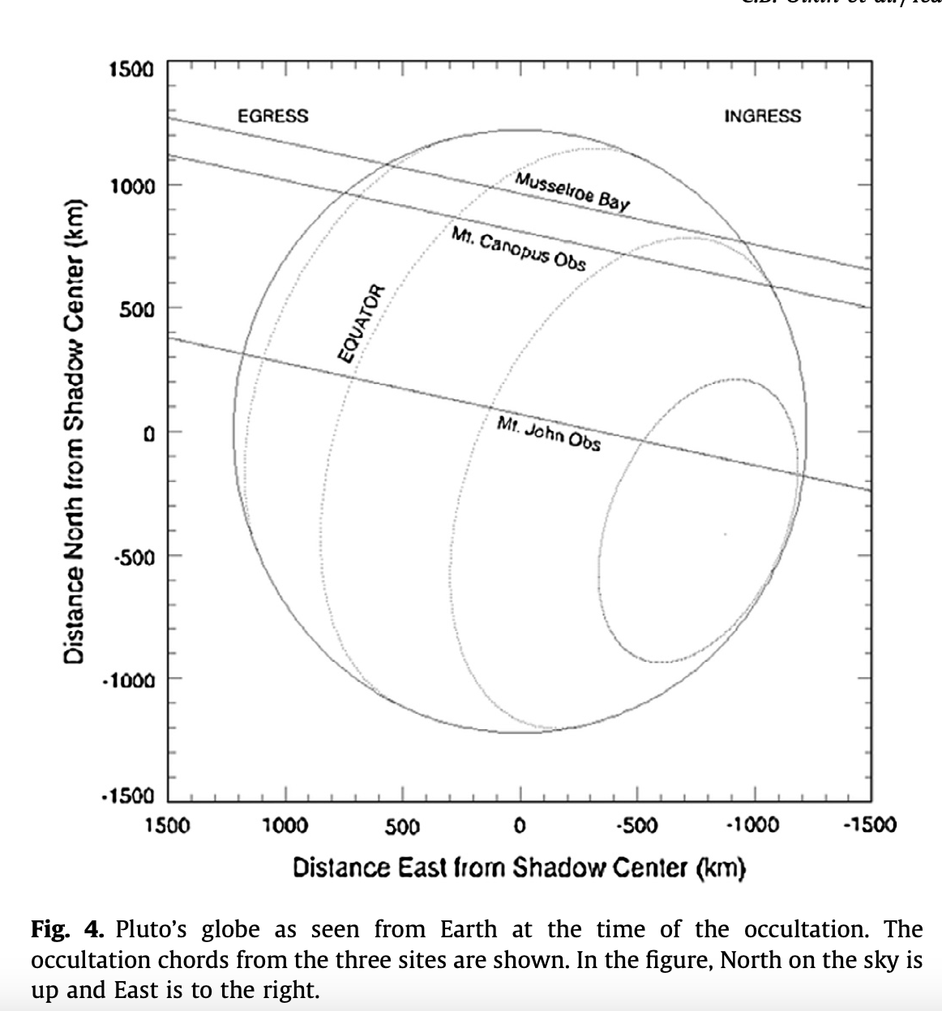
C.B. Olkin et al. (2014)
Pluto’s Globe as seen from Earth
Notes:
C.B. Olkin et al., Icarus 239 (2014) 15-22
Pluto’s globe as seen from earth

Slide 12
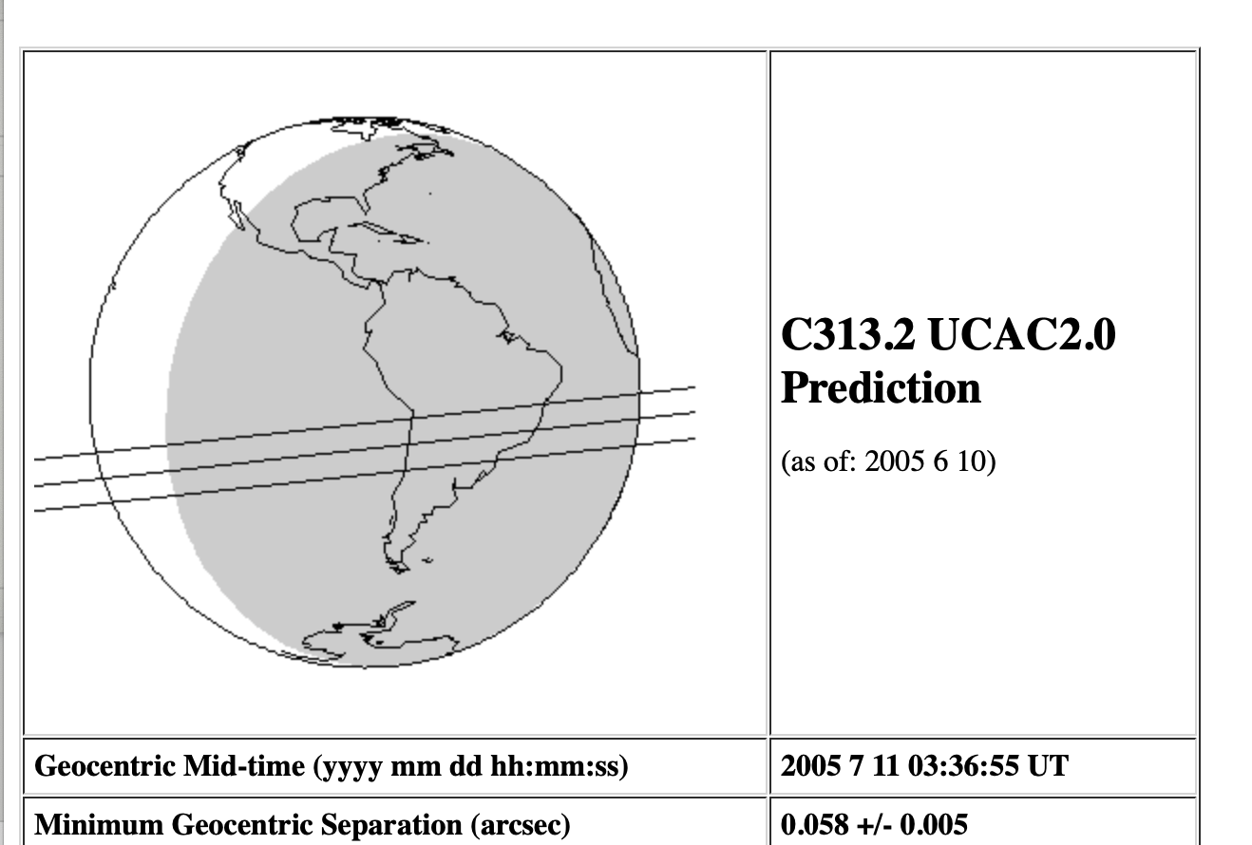
Charon Occultation prediction
Notes:
Prediction for the 2005 July 11 Charon occultation by C313.2 across South America
3 separate research groups went after this one. Goal was to constrain the atmosphere and get more detail about the shape and size in order to figure out Charon’s density.
8 total observation sites

Slide 13
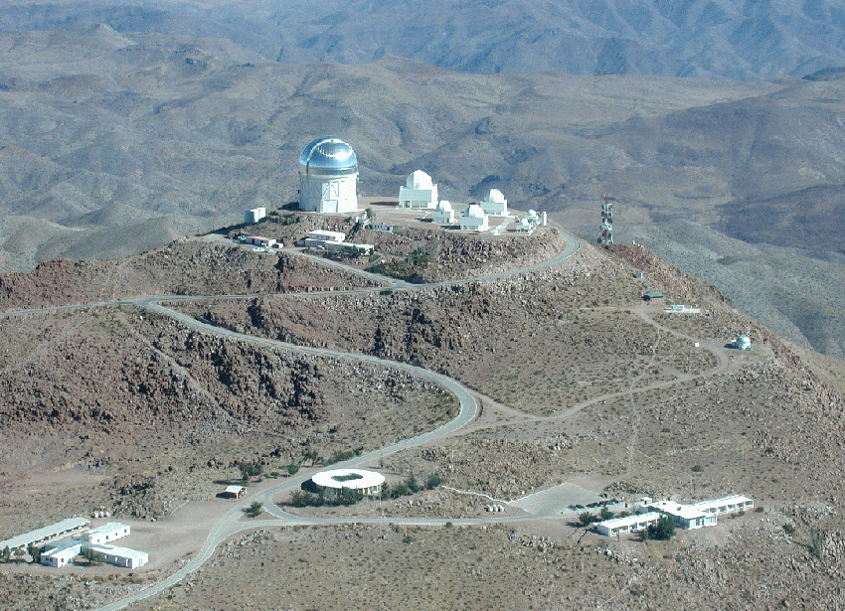
Getting Creative: Cerro Tololo Charon Occultation
Photograph: NOAO/AURA/NS
Notes:
July 11, 2005.
CTIO telescope in La Serene, Chile
4 meter Cerro Blanco telescope
Charon occultation - looking at the atmosphere.
One of 8 major telescopes looking at Charon
Trying to figure out Charon’s density. The biggest uncertainty at the time was the radius. This observation was meant to constrain Charon’s radius

Slide 14
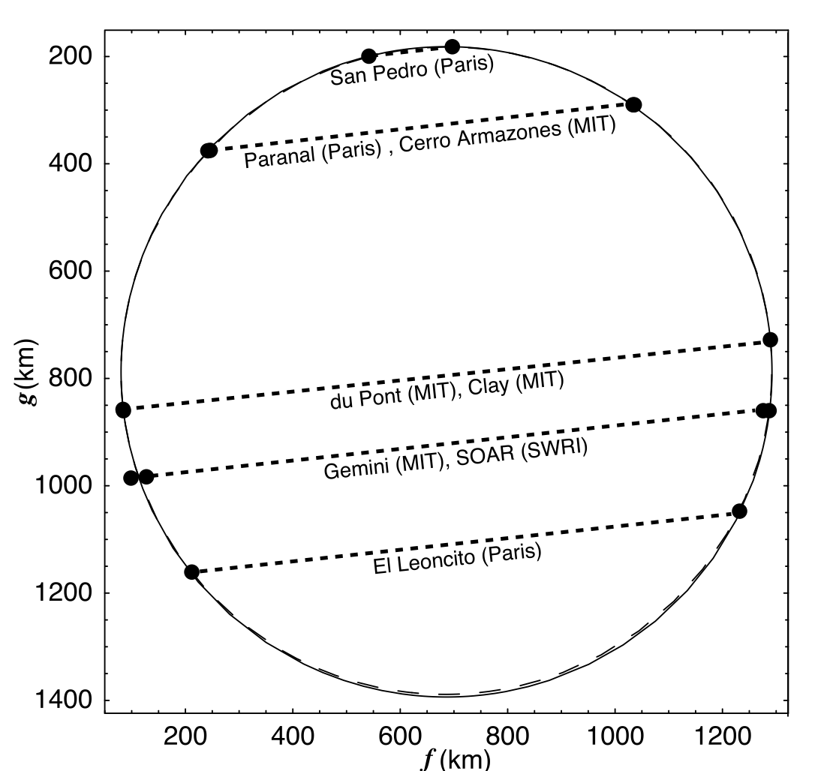
Notes:
Results from the 2005 occultation
Constrained Charon’s atmosphere which allowed scientists to figure out the density
Results: no atmosphere, unlike Pluto
The Astronomical Journal, 132:1575Y1580, 2006 October

Slide 15
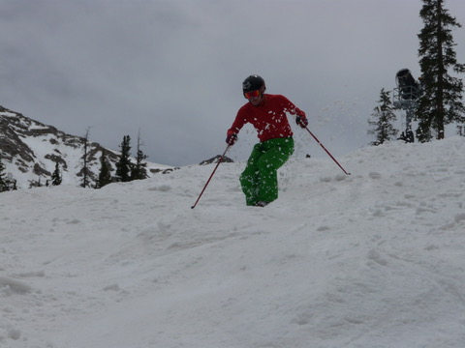
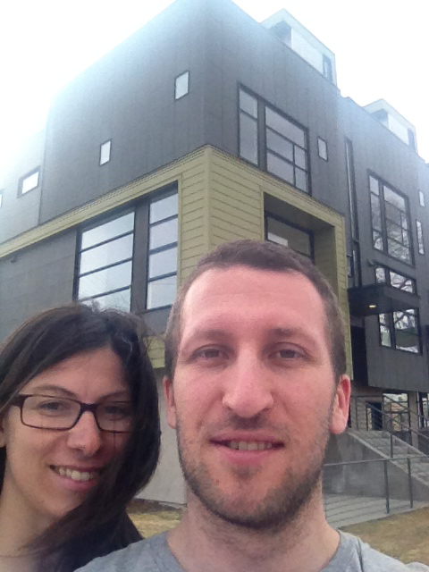
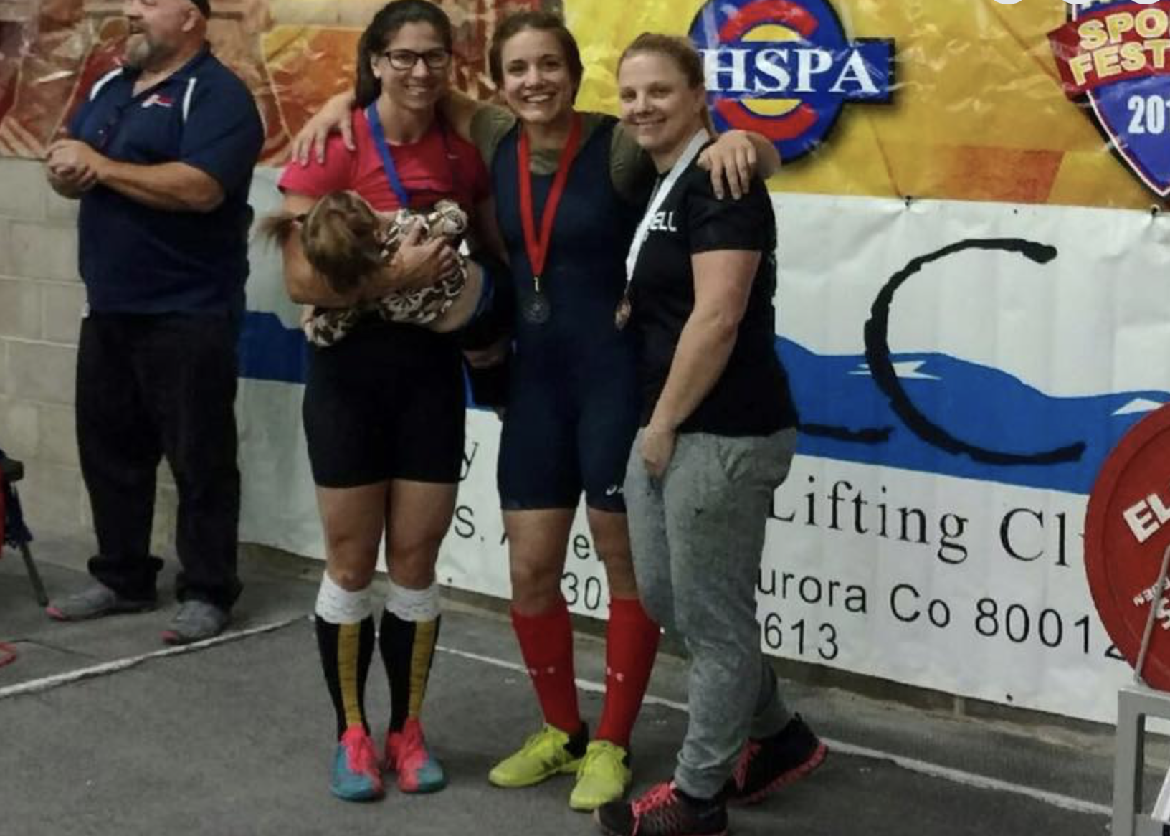
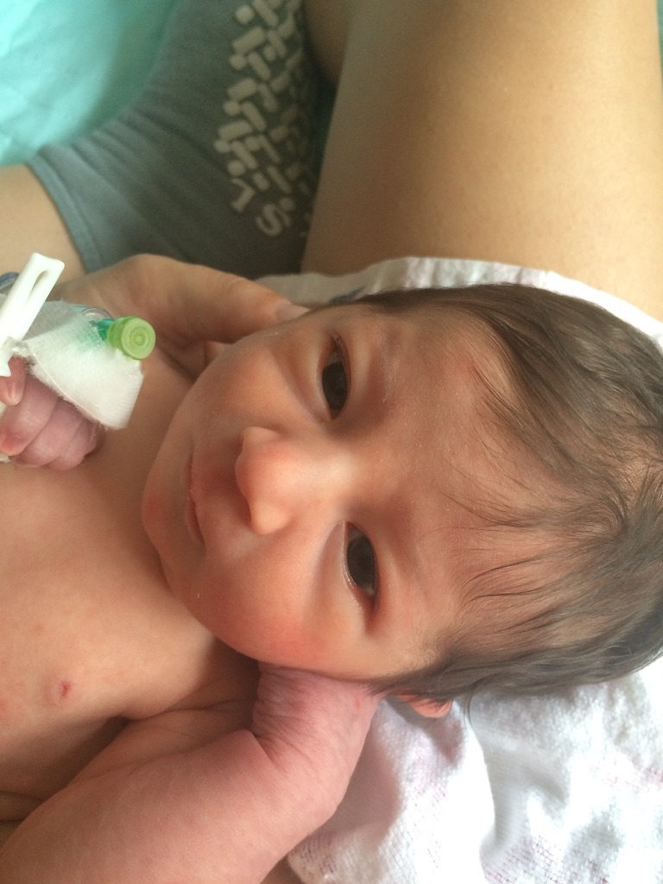
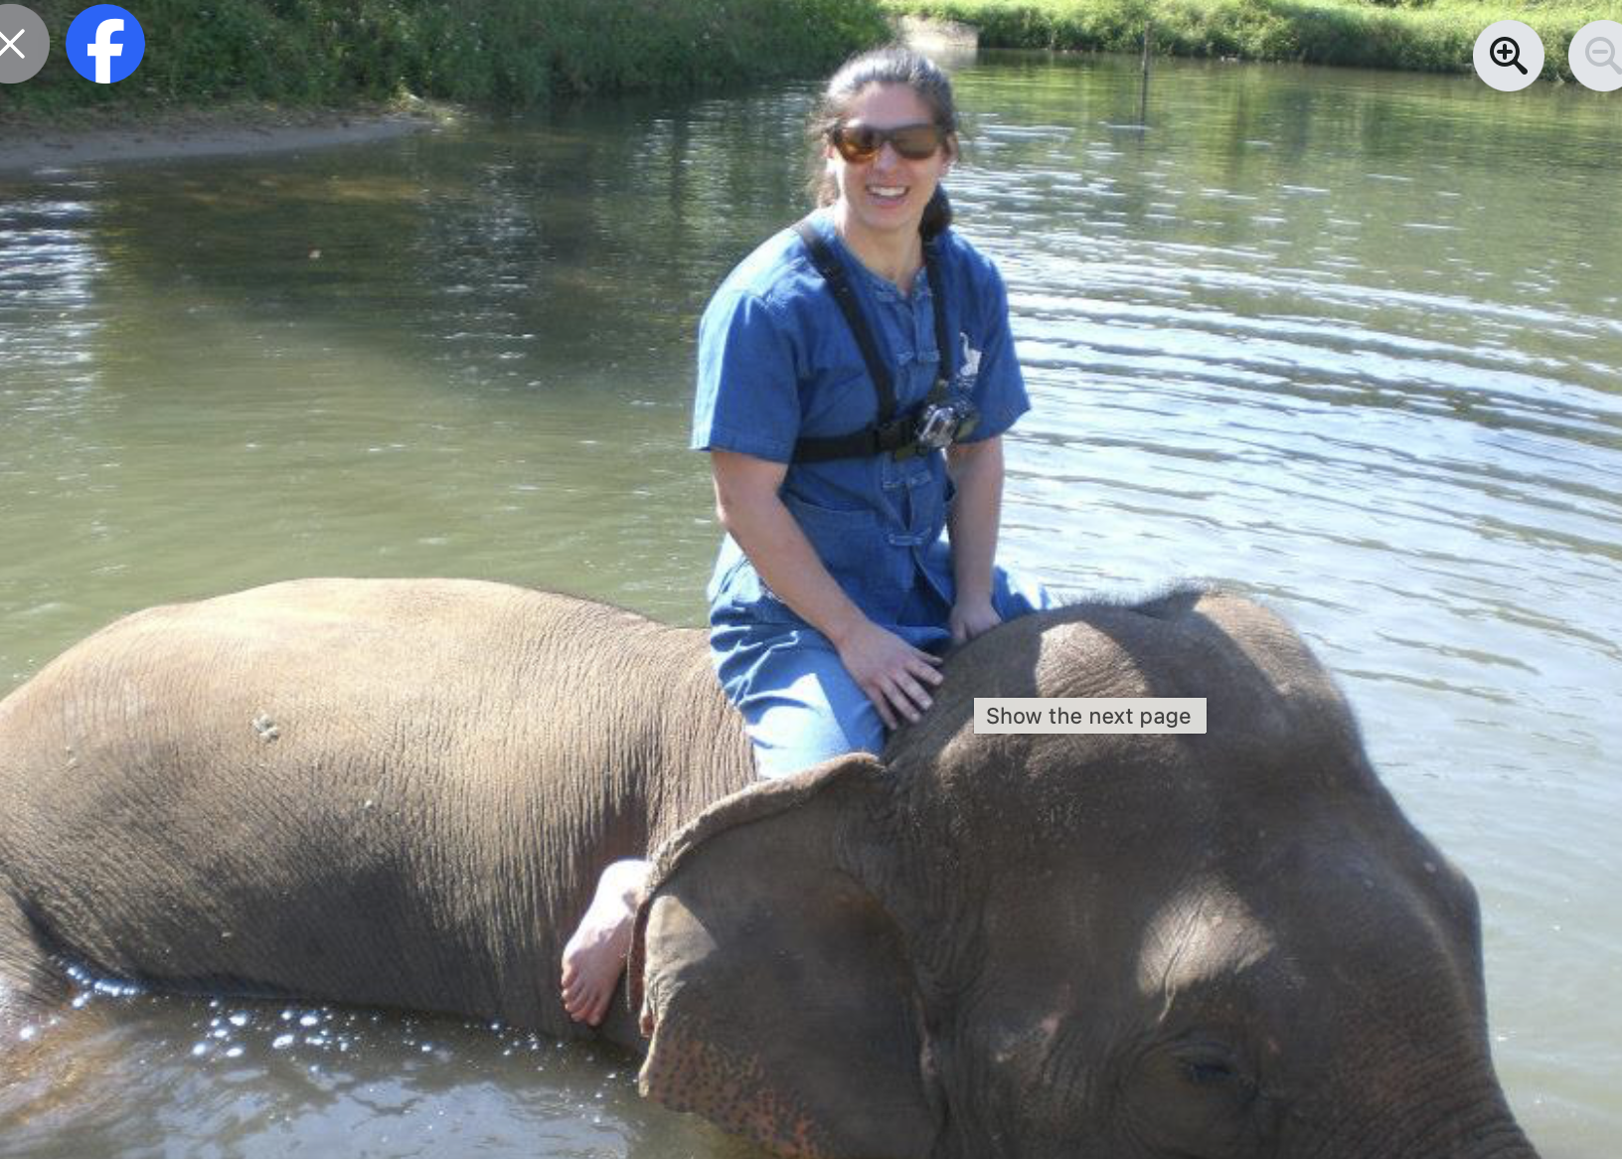
Notes:
A whole lot of life happens
10 years, actually.
2017 I get a phone call

Slide 16
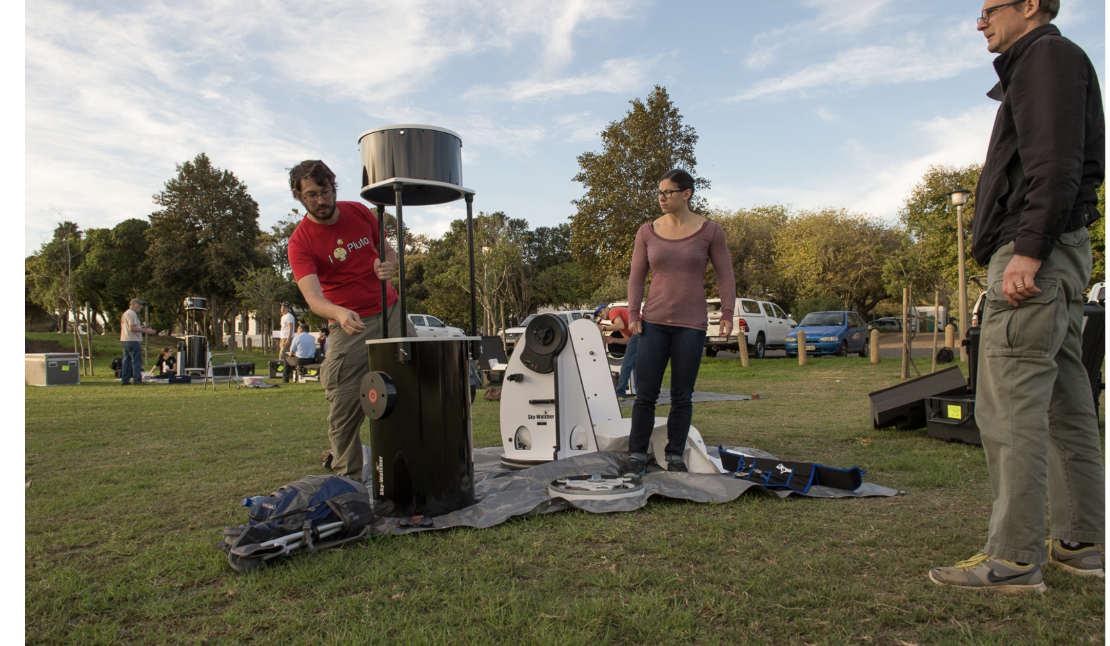
South Africa 2017, New Horizons extended mission
Notes:
New Horizons was still out there
It had already flown by Pluto in 2015
Now they were looking at an extended mission ‘
South Africa June 3, 2017
Asteroid had only been discovered in 2014
Potential target for New Horizons extended mission
Needed to see if there’s any debris around it that would destroy the spacecraft
Brought 5000 pounds of telescope.
Skywatcher 16 inch telescope

Slide 17
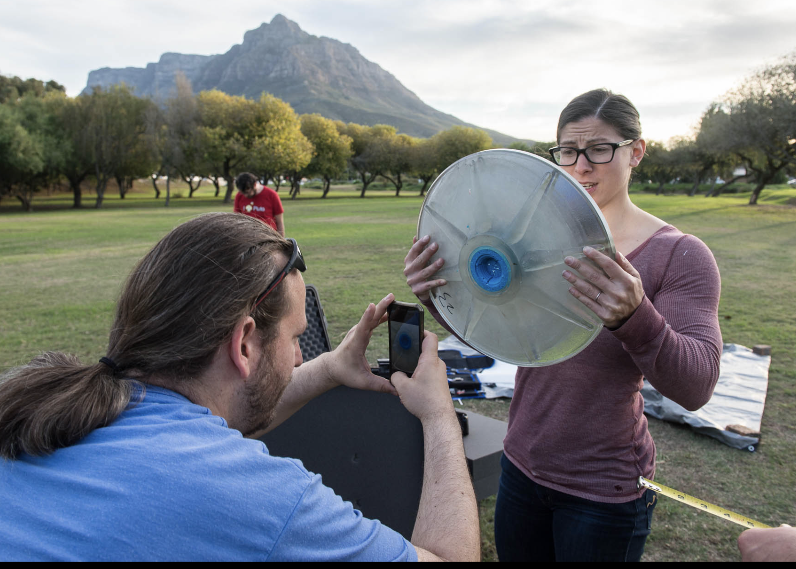
Primary mirror came off
Notes:
And this one piece was broken.
Field work fixing a broken mirror

Slide 18
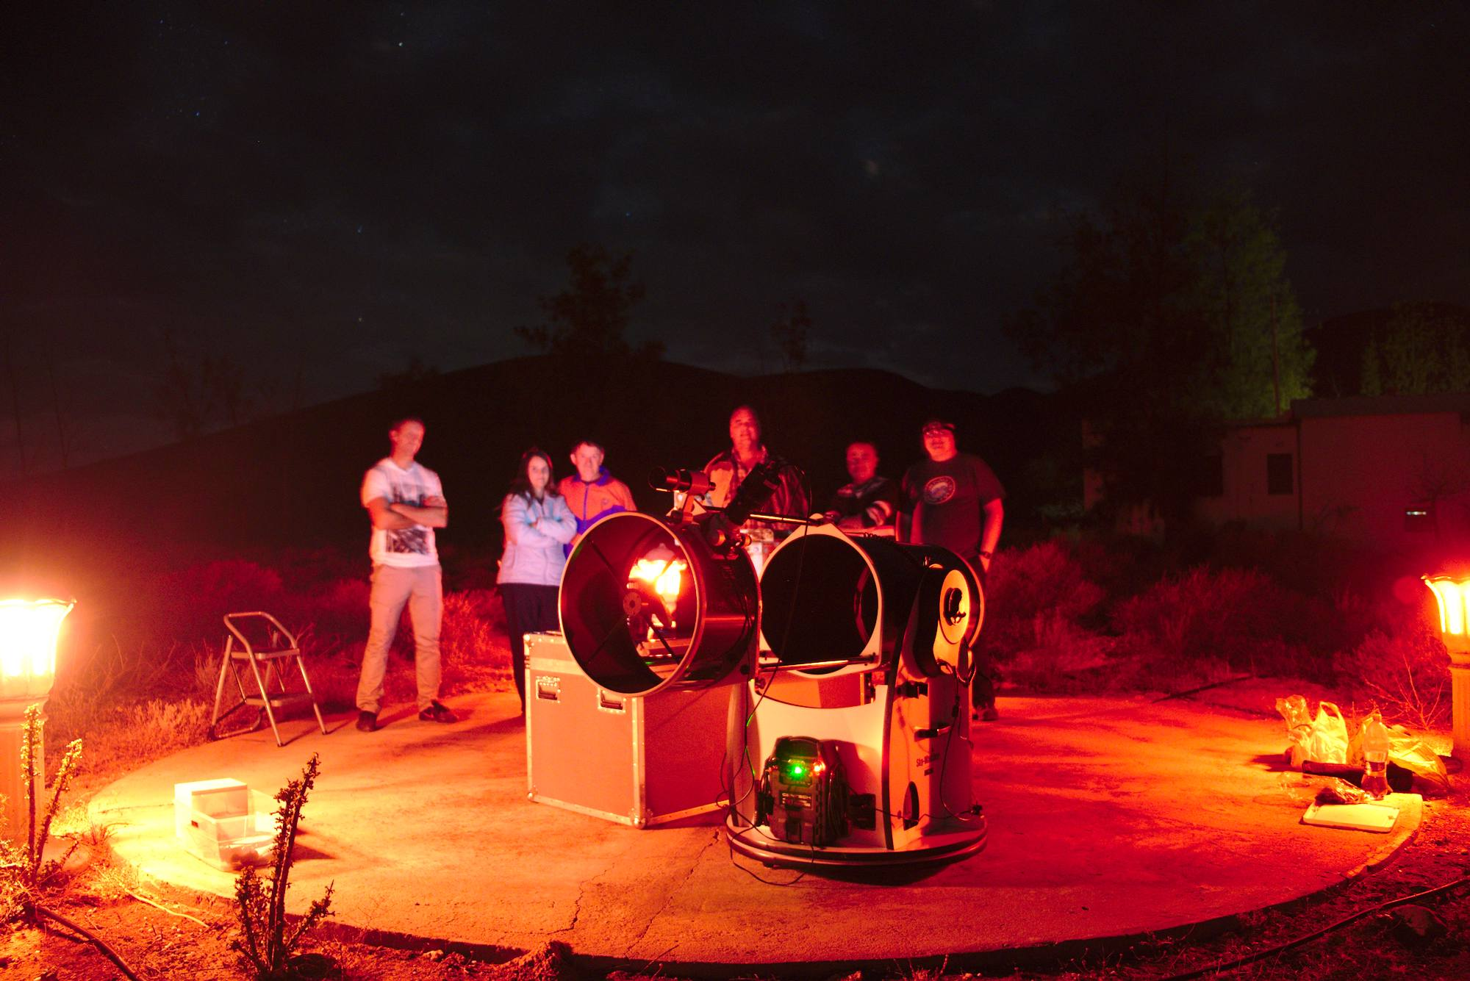

Slide 19
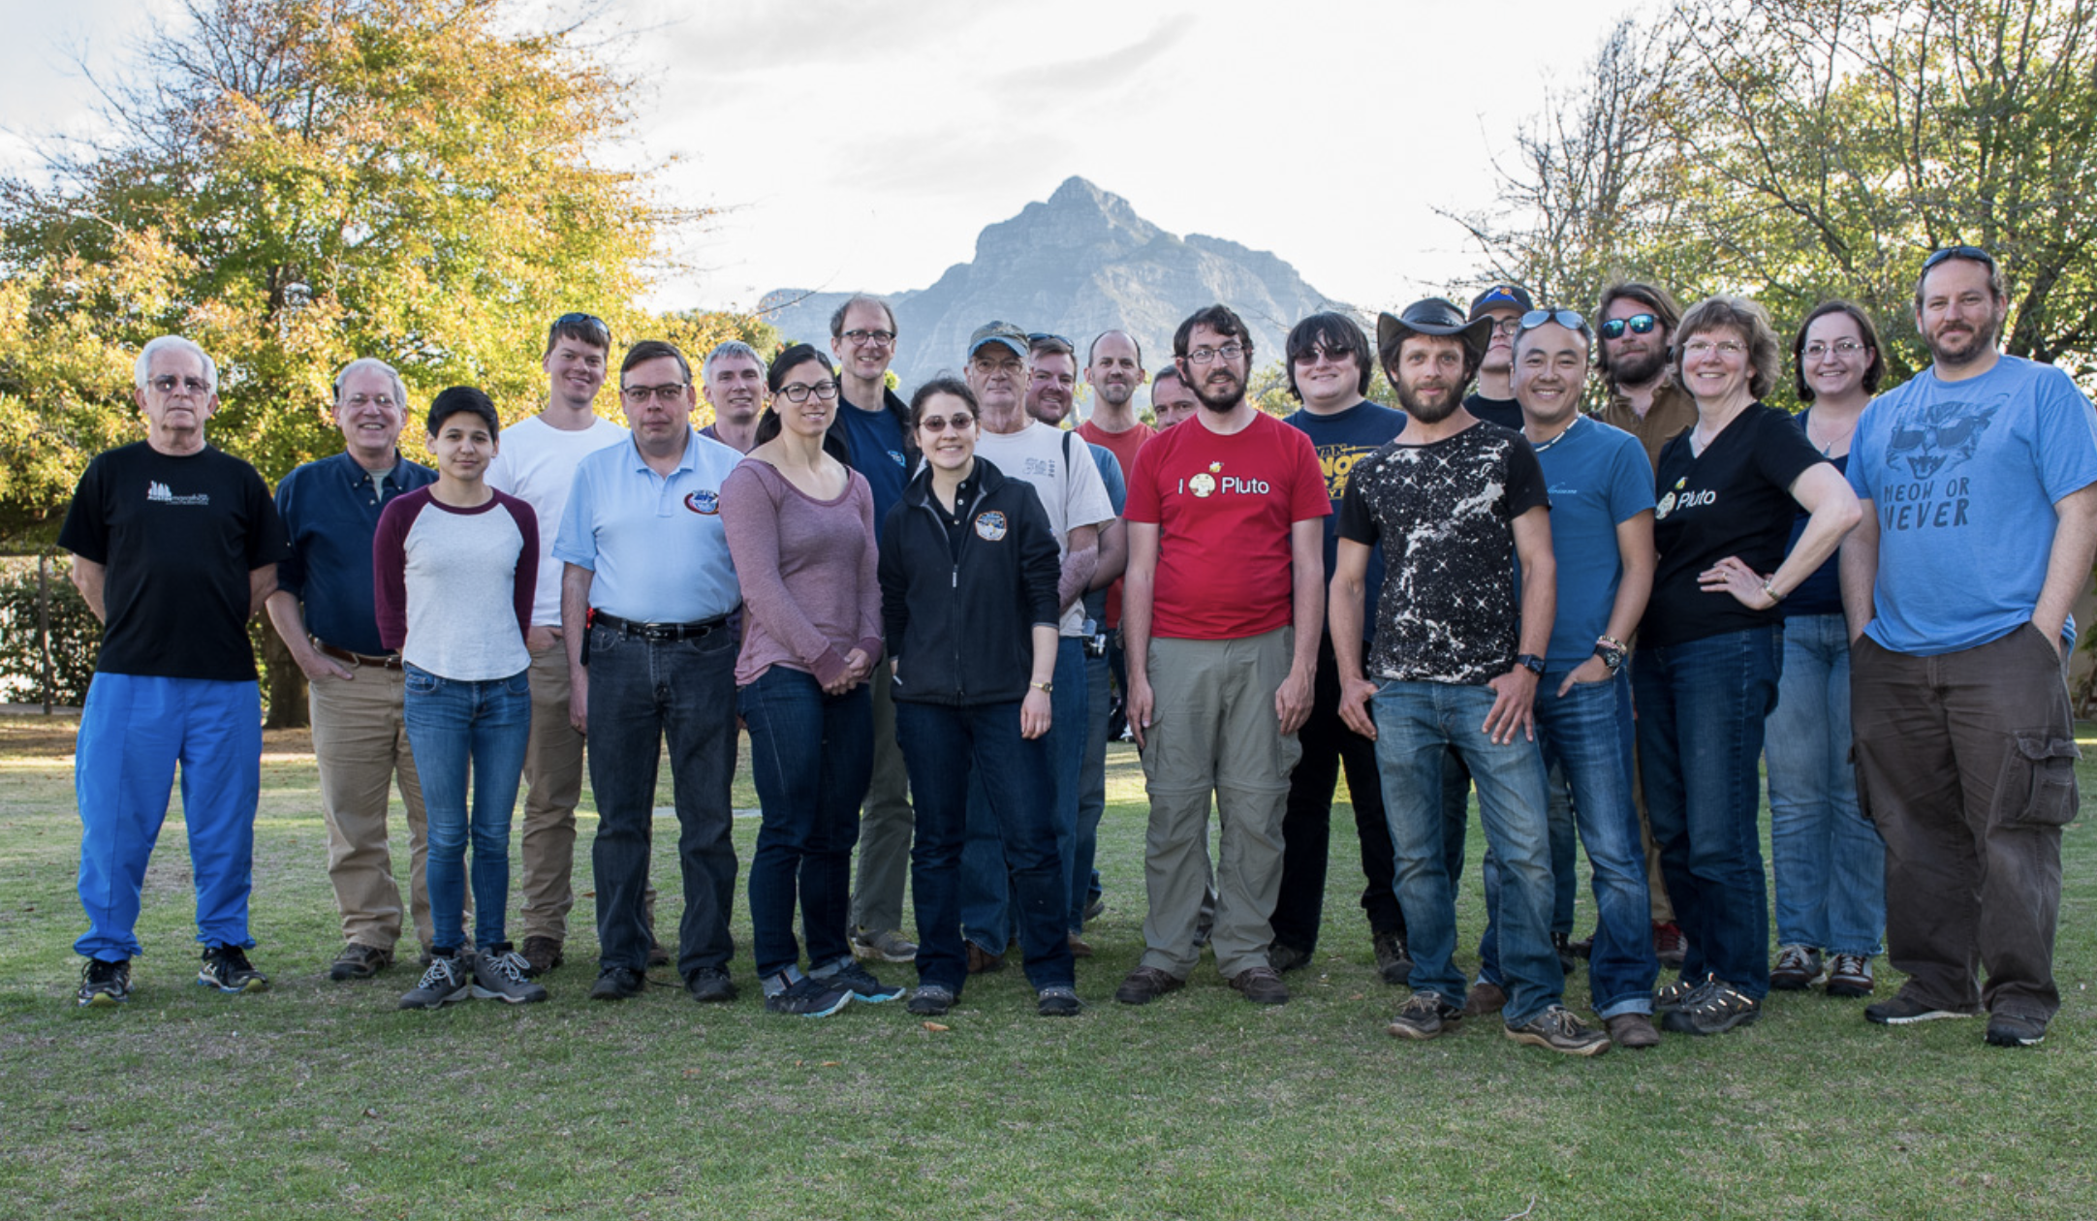
South Africa MU69 2017
Notes:
Cape Town, South Africa 2017
13 teams to Cape Town
12 to Mendoza, Argentina
MU69 is 10,000 times fainter than Pluto. Observations are HARD. Hubble can barely detect it.
Needed to know how bright the surface is. Can tell this by the size — we had barely any constraints on size. Could have been as large as 40KM across. If it was very bright, it could be very small which also could pose a problem
Had a miss for this event. Still scientifically valuable because knew where MU69 was not

Slide 20
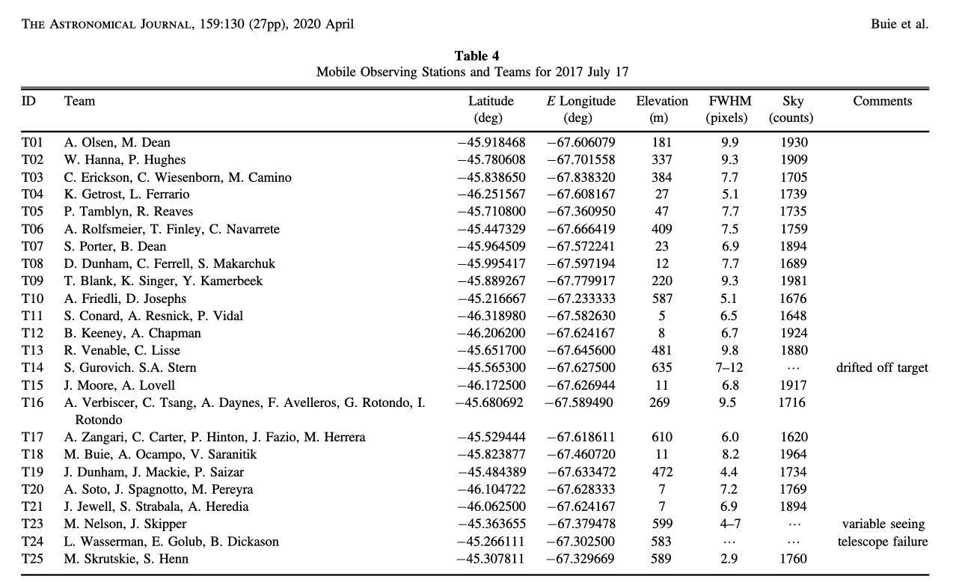
Notes:
Second event that summer July 17 2017.
Called it the “Summer of MU69”
Second event (I was unable to participate) got some positive chords

Slide 21
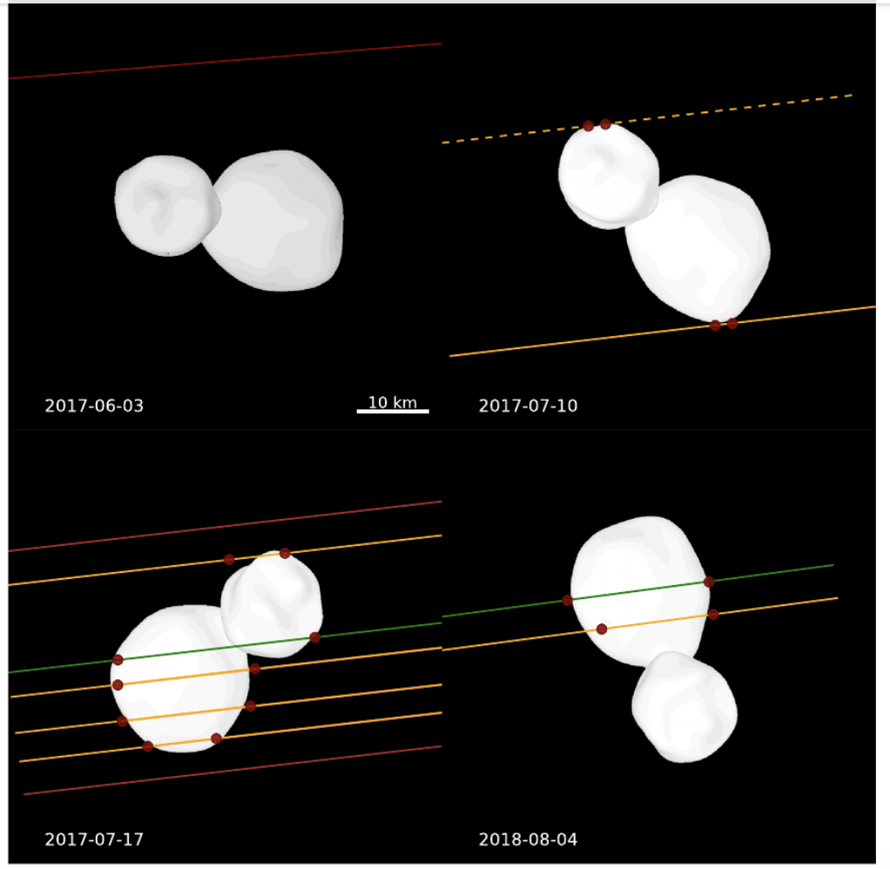
Notes:
4 occultations. 2017 “Summer of MU69”
Constrained the data and named Arrokoth for New Horizon’s extended mission
Contact binary

Slide 22
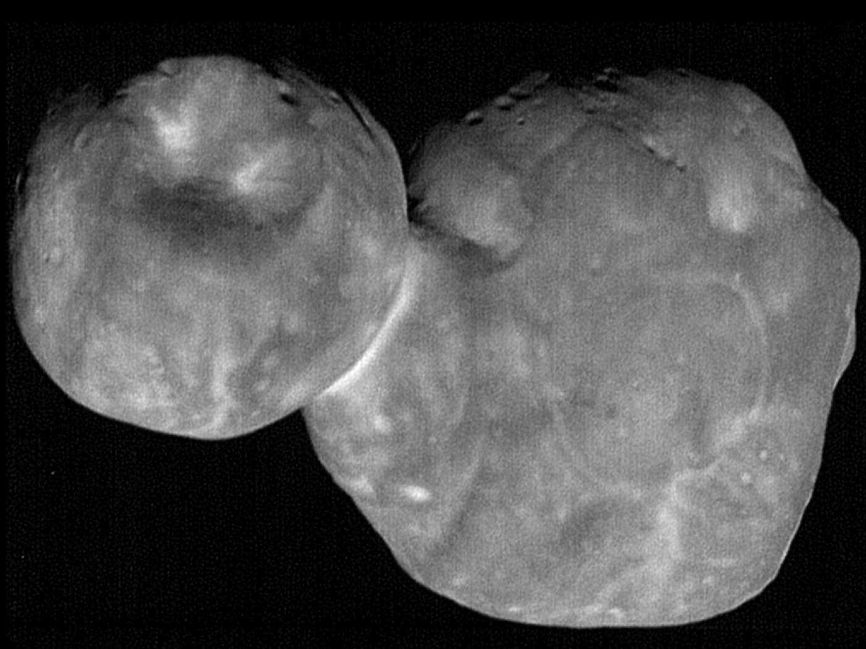
Notes:
Arrokoth: most distant and primitive object ever explored. 22 miles long, 12 miles wide
New Horizons flyby January 1, 2019. Image taken from about 4000 miles away. 4.1 billion miles from the sun. 110 feet per pixel
“Stretch mission” and it worked
New Horizons 32,000 miles per hour
33 degrees from its direction of travel
“Well-preserved” sample of the solar system’s birth.

Slide 23
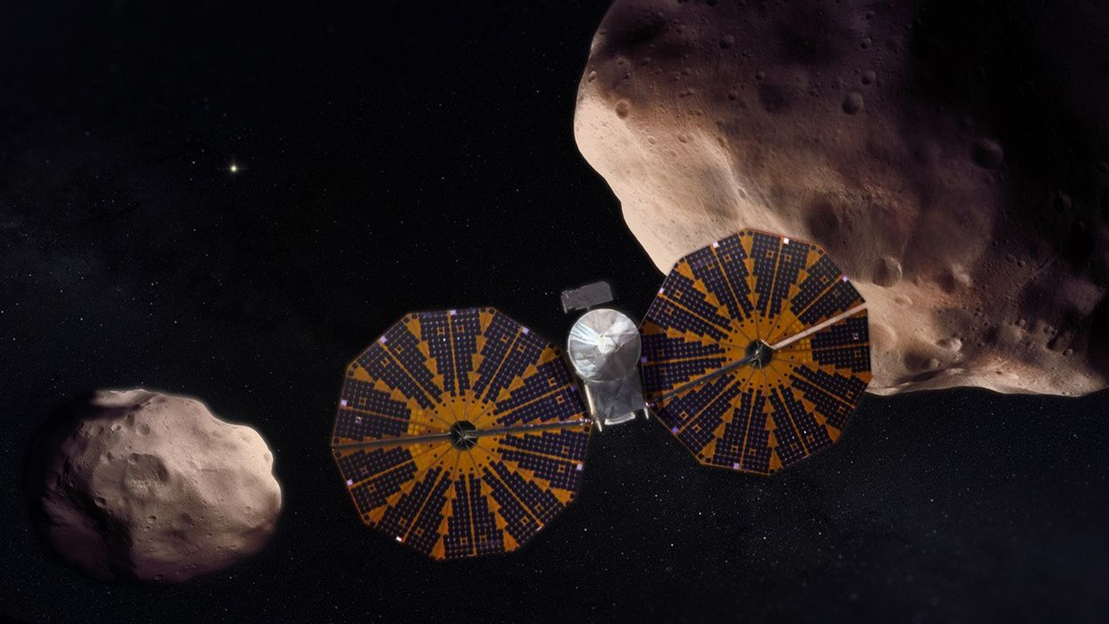
Lucy Mission to Trojan Asteroids
Notes:
Lucy
Occultation work began in 2017 to observe the Trojan asteroids in the La Grange points L4 and L5 of Jupiter’s orbit
Asteroids came from the outermost solar system
Thought to be fossil remnants of the birth of the solar system
Dinkinish (1st one)
DonaldJohanson
Eurybates and its satellite
Polymele and its satellite (discovered by occultation)
Leucus
Orus
Patroclus and Menoetius

Slide 24
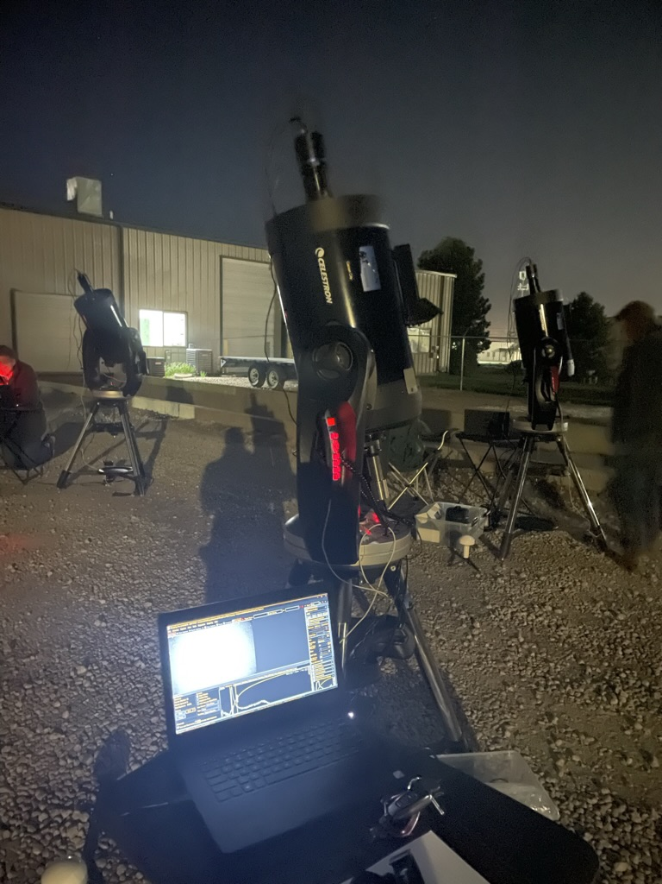
Notes:
Because Time and Place is so important
Equipment: can be very basic
Way to have accurate recording of your place
Accurate recording of time

Slide 25
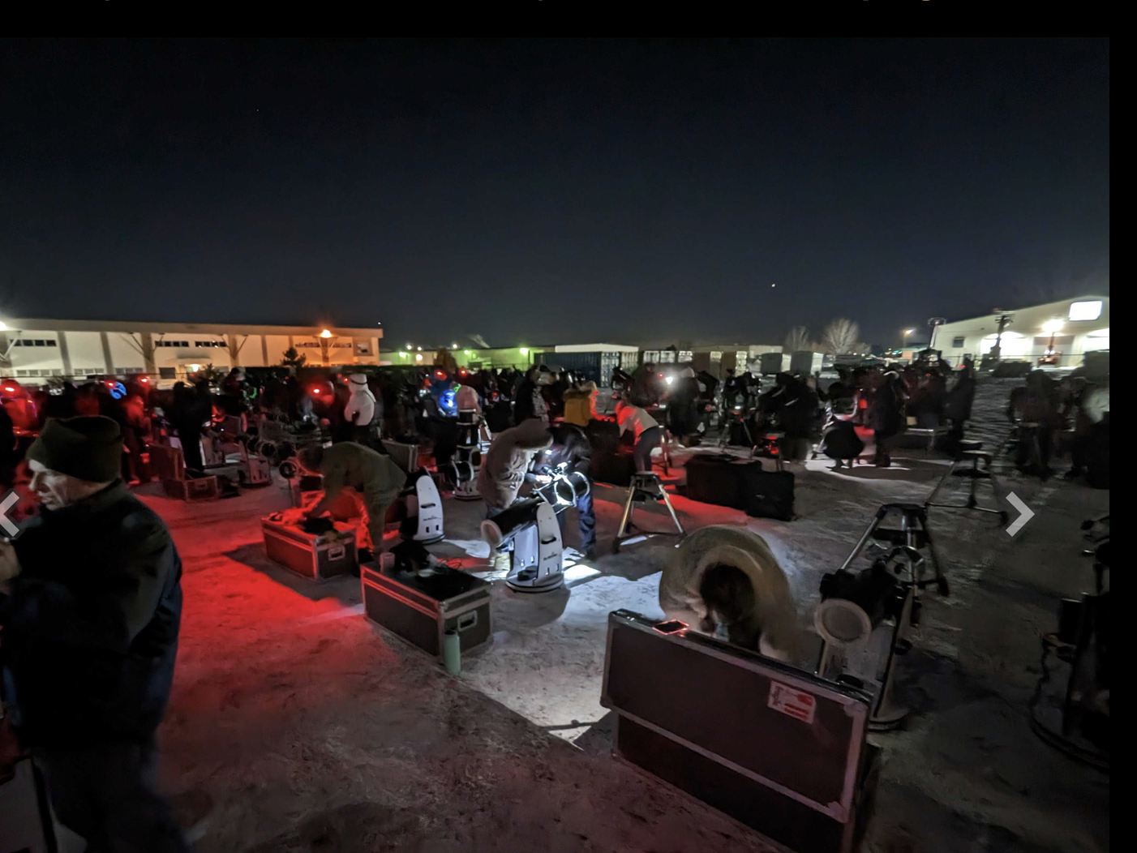
LUCY mission occultation practice
Celestron telescopes
Notes:
Lucy telescopes set up outside of Longmont, CO

Slide 26
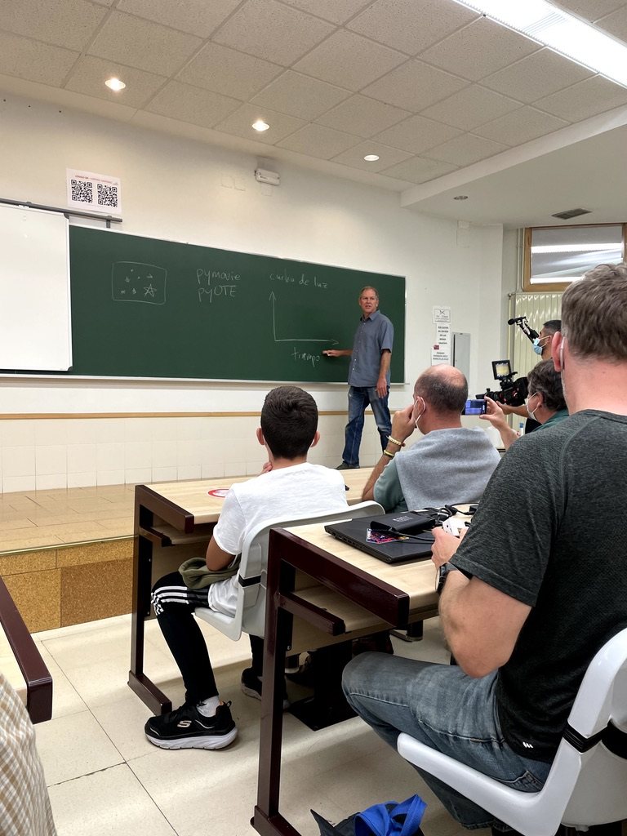
Espana 2021
Polymele Occultation
Notes:
John Keller in Leon, Spain, teaching a group of local astronomers and the sponsoring Lucy mission group about occultations and how to analyze their data.
This occultation was crowded out.

Slide 27
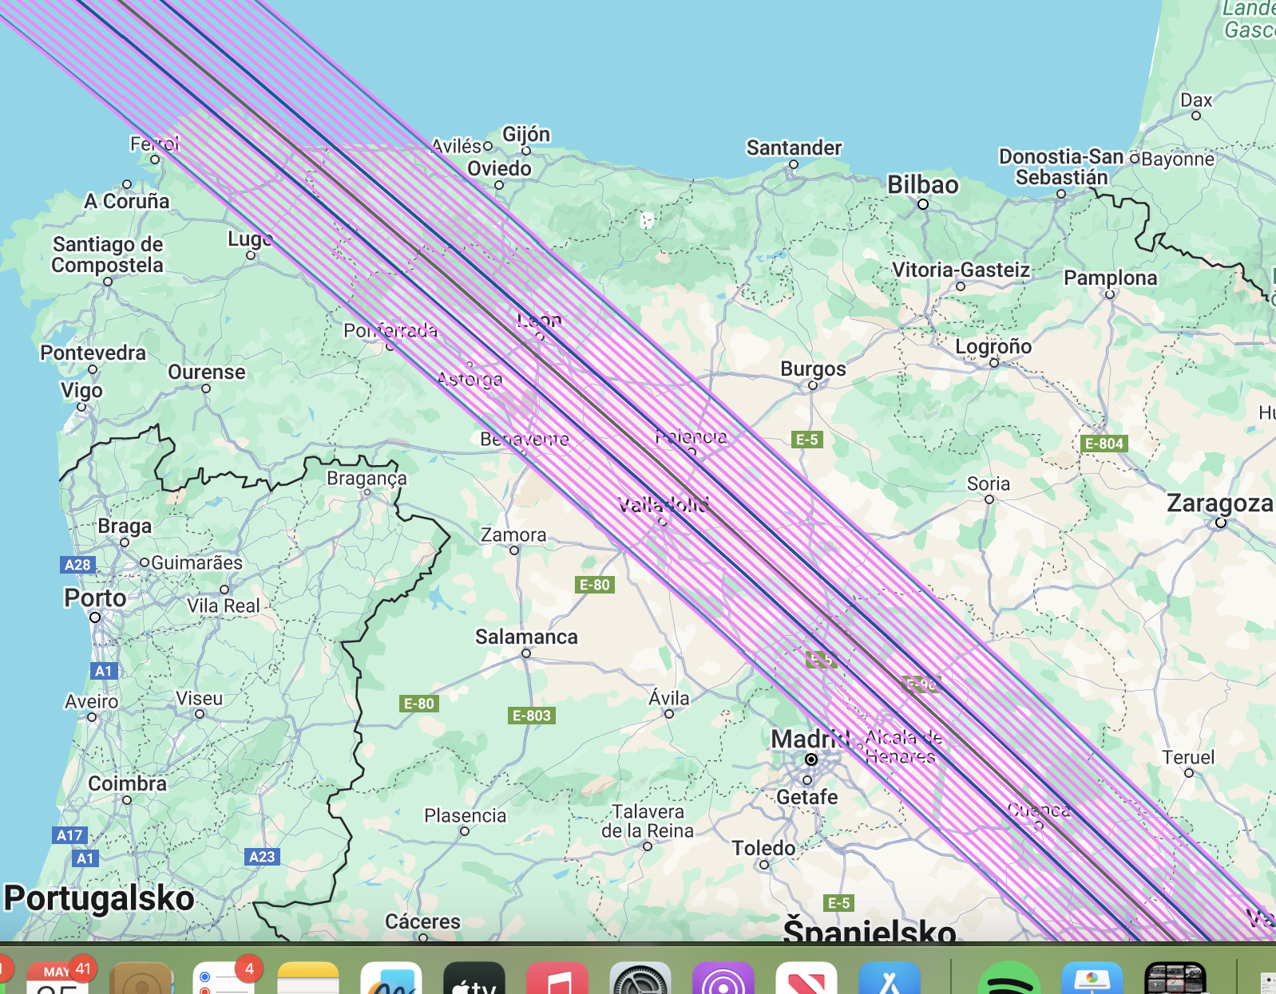
Polymele 2021 proposed tracks
Notes:
Polymele occultation tracks 2021.10.01
Observers had to figure out where they were going to observe on from along their assigned track.

Slide 28
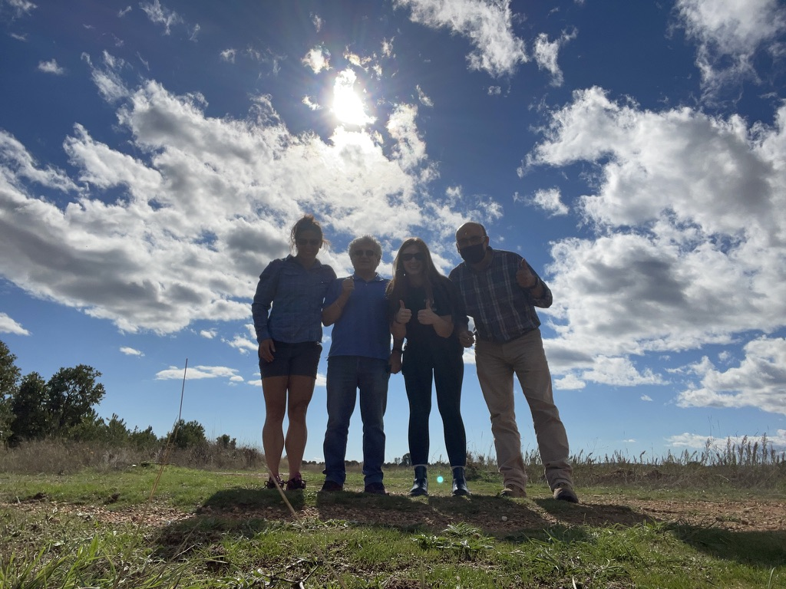
Polymele Team 2021, Spain
Notes:
My observing team in Spain in 2021. Trying to observe Polymele. This is the location we chose.
Spain in October is very humid. The primary would get covered with dew. Had to keep the telescope in the car as long as possible with heat on full blast
Then take it out about an hour before the event, boresight, get on field, and record data

Slide 29
Practical Opportunities
It’s not a problem, it’s an opportunity
Notes:
Summer 2022 5 occultations in Australia all within about 6 weeks
1 person
1 car
1 telescope
12 teams total.

Slide 30
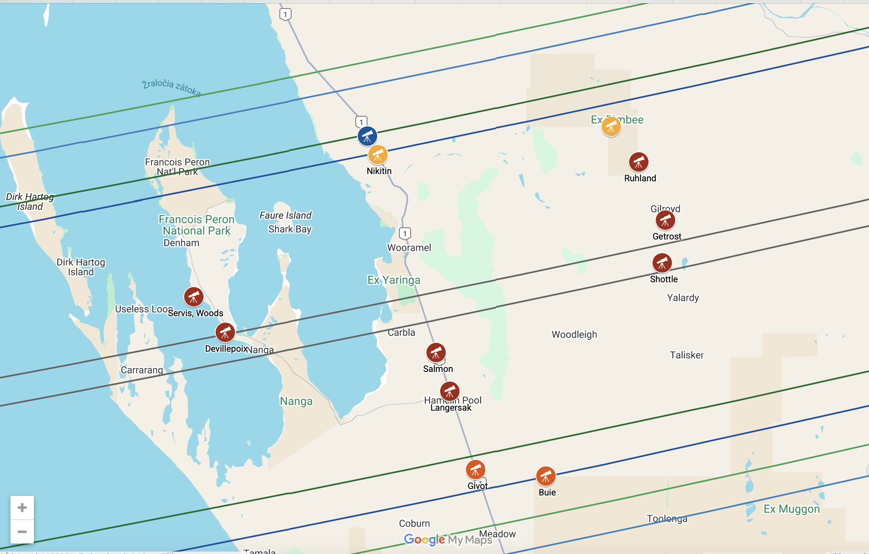
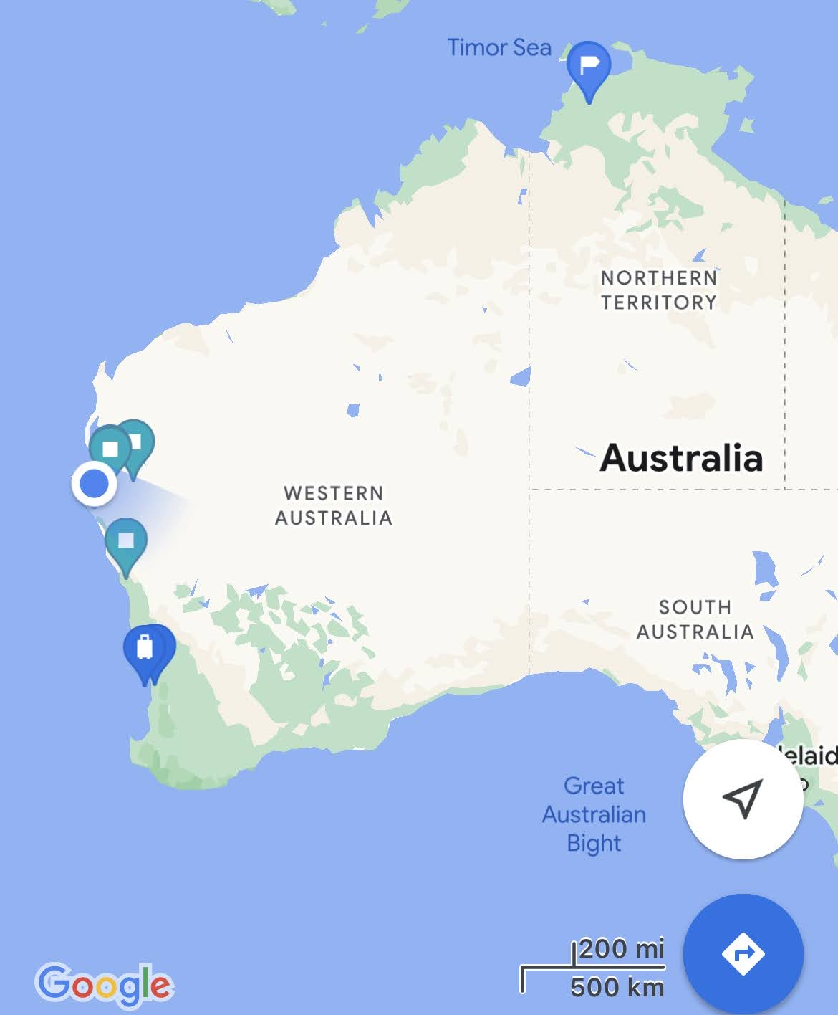
Notes:
Patroclus and Menoetius occultations — Summer of 2022 in Australia. 5 events within 6 weeks.
Sense of how remote this area is. Patroclus and Menoetius are 113km and 108 km respectively. So needed to be spaced apart about 10km from each other. Because of prior occultations, not a lot of uncertainty in position or time. Location very important.
First event July 22, 2022 Patroclus
successful observation
Second event July 28, 2022

Slide 31
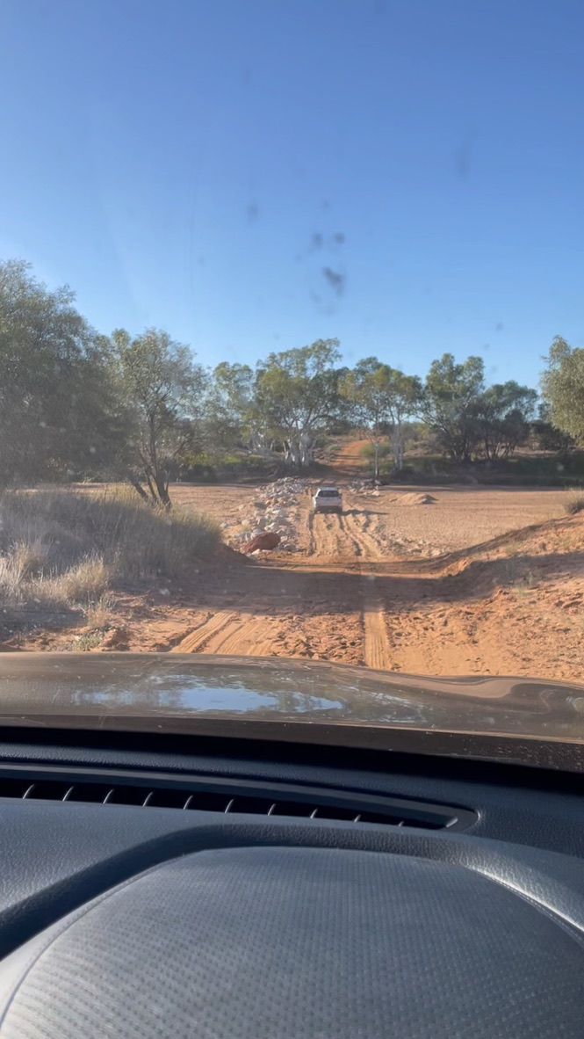
Notes:
Crossing a dry river bed to get to our observation location in Western Australia

Slide 32
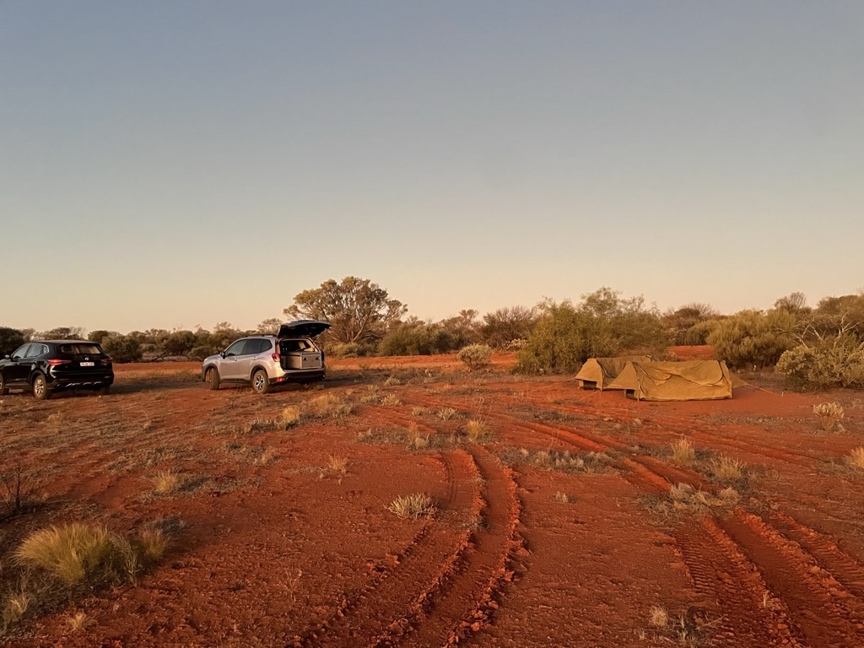
Notes:
Can see the telescope in the back of my car for this. Two tents — one for me, Brian Keeney, one of the professional astronomers leading the trip.

Slide 33
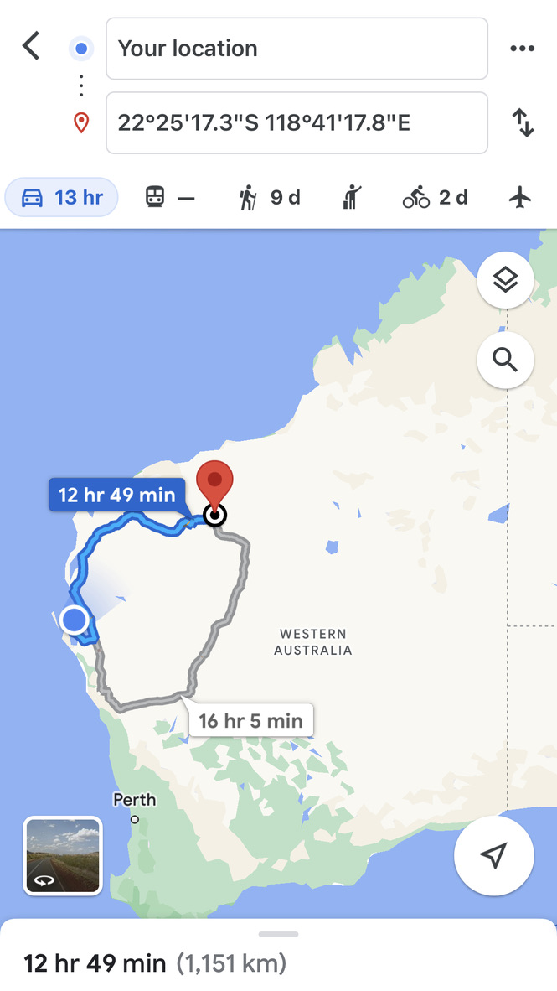
Notes:
First event to second event.
Need to scout location
Make sure there’s nothing in your line of site during occultation time
Permission from land owners, if applicable

Slide 34
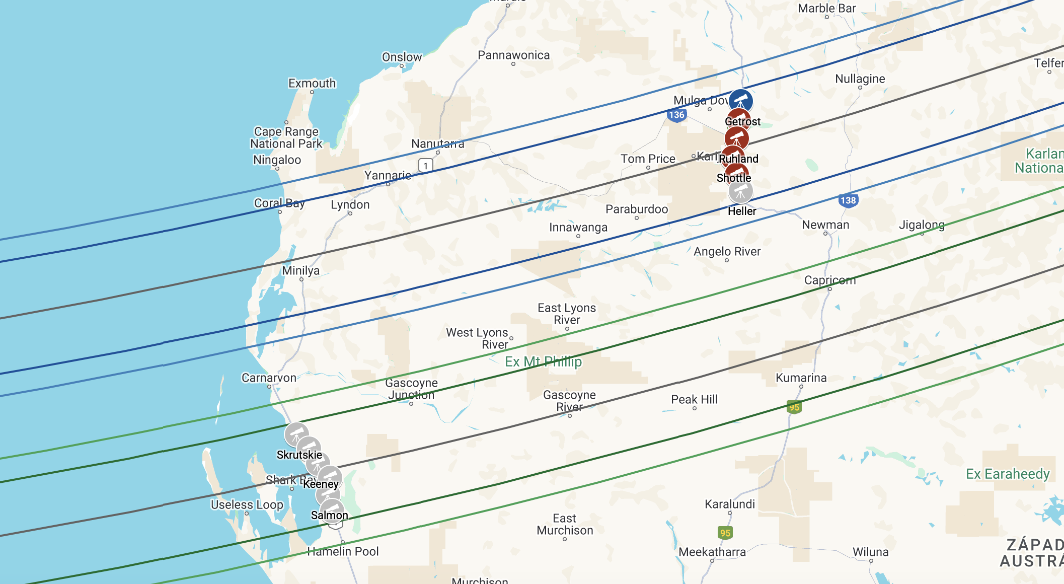
Notes:
Second event: July 28, 2022. Also Patroclus and Menoetius. Split the teams because of weather.

Slide 35
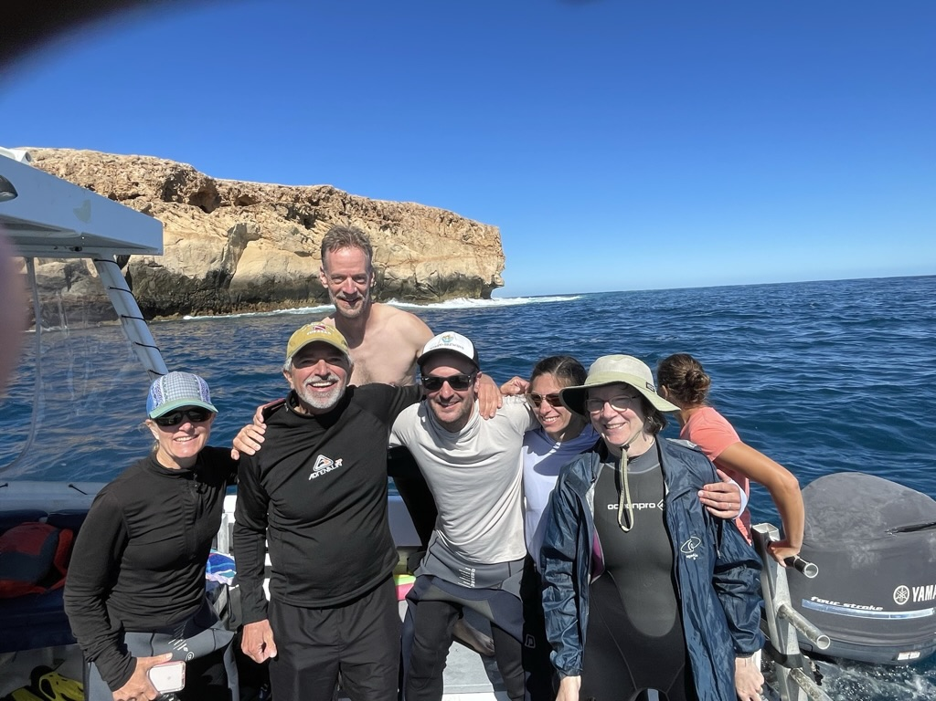
Dirk Hartog Island, Western Australia 2022 Patroclus Campaign
Notes:
Mix of amateurs and professional astronomers

Slide 36
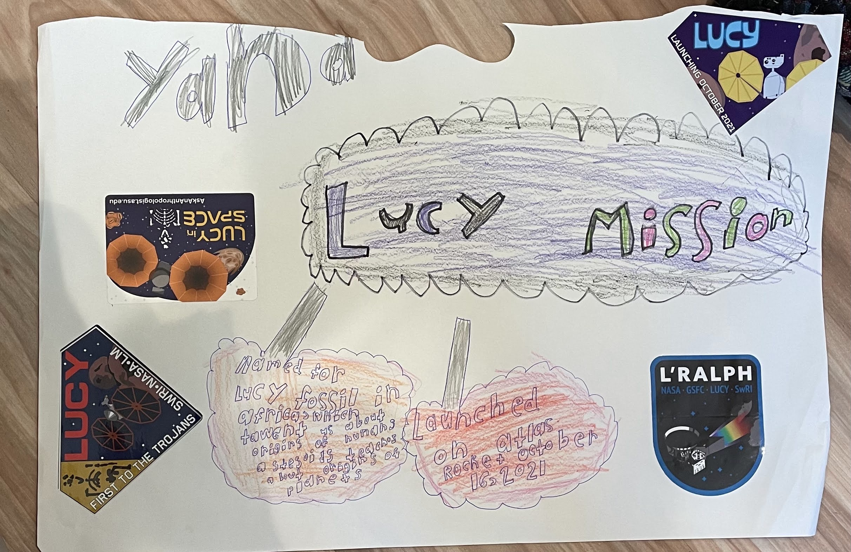
From Student to Mission Support
Notes:
Amateur astronomy creates future astronomers.
Outreach is critical. Bring in others, create community and it will pay dividends.
Image; Courtesy Yana Ruhland, 2022 age 7.

