Slide 1
The effect of Protostellar Jets on the surrounding ISM
N Sansith Hewapathirana
Rowan J Smith

Slide 2
Summary
A new implementation of protostellar jets within AREPO
Examine the influence of these jets on the filamentary structure

Slide 3
Protostellar Jets?
Collimated outflows
From star forming regions
High-speed
100-1000km/s
Reipurth & Bally 2001

Slide 4
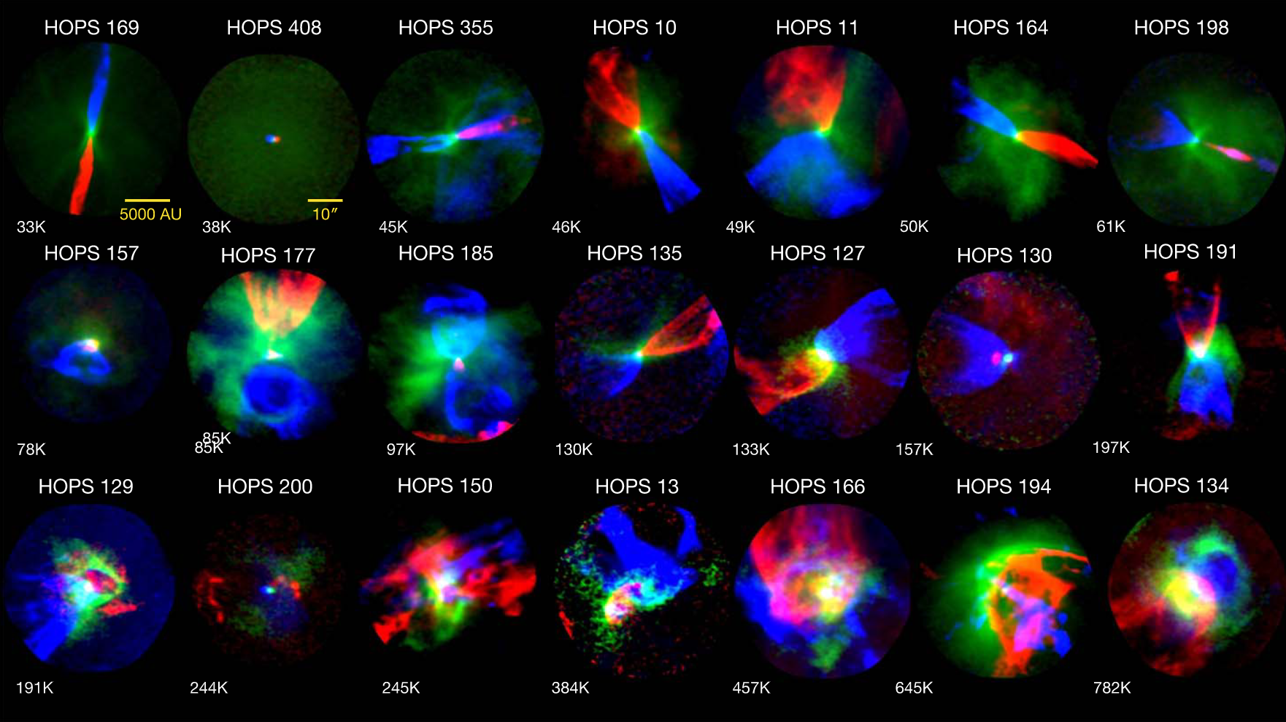
Much variety
Typically bipolar
But varies a lot
Hsieh et al. 2023

Slide 5
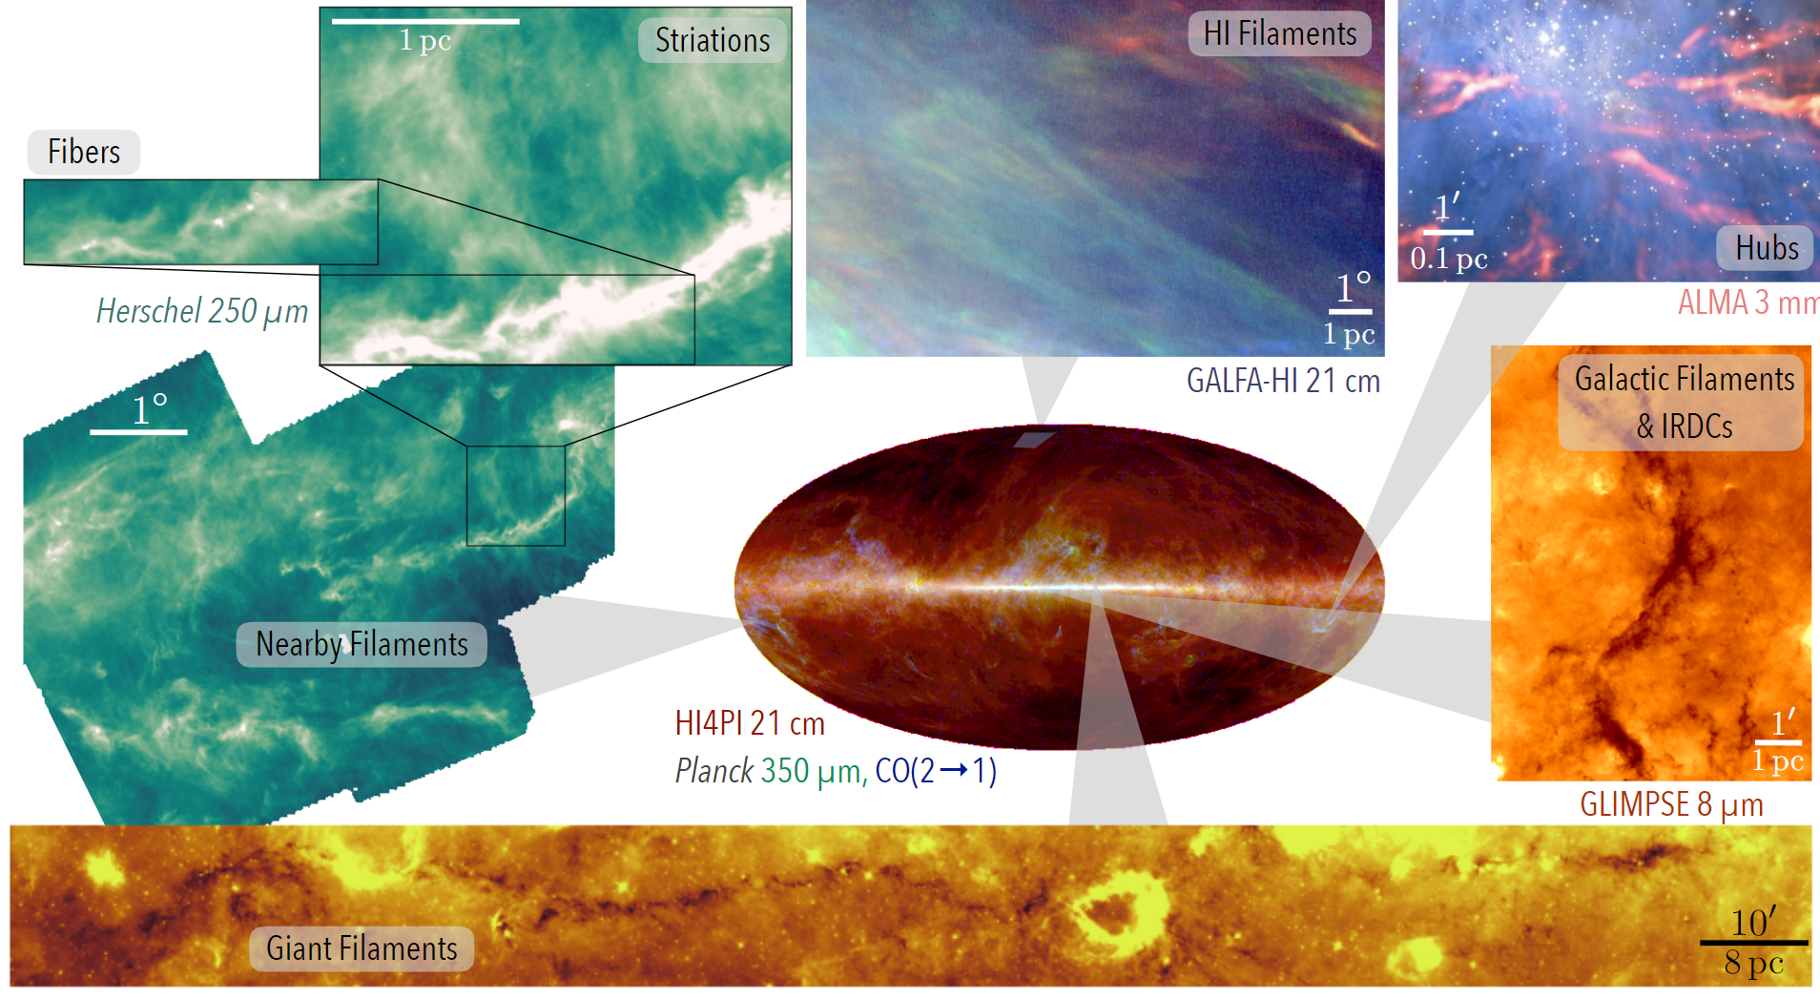
Filamentary
Consistently found across all length scales
They interact with star forming regions and feed them
Offner et al. 2014

Slide 6
Why does this matter
It is unclear how protostellar jets interact with the filaments they form in
Filaments encourage feeding axially
While jets disperse matter along the line of impact
Both protostellar jets and filaments have strong directionality
Any interactions will leave a statistical effect that should be observable
If there is a correlation
Jets can be used as a diagnostic for the accretion processes within filaments

Slide 7
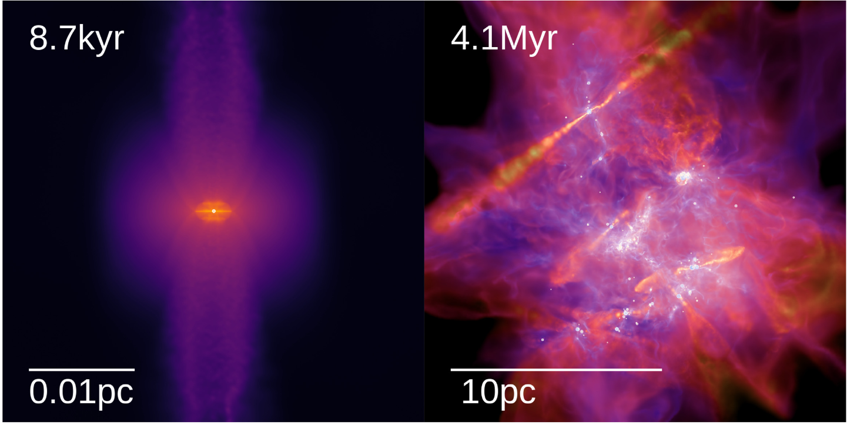
Simulations
Simulated by various teams
Federrath et al. 2014
Grudić et al. 2021
Focus tends to be on isolated systems and clusters
Grudić et al. 2021

Slide 8
AREPO
Moving-Mesh Hydrodynamical Simulation
Cells roughly follow bulk motion of gas
Small-scale advection modelled by exchanging fluxes between cells
Used for many scales
IllustrisTNG – cosmological scale
D Nelson+ 2021
SMUGGLE – full galaxies
F Marinacci+ 2019
Cloudfactory – molecular clouds
RJ Smith+ 2019
Notes:
Advection not diffusion
less numerical diffusion

Slide 9
Ingredients
Time dependent chemistry
H2, HI, H+, CO, C+
Glover & Low 2007
Jeans refinement
Gas softening length : 8.02 AU
Sink softening length : 802 AU
I have implemented:
Additional refinement
Additional feedback

Slide 10
Sink particles
Treatment of dense regions
Corresponds to star of stellar system
(at these scales)
The sinks can accrete further mass
To form, need the following conditions
Converging gas flows
Local minimum in gravitational potential
Not already in another sink’s accretion radius
Gravitationally bound

Slide 11
Refinement
Dynamically increase/decrease resolution by adding/removing cells from the underlying Voronoi grid

Slide 12
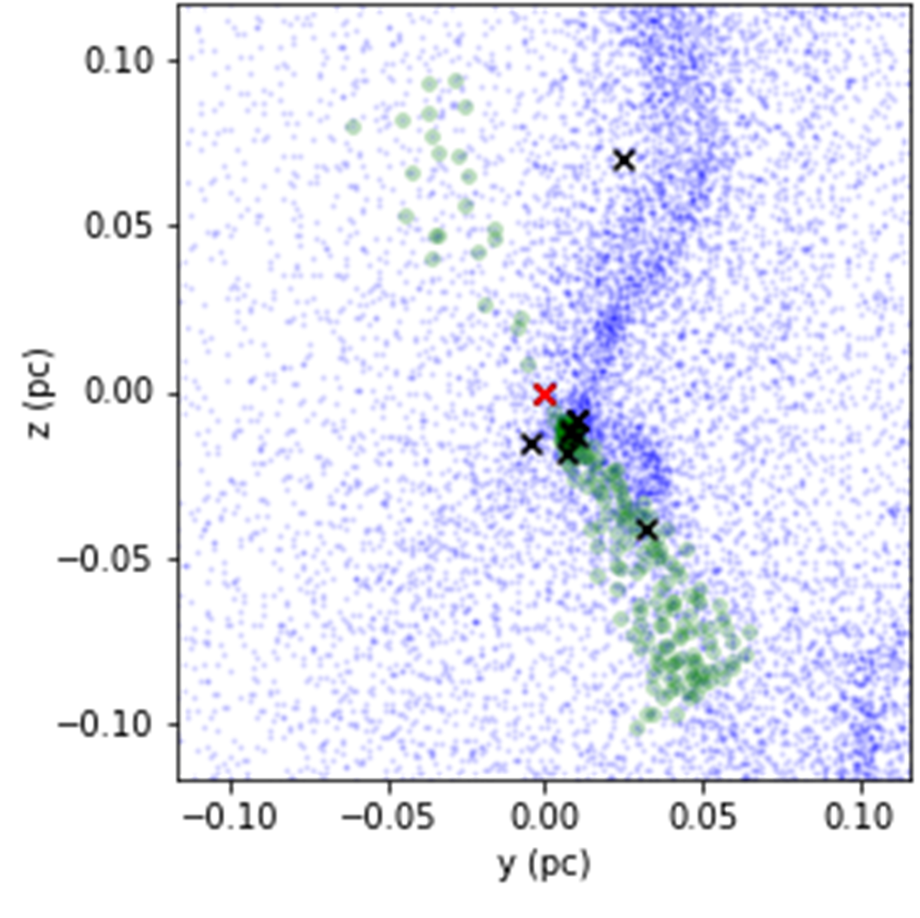
Injection region
Track angular momentum of sinks
Define “Injection Region” for each sink
2 cones aligned along the angular momentum vector
0.1pc in length
15° opening angle
If a cell is within an “Injection Region”
Mass + Momentum added
C Federrath+, 2014

Slide 13
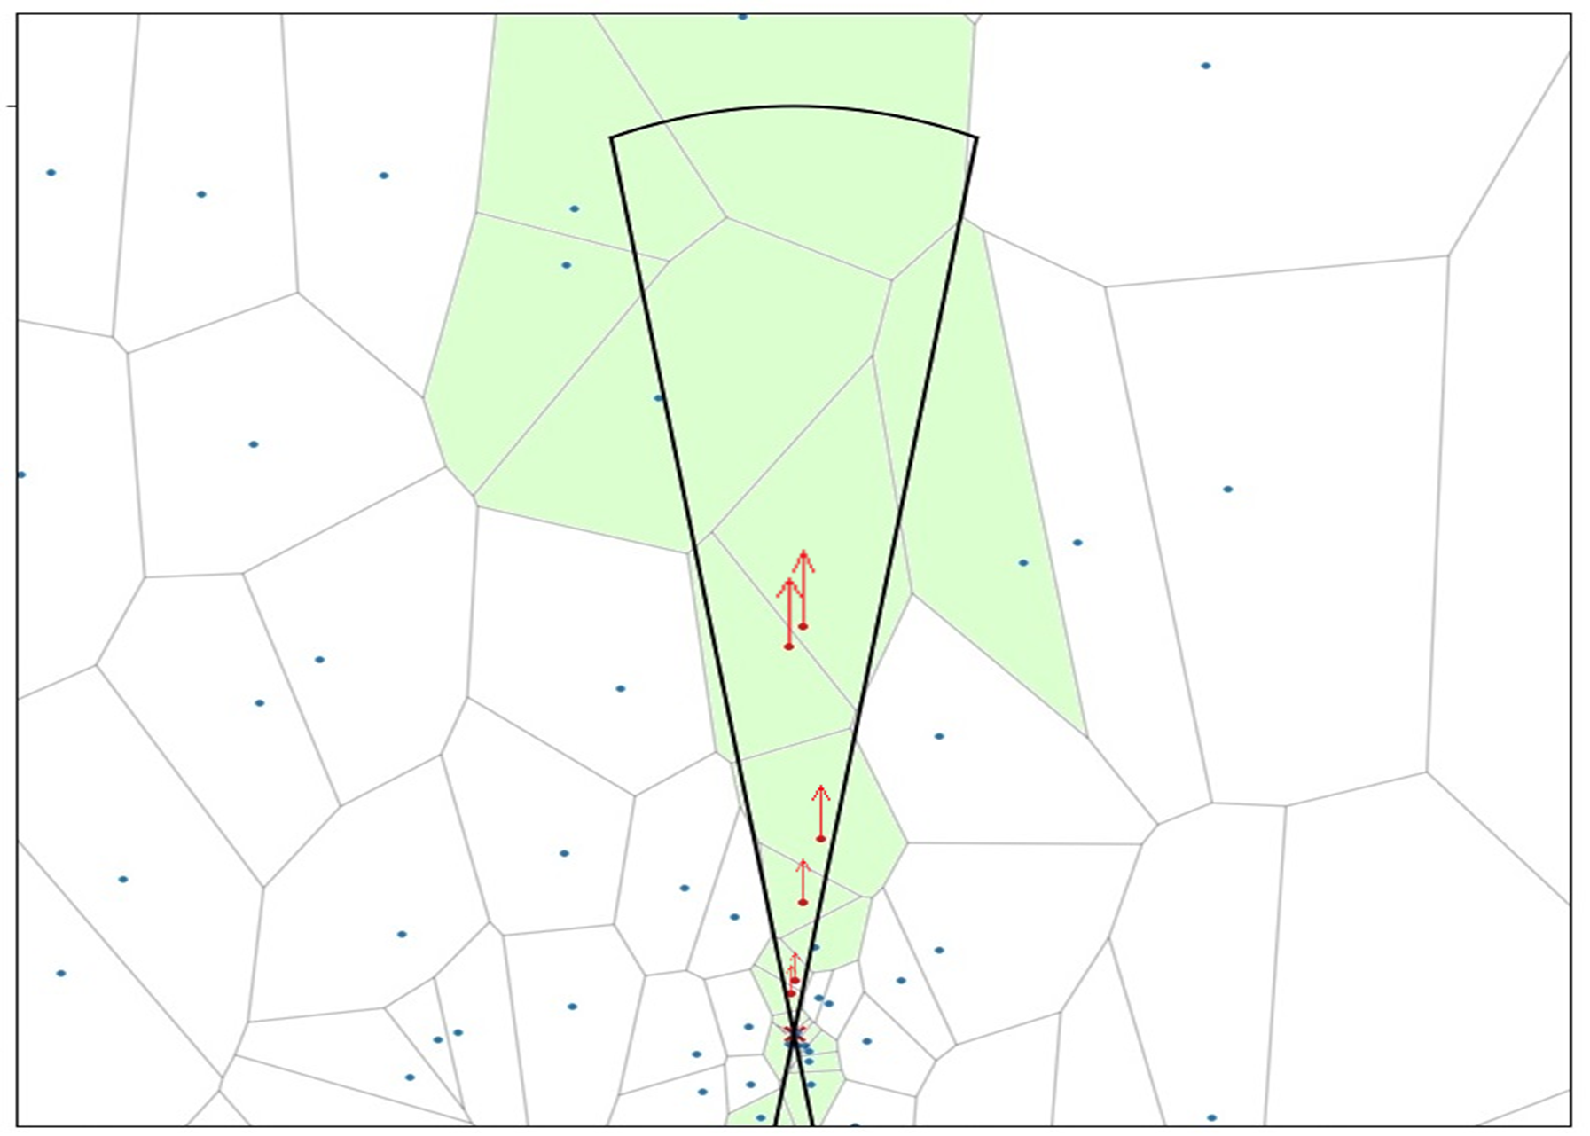
Injection region
Resolution is based primarily on the density of the cells
However, protostellar jets clear out regions
Therefore tend to be under-resolved
Implemented new refinement criteria
Much smaller target mass within injection regions

Slide 14
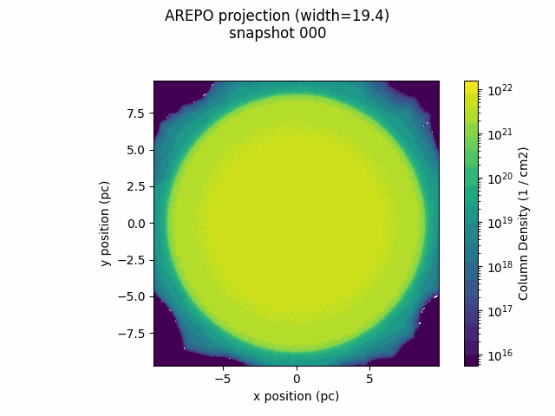
Initial test case
No protostellar jets
With protostellar jets

Slide 15
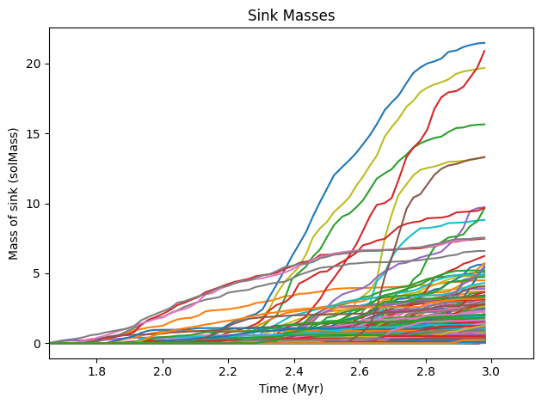
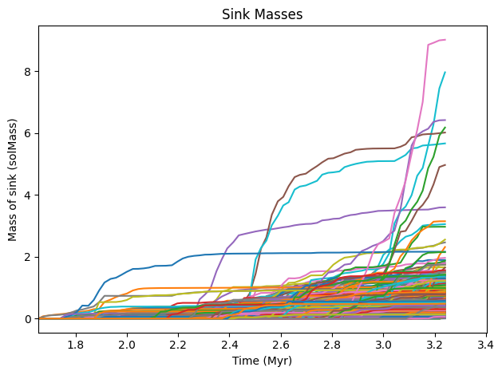
Initial test case
No protostellar jets
Number of sinks formed: 913
With protostellar jets
Number of sinks formed: 1282

Slide 16
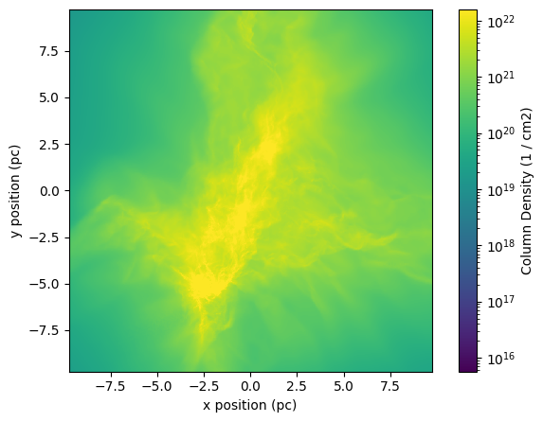

Slide 17
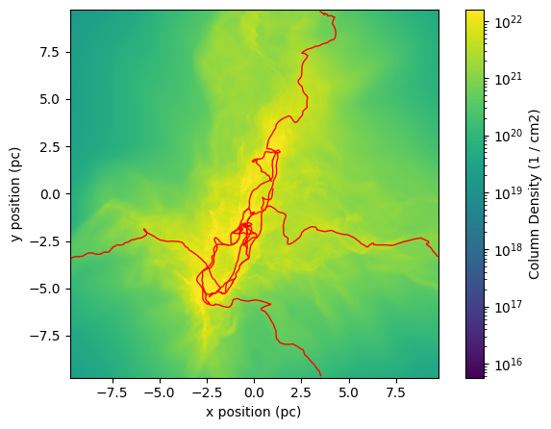

Slide 19
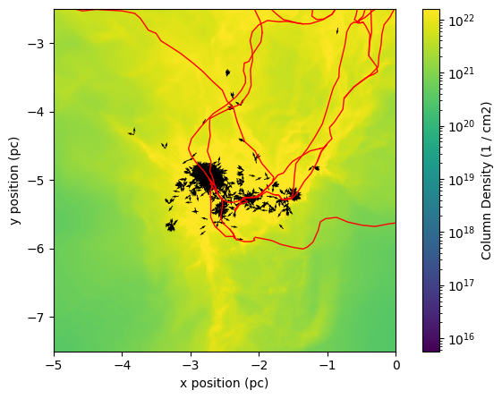

Slide 20
Conclusion
I have implemented protostellar jets into AREPO
Handles refinement and injection of mass + momentum from sinks
Inhibits growth of sinks
Results in more and smaller sinks
Cannot currently make correlation between the filaments and sinks

